Slide 1
The Christian Duty To Defend Democracy www.davidalton.net
www.davidalton.net

Slide 2
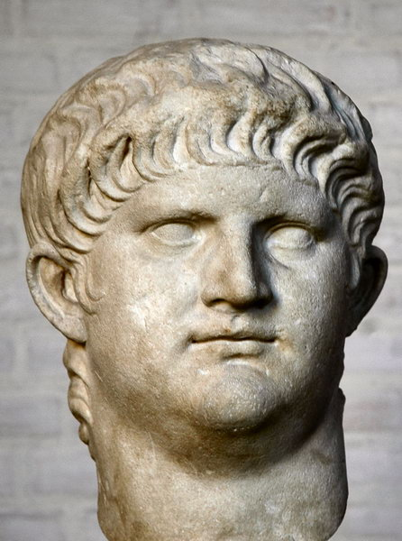
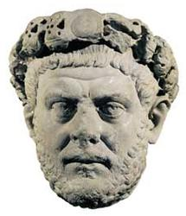
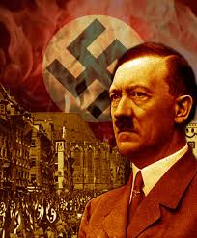
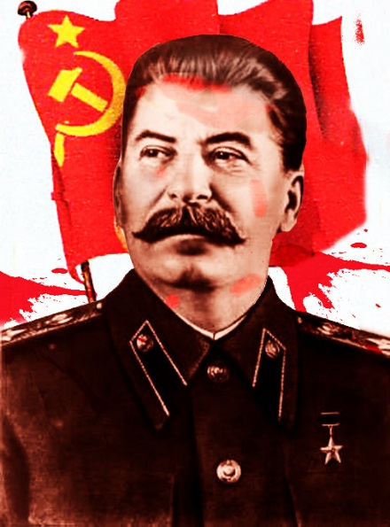
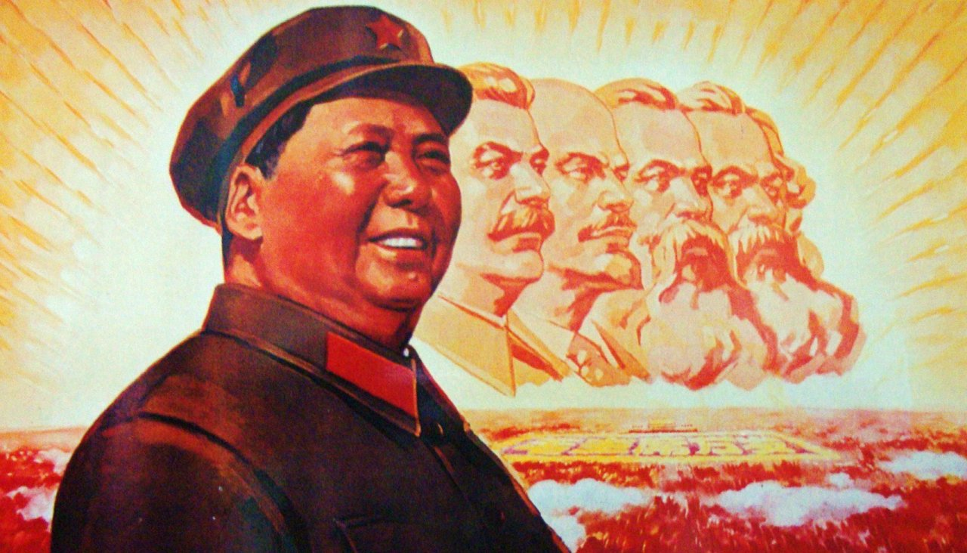
From Nero and Diocletian to Hitler, Stalin and Mao; from Roman dictatorship to Nazi and Communist atheism; it has survived.

Slide 3
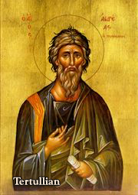
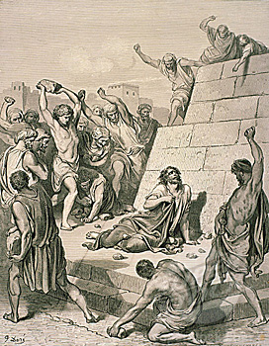
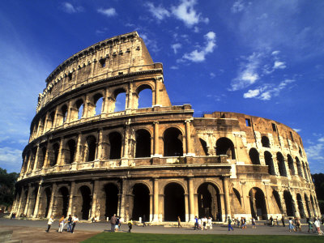
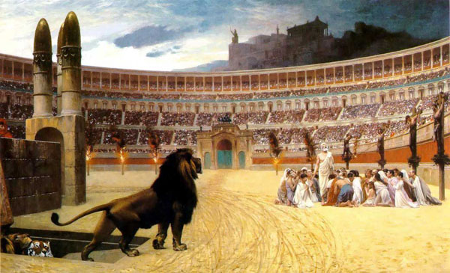
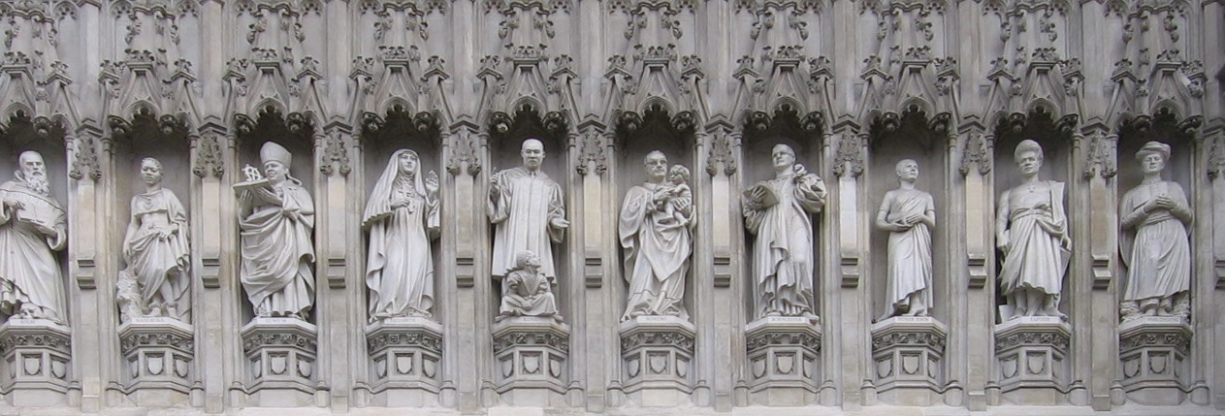
Paradoxically, as Tertullian observed, persecution has proved to be the seed of the Church.

Slide 4
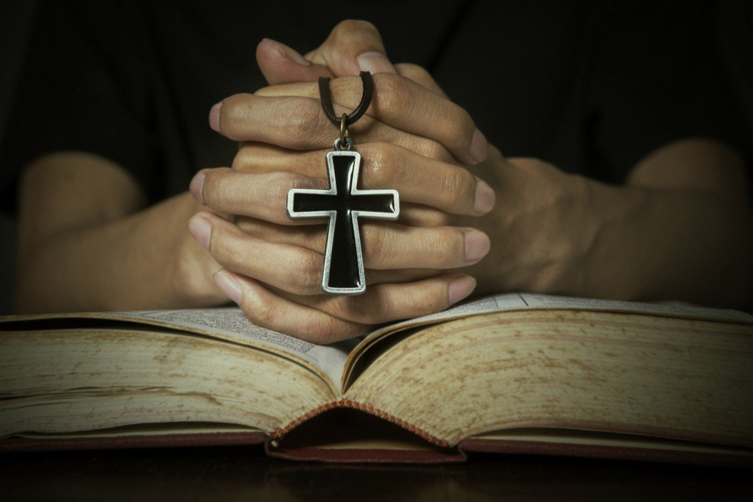
Christianity, then, does not need democracy to survive.
Yet, as I shall argue, democracy does need Christianity.

Slide 5
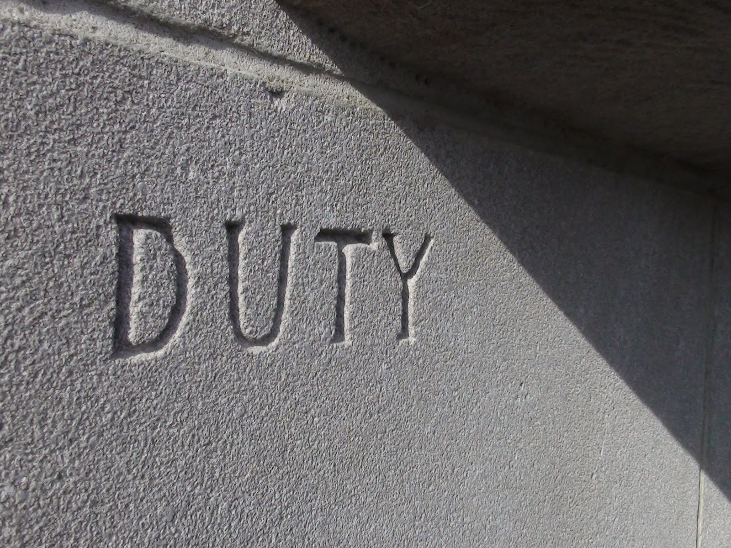
We must cultivate a belief in duty, virtue, and servant leadership

Slide 6
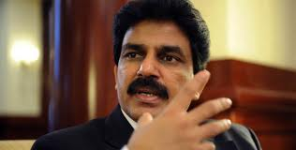
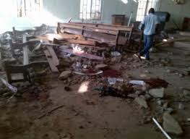
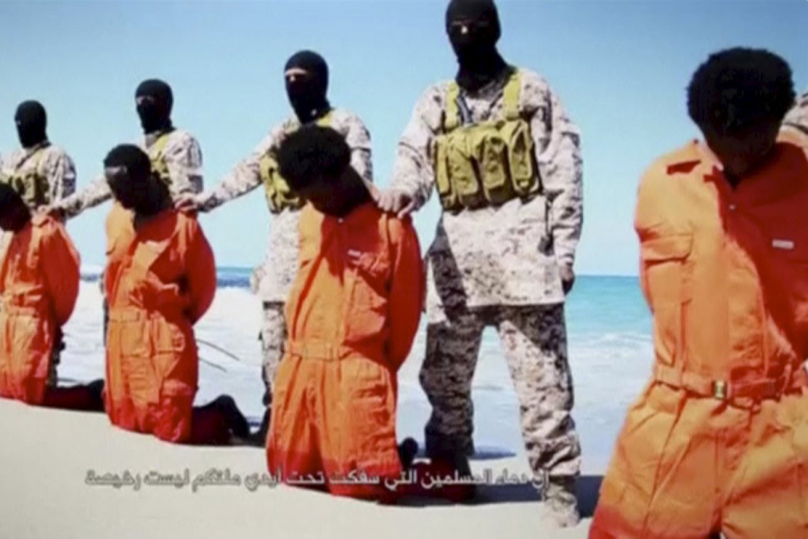
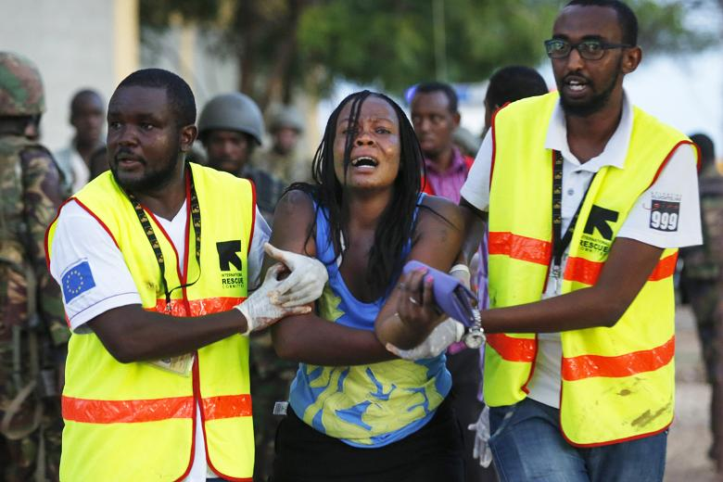
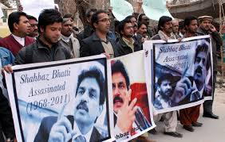
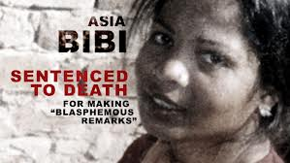
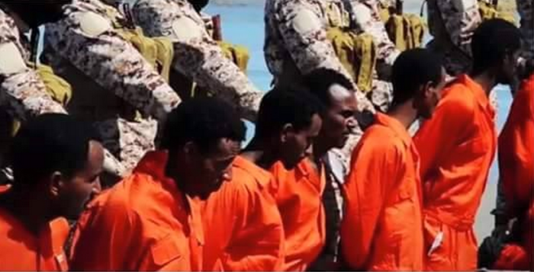
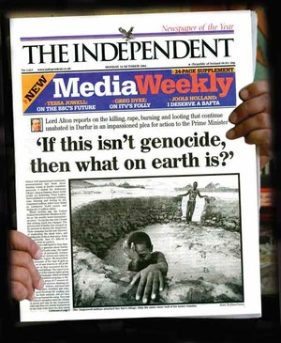
We are enormously privileged to live in a democracy like the United Kingdom

Slide 7
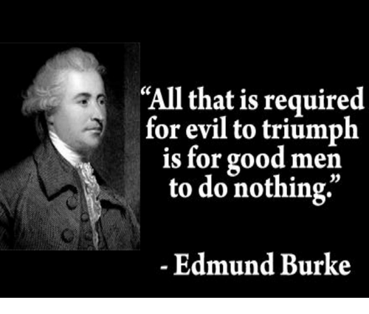

Slide 8
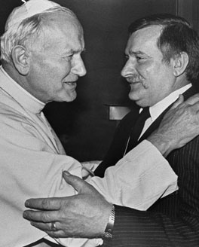
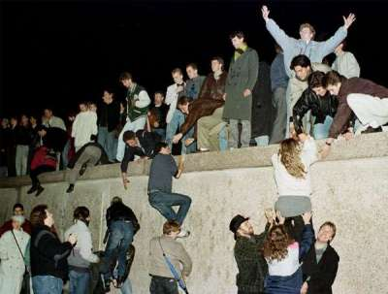
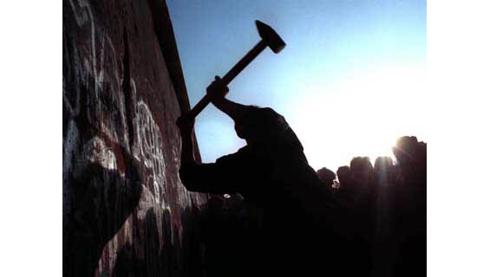
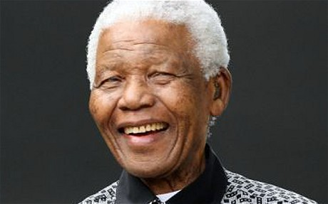
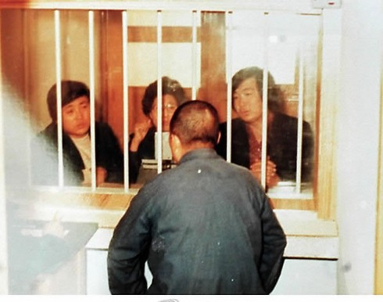
We have been privileged to see many examples of people in faraway places refusing to let evil triumph
Berlin, South Africa, South Korea…

Slide 9
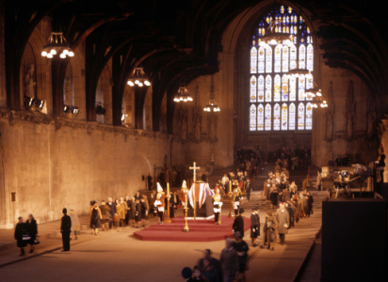
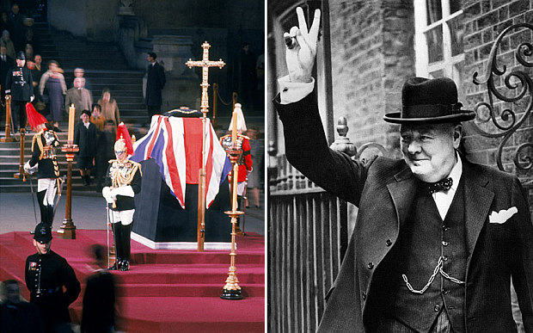
1965 Winston Churchill laid in State in Westminster Hall

Slide 10
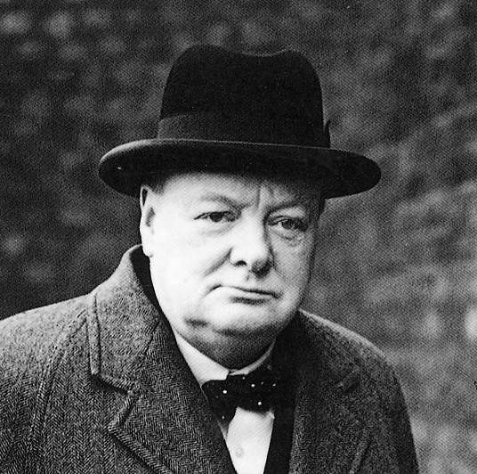
Winston Churchill: 1947-
“Many forms of Government have been tried, and will be tried in this world of sin and woe. No one pretends that democracy is perfect or all-wise. Indeed, it has been said that democracy is the worst form of Government except for all those other forms that have been tried from time to time.…”

Slide 11
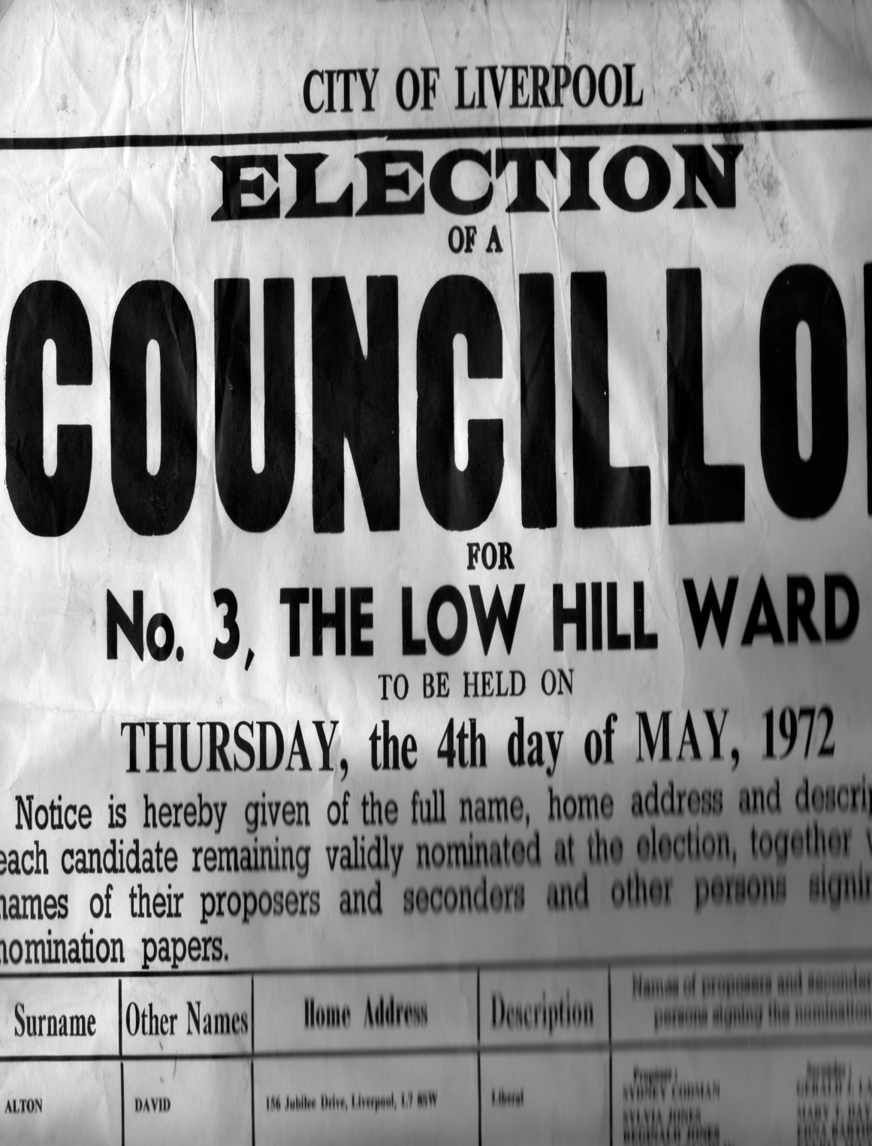
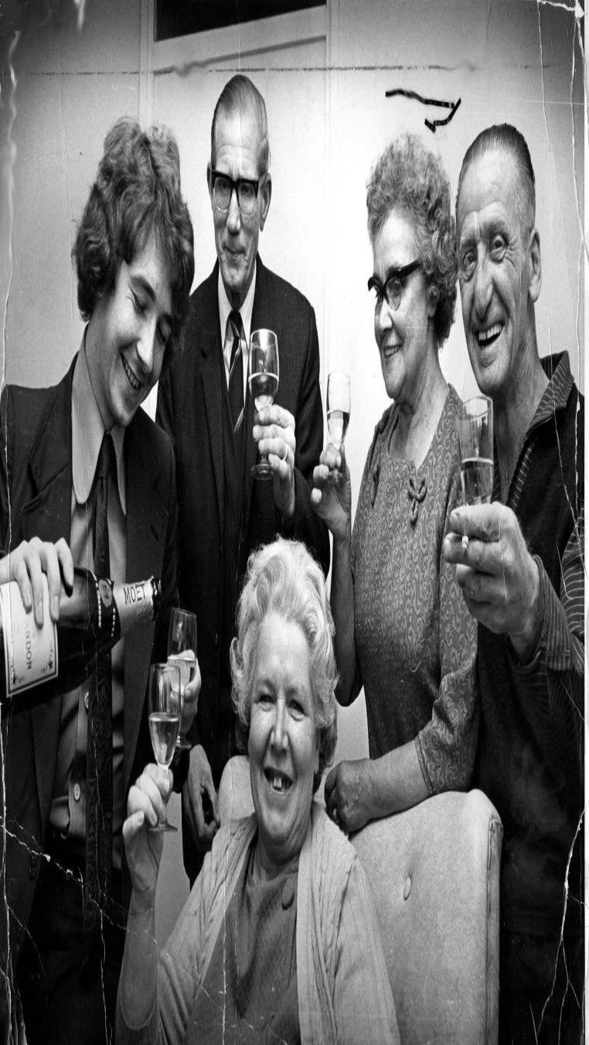
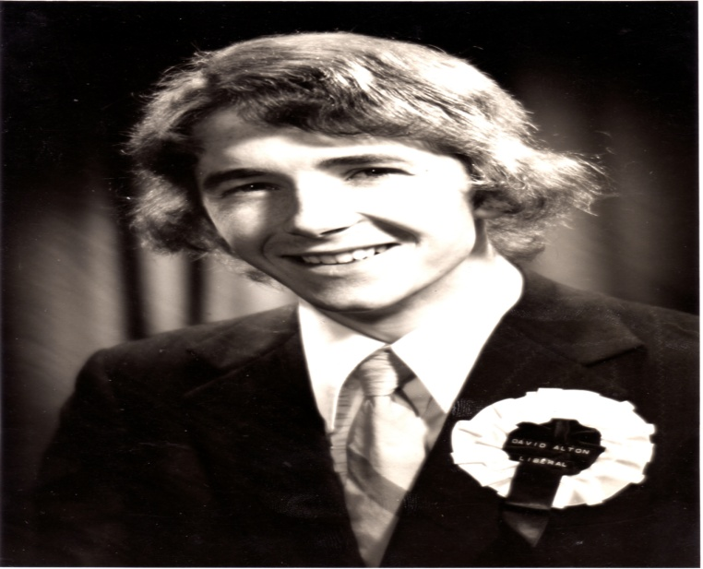

Slide 12
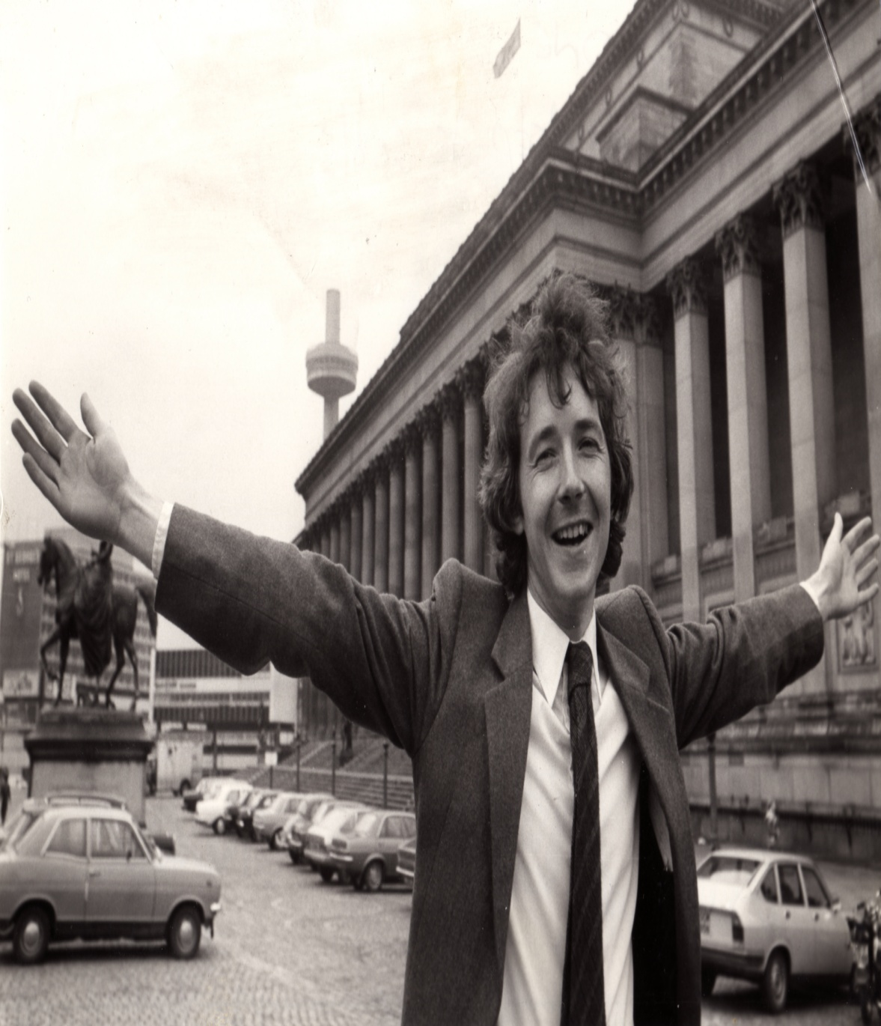
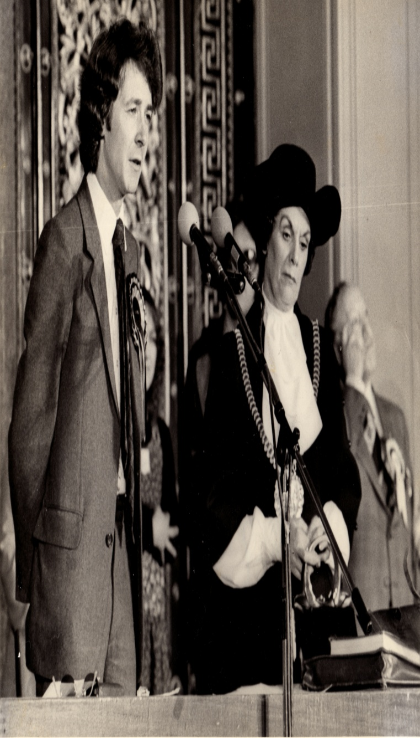
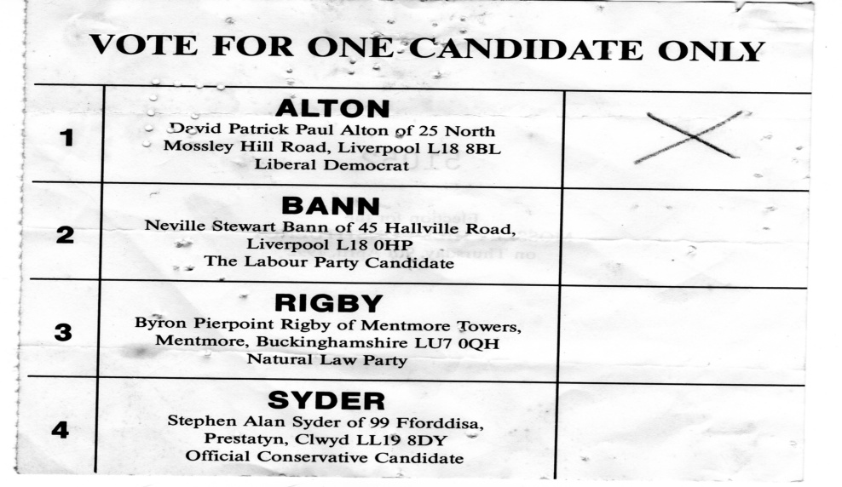

Slide 13
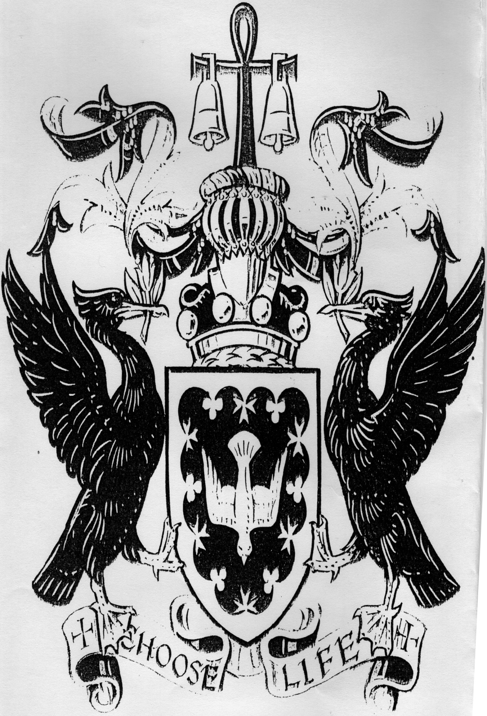

Slide 14
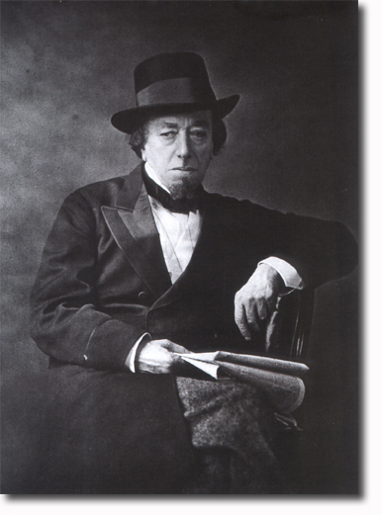
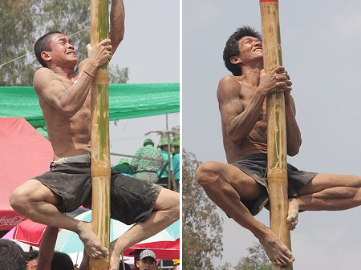
Doing things rather than being things
“I have climbed to the top of the greasy pole“
- Benjamin Disraeli

Slide 15
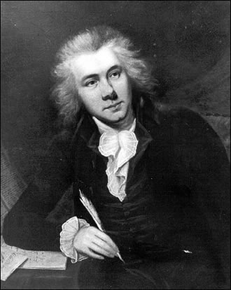
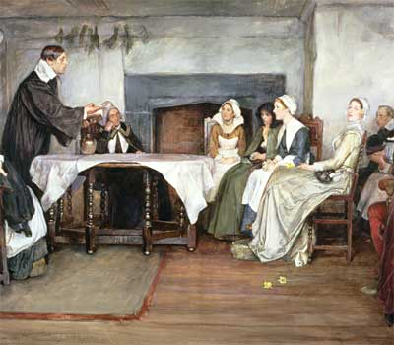
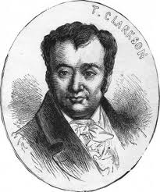
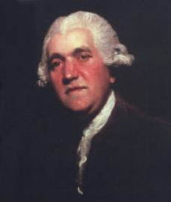
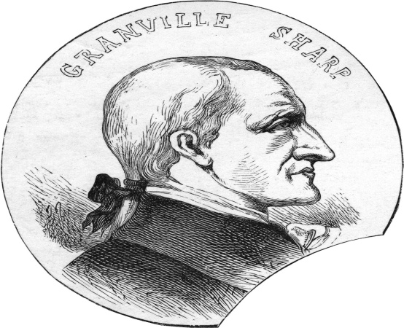
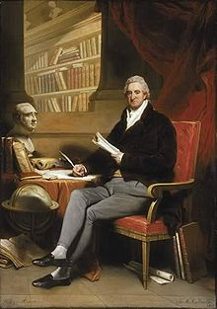
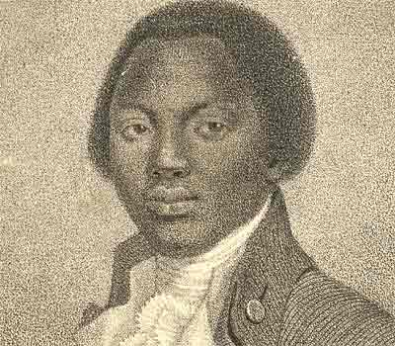
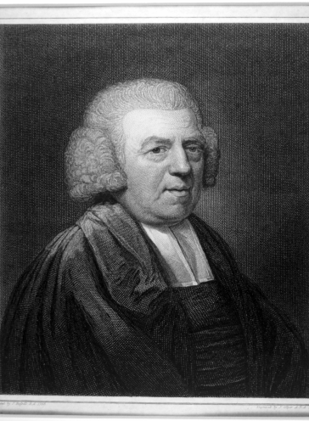
William Wilberforce, The Quakers, Thomas Clarkson, Granville Sharpe, Olaudah Equiano, Josiah Wedgewood, John Newton, and the Liverpool MP William Roscoe led the campaign to abolish slavery.

Slide 16
For the pearl to emerge from the oyster, you need a bit of grit to enter in.
Judge people by their causes.

Slide 17
This “least worst form of government,” in this “world of sin and woe” – impaired but always preferable to dictatorship or totalitarianism – cannot function without virtue and commonly held values.

Slide 18
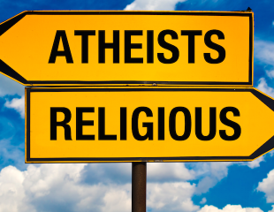
Angry Atheism and Forgetting Who We Are

Slide 19
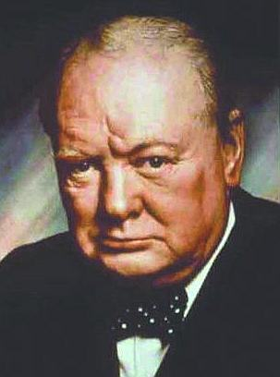
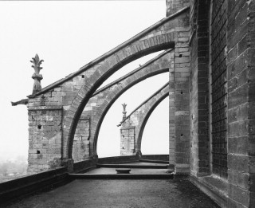
When Churchill was once described as “a pillar of the church,” he corrected the speaker by interjecting: “No, no, not a pillar, but a buttress, supporting it from the outside.” He understood that the “least worst form of government” was dependent on Judeo-Christian values.

Slide 20
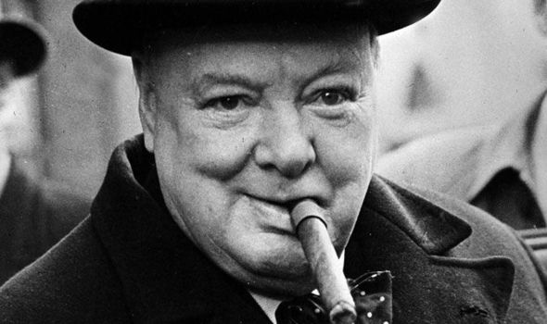
“The flame of Christian ethics is still our highest guide. To guard and cherish it is our first interest, both spiritually and materially… Only by bringing it into perfect application can we hope to solve for ourselves the problems of this world and not of this world alone.”
“Upon this battle depends the survival of Christian civilization.”

Slide 21
2017 saw the centenary of the Bolshevik Revolution, which paved the way for totalitarianism, social engineering, state terror and mass murder, leaving a legacy of prison camps and unmarked graves.

Slide 22
It is estimated that up to 30 million people were executed, starved to death or perished in labour camps.

Slide 23
North Korea’s Concentration Camps where 2-300,000 people are incarcerated

Slide 24
Hilaire Belloc’s “Cautionary Tales for Children”

Slide 25
We have seen crucifixes removed from classrooms; Christian midwives lose their jobs because they refuse to abort a child; universities deny free speech to Christian speakers; political leaders forced from office because they are told their beliefs are incompatible with ascendant angry atheism – like a secular illiberal mirror image of Sharia law.

Slide 26
The Pew Research Centre, a renown independent think tank, found that more than eight in 10 people in the world identify with a religious group. When 84 percent of the globe’s inhabitants say they cherish religious beliefs, the liberal elites who govern them need to understand and harness those impulses for the common good – not side-line and denigrate believers.

Slide 27
In Integral Humanism, Maritain explored ways in which, in a pluralistic society, Christianity should enter the Public Square to inform and affect political discourse, without which democracy cannot thrive. Maritain wrote that “Christianity taught men that love is worth more than intelligence.”

Slide 28
1948 Universal Declaration of Human Rights – a classic example of how a religious dimension is central to how religious values can enrich and inform.

Slide 29
St. John Paul II in his Encyclical Veritatis Splendor, published in 1993: "Today, when many countries have seen the fall of ideologies which bound politics to a totalitarian conception of the world - Marxism being the foremost of these - there is no less grave a danger that the fundamental rights of the human person will be denied and that the religious yearnings which arise in the heart of every human being will be absorbed once again into politics. This is the risk of an alliance between democracy and ethical relativism, which would remove any sure moral reference point from political and social life, and on a deeper level make the acknowledgement of truth impossible. Indeed, if there is no ultimate truth to guide and direct political activity, then ideas and convictions can easily be manipulated for reasons of power. As history demonstrates, a democracy without values easily turns into open or thinly disguised totalitarianism."

Slide 30
The Methodism of John Wesley (1703-1791) saved Britain from the Marxism of the Communist Party

Slide 31
As John Stuart Mill (1806-1873) argued in 1859 in On Liberty, majoritarianism can lead to oppression by majorities comparable to the oppression of tyrants or despots.

Slide 32
Plato insisted that the uneducated couldn’t possibly be on a par with the intellectuals and that those best qualified to govern were the philosophers and intellectual elites.

Slide 33
Edmund Burke said “the tyranny of a multitude is a multiplied tyranny”; American Founding Father James Madison described “the violence of majority faction”; the Whig historian Lord Macaulay; in Alexis deTocqueville’s Democracy in America. And the Victorian Liberal historian, Lord Acton, who wrote: “The one pervading evil of democracy is the tyranny of the majority.”

Slide 34
De Tocqueville insisted that “Liberty cannot be established without morality, nor morality without faith.”
In observing American democracy, he noted that “[the] Americans combine the notions of religion and liberty so intimately in their minds, that it is impossible to make them conceive of one without the other.”

Slide 35
Consider, finally, this tale of two princes:
Prince Lev Myshkin, the protagonist of Fyodor Dostoyevsky’s masterpiece novel The Idiot, famously stated that “beauty will save the world.”

Slide 36
In the battlefield that is the heart of man, a small victory occurs when our self-serving is replaced by a love of the common good: giving a life to gain a life. Through the purity and lack of guile that characterizes Prince Myshkin, Dostoyevsky is telling us that the beauty which will save the world is the love of God; that His beauty must change us if we wish to change our families, our communities and our societies.

Slide 37
Niccolo Machiavelli’s The Prince
In The Prince, Machiavelli tells us that the ruler should not hesitate to deceive and be prepared to choose evil as the price of power.
Machiavelli despised many traditional Christian beliefs, turning on their head Christian words such as virtue, believing that real virtue emanated from the pursuit of ambition, glory and power.

Slide 38
This represented a fundamental break with Aquinas and medieval scholasticism and the Aristotelian belief in the pursuit of virtue.

Slide 41
If the imperfect system of democracy is to function and survive, there must be a continuous cultivation of virtue and an upholding of those values that enrich and underpin a system that can so easily be subverted.
In rendering unto Caesar, we must offer our Faith as a source of enrichment; speak clearly about the beliefs that have stood us in such good stead for two millennia; and recognise, in the words of the title of tonight’s talk, that everyone of us has a duty to play our part.

Slide 42
The Christian Duty To Defend Democracy www.davidalton.net
www.davidalton.net

