Slide 1
World Summit In Defence of Persecuted Christians
May 2017 Washington D.C.
David Alton – Lord Alton of Liverpool
www.davidalton.net
+ If a faith is worth dying for it might be worth living for.

Slide 2
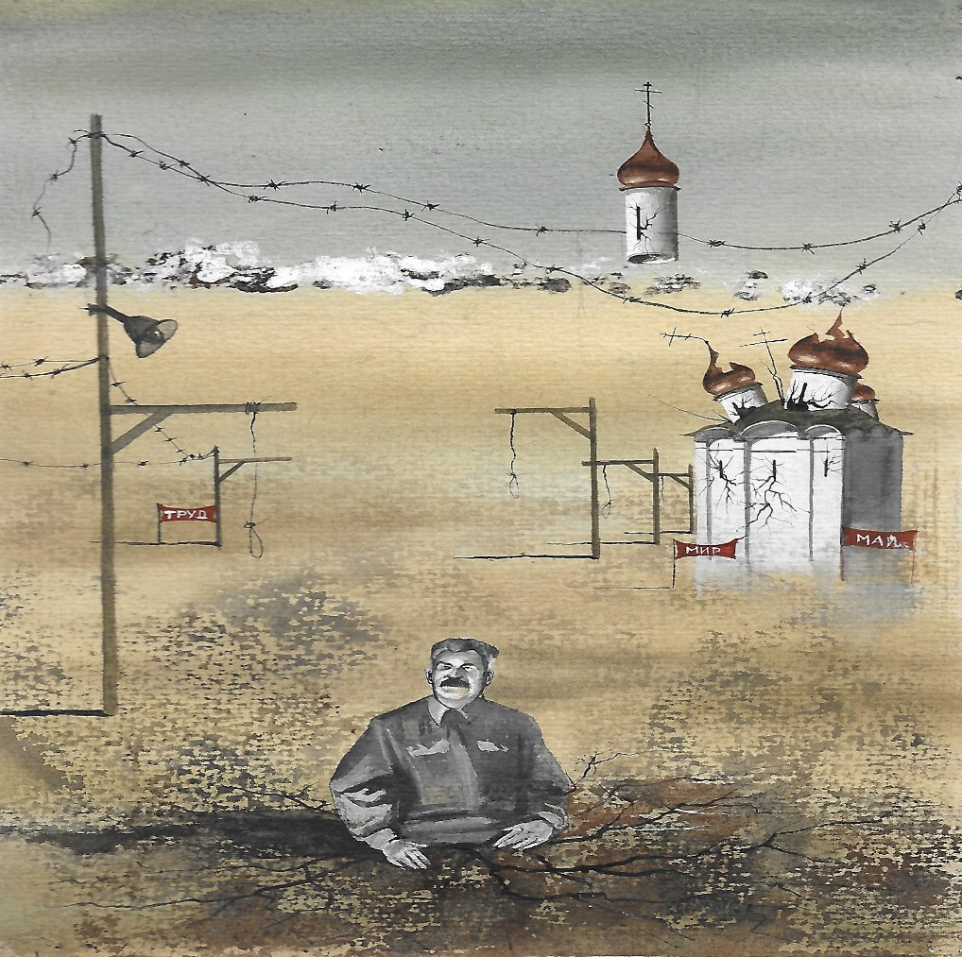
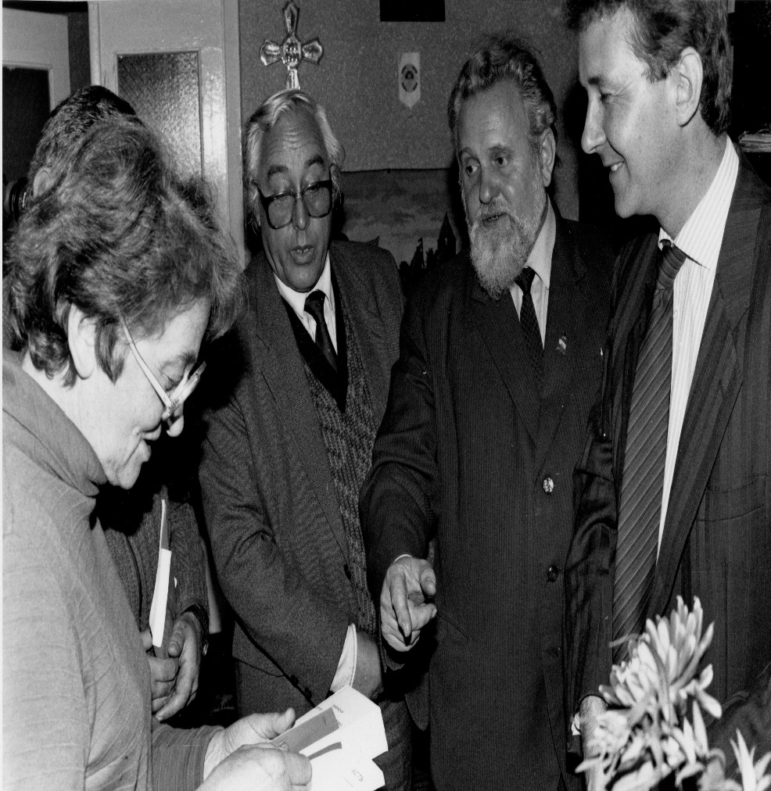
‘Christianity has died many times and risen again; for it had a God who knew the way out of the grave’ G.K.Chesterton - The Everlasting Man

Slide 3
During my remarks I will describe 3 things:
1. the world’s promise of protection: genesis of Article 18 of the1948 Universal Declaration of Human Rights which proclaims the right of every human being to believe, not to believe or to change their belief; and the Genocide Convention;
2. the reality: for many, Article 18 is not worth the paper on which it is written; and
3. how we should respond; what we might do.

Slide 4
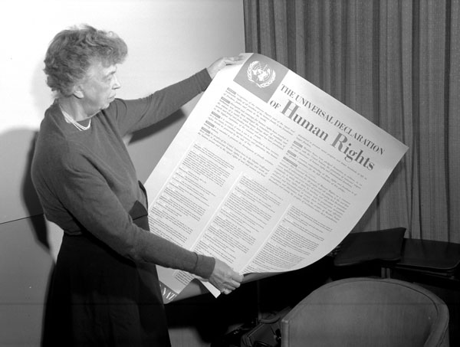
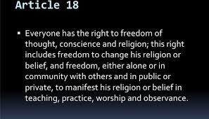
1. the world’s promise of protection: Article 18 remains one of the most important but overlooked of the 30 articles that comprise the 1948 Universal Declaration of Human Rights. The declaration’s stated objective was to realise, “a common standard of achievement for all peoples and all nations”.

Slide 5
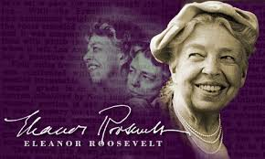
“Religious freedom cannot just mean freedom for some…it must be freedom of all religious people”. “A common standard of achievement for all peoples…”
“ an international
Magna Carta for all mankind”

Slide 6
Article 18 and the Genocide Convention emerged from the infamies of the 20th century
…..from the Armenian genocide to the defining depredations of Stalin’s gulags and Hitler’s concentration camps; from the pestilential nature of persecution, demonisation, scapegoating and hateful prejudice; and, notwithstanding violence associated with religion, it emerged from ideology, nation and race.

Slide 7
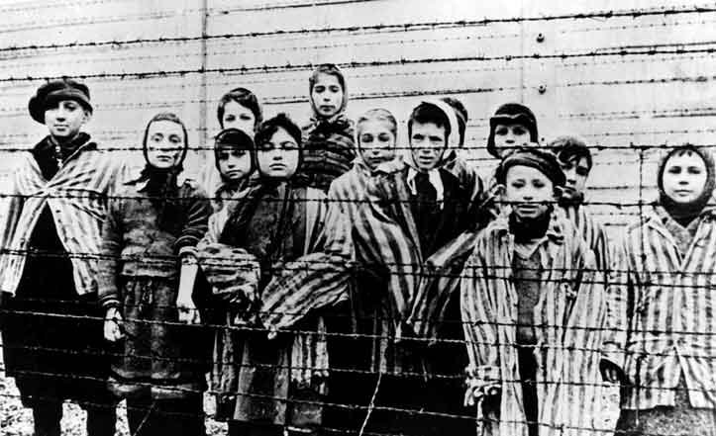
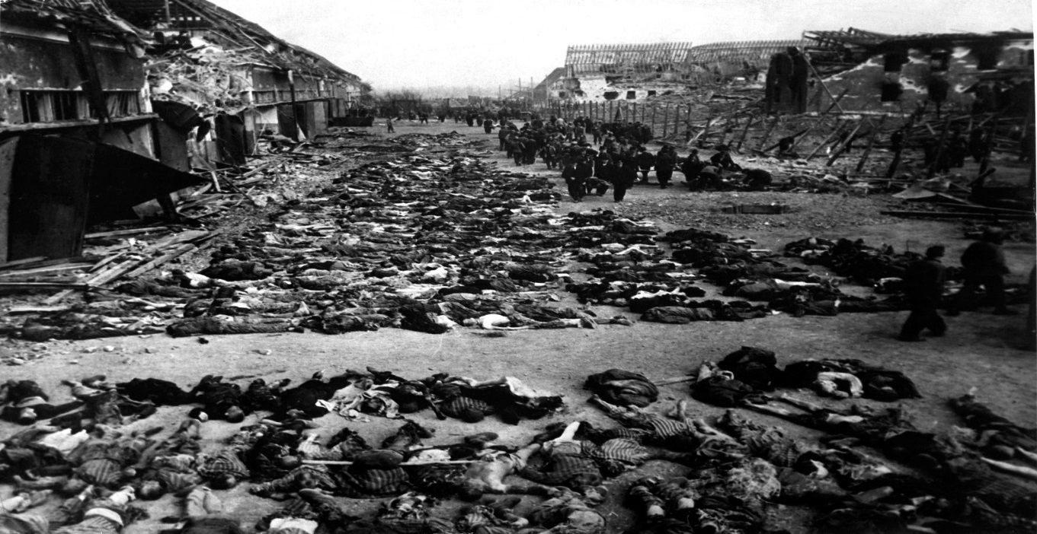
The depredations of Stalin’s gulags and Hitler’s concentration camps

Slide 8
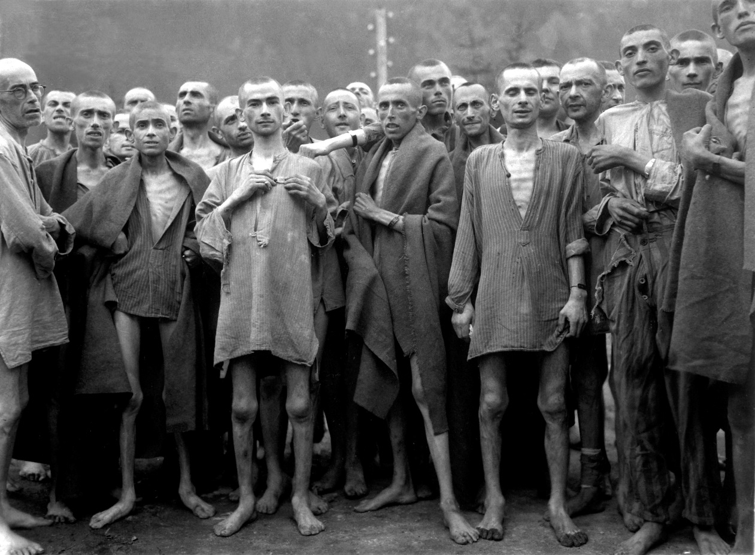
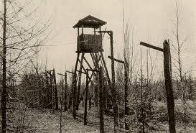
The bloodiest century in human history with the loss of 100 million lives. The Dead Were Measured In Their Millions

Slide 9
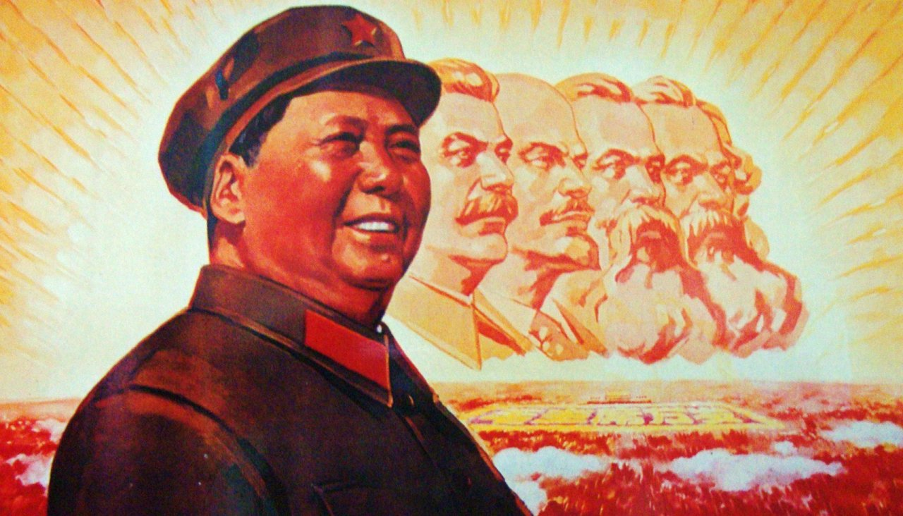
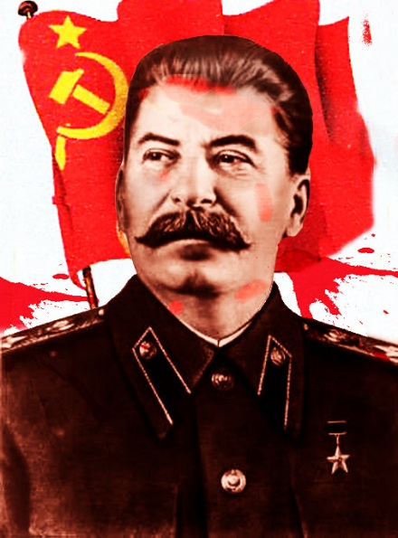
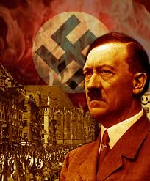
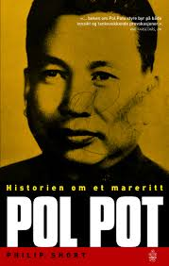
The four great murderers of the 20th century—Mao, Stalin, Hitler and Pol Pot—were united by their hatred of religious faith.

Slide 10
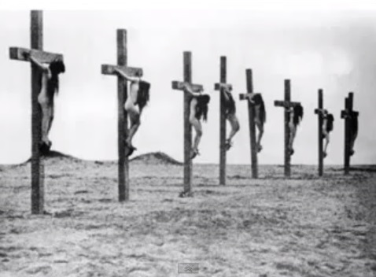
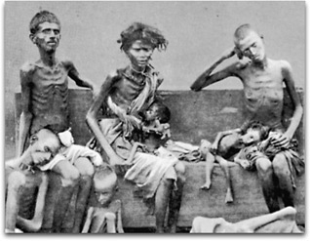
Lemkin studied the 1915 genocide of Armenian Christians and the massacre of Assyrian Christians at Simele, in Iraq, in 1933.

Slide 11
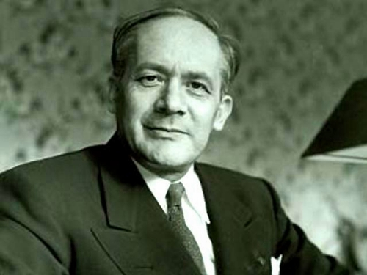
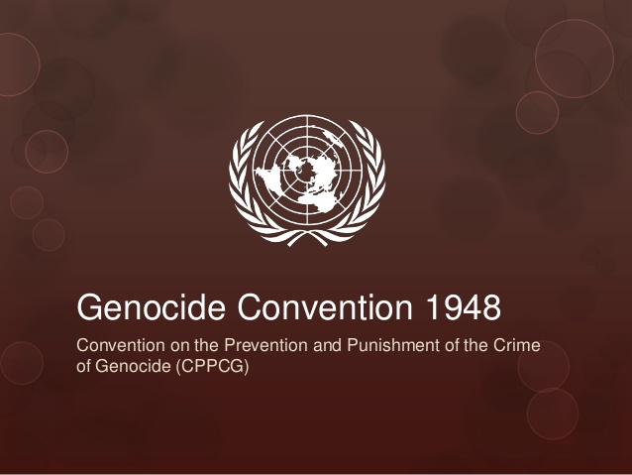
The Genocide Convention was the culmination of years of campaigning by the Jewish lawyer, Raphael Lemkin. It recognised that “international co-operation” was needed, “to liberate mankind from such an odious scourge”.

Slide 12
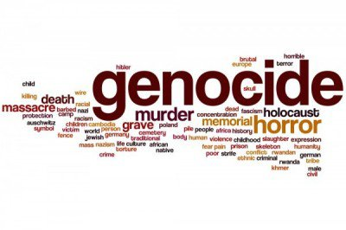
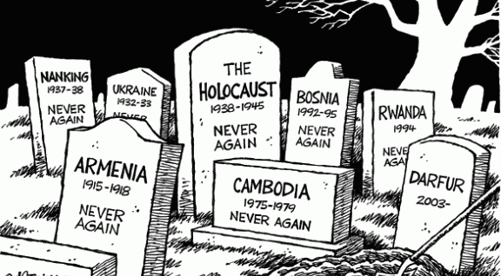
Genocide:The 147 signature countries have a moral and legal duty to, “undertake to prevent and to punish.

Slide 13
2. The Reality: for many, Article 18 is not worth the paper on which it is written. It is a moral outrage that whole swathes of humanity are being murdered, terrorised, victimised, intimidated, deprived of their belongings and driven from their homes, simply because of the way they worship God or practise their faith.

Slide 14
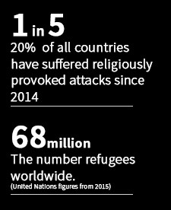
The annual Pew study found that 74% of the world’s population live in the countries where there are violations of Article 18. In every country where there are violations an estimated 250 million Christians are persecuted.
Religious Persecution Is In Violation of the 1948 UDHR, Ruins Lives, Destroys Countries and is a Key Driver for Forced Migration.

Slide 15
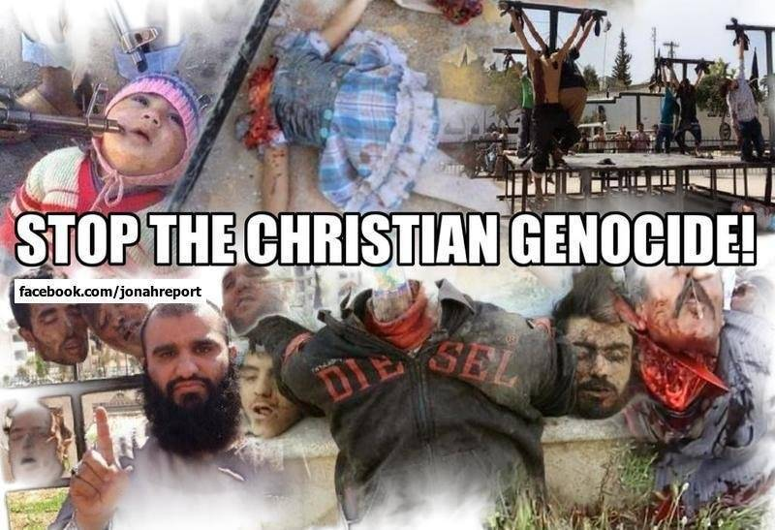
Infringement of freedom of religion and belief morphs into persecution and can morph into crimes against humanity and genocide.

Slide 16
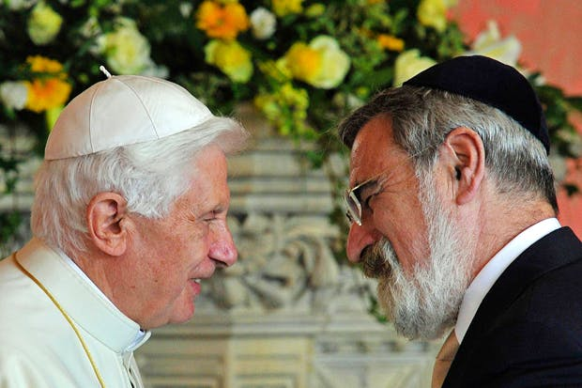
“The persecution of Christians …is one of the crimes against humanity of our time. I am appalled at the lack of protest it has evoked. It is the religious equivalent of ethnic cleansing” Jonathan Sacks

Slide 17
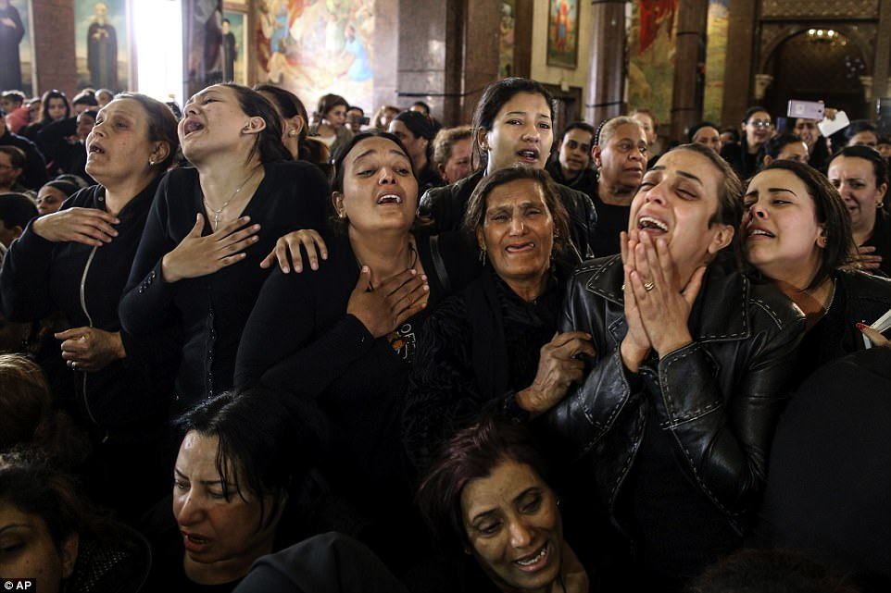
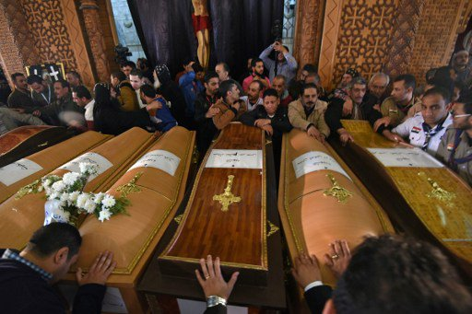
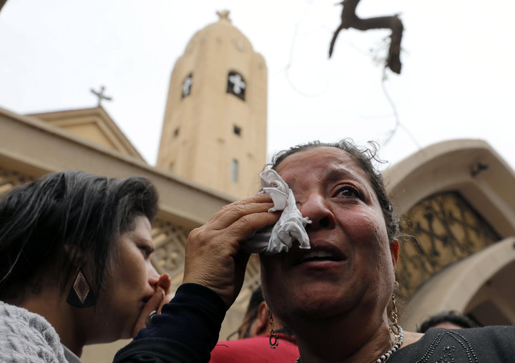
Palm Sunday 2017: two suicide bombings killed 44 people at Coptic churches in Egypt as the Coptic patriarch, Pope Tawadros II, led a Palm Sunday service
+

Slide 18
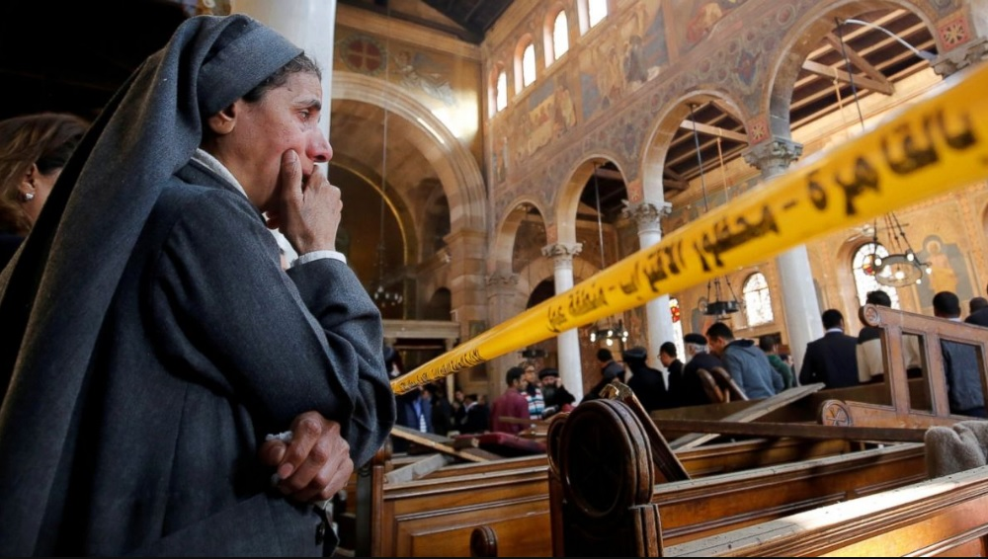
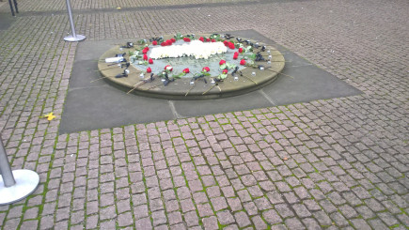
December 2016 Explosion kills 25 Coptic Orthodox worshippers during Sunday worship in Cairo.

Slide 19
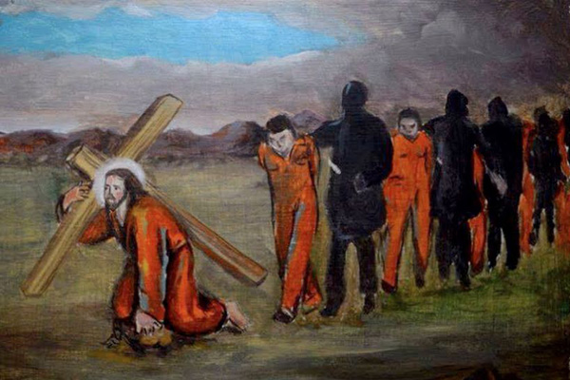
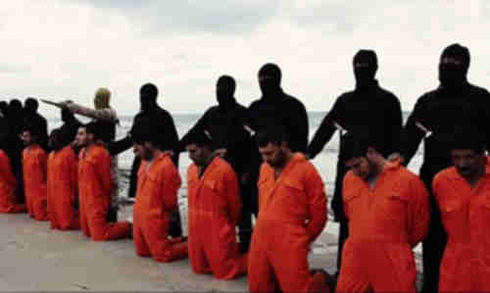
“in the moment of their barbaric execution”, some of the 21 Christians were repeating the words “Lord, Jesus Christ,” – February 2015
+ If a faith is worth dying for it might be worth living for.

Slide 20
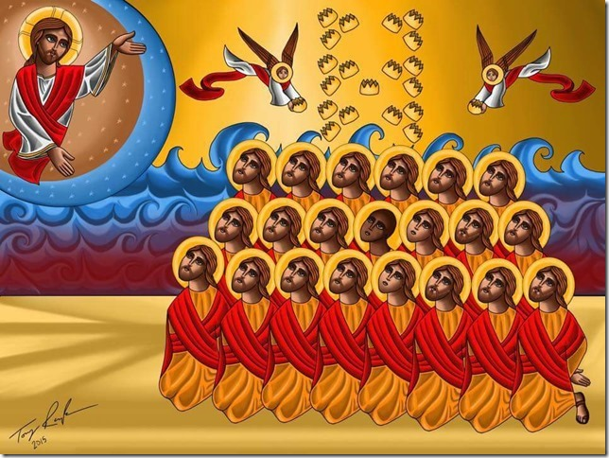
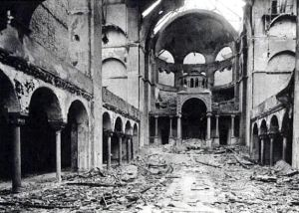
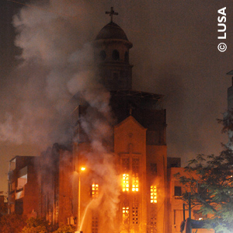
2013 - Egypt’s Kristallnacht - the burning or bombing of more than 50 of Egypt’s churches in Alexandria, Arish, Assiut, Beni Suef, Cairo, Bayou, Gharbiya, Giza, Minya, Qena, Sohag and Suez. Also attacked were schools, homes and businesses belonging to Coptic Christians.
+ If a faith is worth dying for it might be worth living for.
ISIS recently proclaimed a new caliphate in Egypt’s Sinai and say Copts are their “favourite prey.”

Slide 21
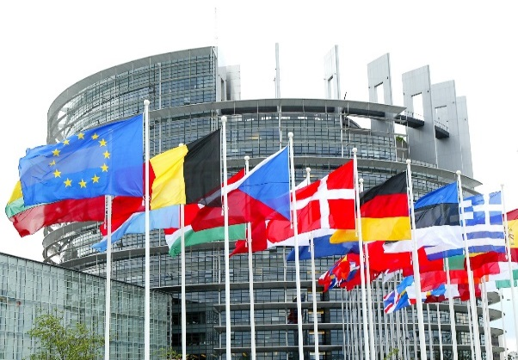
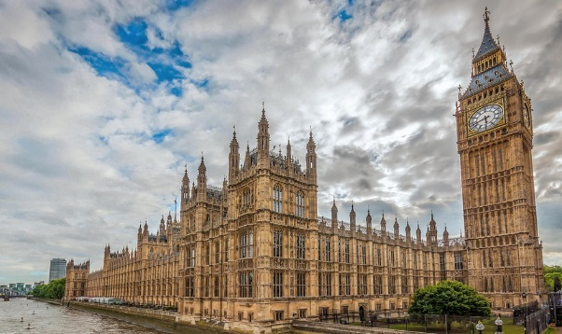
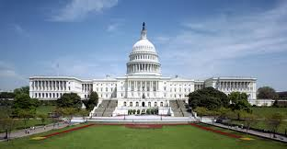
This systematic campaign is an attempt to repeat the horrors of Syria and Iraq – where Parliaments, Congress and world leaders have formally declared a genocide but such declarations are meaningless if there is no basis for bringing to justice those responsible
The Times said the destruction of Christians from the Middle East “now amounts to nothing less than genocide.”

Slide 22
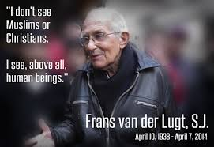
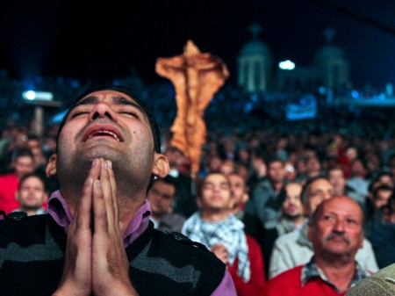
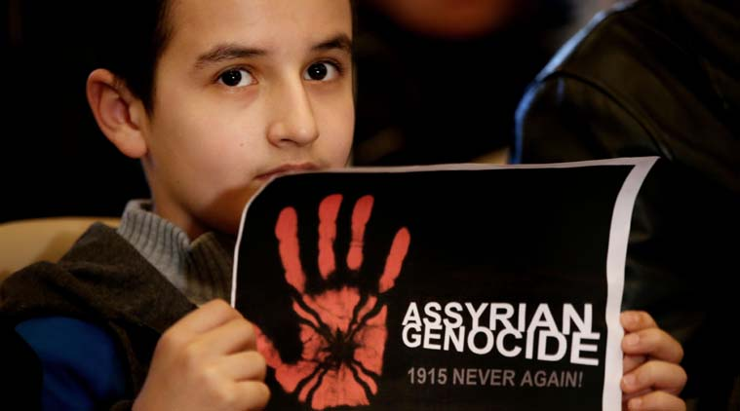
Iraq and Syria: 2017 - Genocide The Crime Above All Crimes.
This genocide includes assassinations of church leaders, mass murders, torture, kidnapping for ransom, the sexual enslavement and systematic rape of Christian girls and women, forcible conversions, the destruction of churches, monasteries, cemeteries and Christian artefacts. In 1914, Christians made up a quarter of that region’s population. Now they are less than 5%.

Slide 23
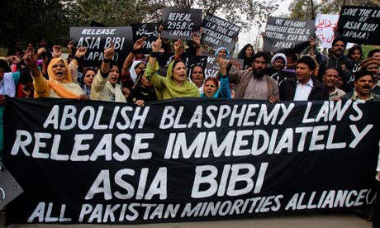
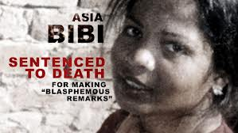
The Use of Blasphemy and Apostasy Laws To Persecute
Genocides occur when you first turn a blind eye to discrimination and persecution – sometimes hidden in the clothes of a country’s laws.
One quarter of the world’s countries have blasphemy laws –more than one in 10 have laws penalizing apostasy: both used to falsely accuse, intimidate, and persecute.
This leads, to a death sentence in cases like that of Pakistan’s Asia Bibi – imprisoned since 2009.

Slide 24
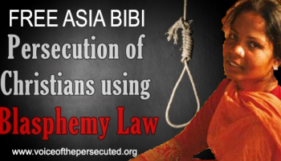
“I cried alone, putting my head in my hands. I can no longer bear the sight of people full of hatred, applauding the killing of a poor farm worker. I no longer see them, but I still hear them, the crowd who gave the judge a standing ovation, saying: "Kill her, kill her! Allahu Akbar!" …I was then thrown like an old rubbish sack into the van... I had lost all humanity in their eyes” – Asia Bibbi –mother of five (one of whom is significantly disabled).
"I believe in my religion and in Jesus Christ, who died on the cross for the sins of mankind.”

Slide 25
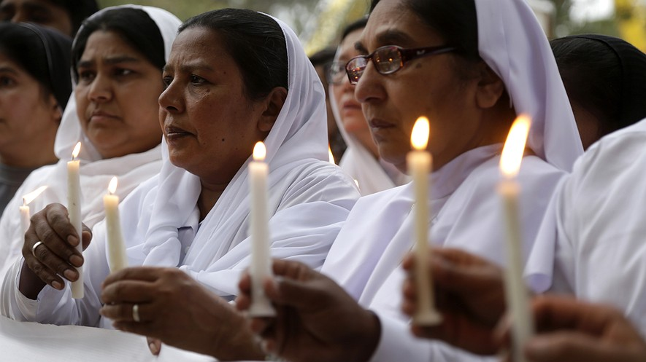
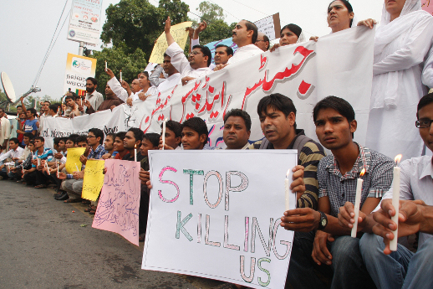
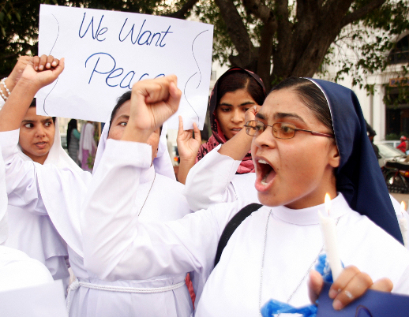
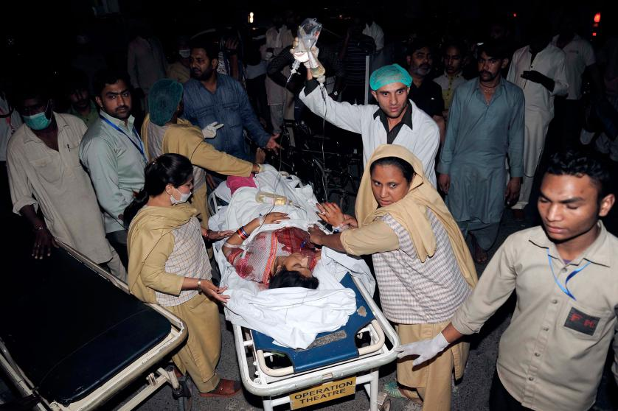
2016 - Easter in Lahore: More than 70 dead; 340 injured
+ If a faith is worth dying for it might be worth living for.

Slide 26
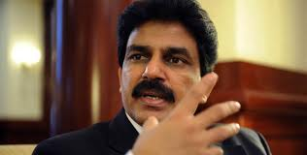
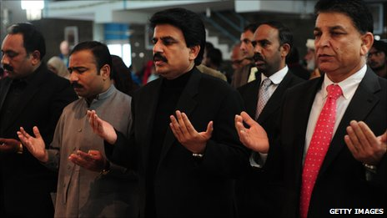
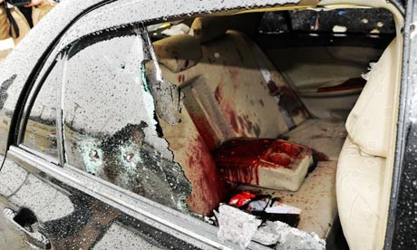
Pakistan 2011 - Shabaz Bhatti was murdered for challenging persecution of minorities and challenging the Blasphemy Laws.
Bhatti said “I want to share that I believe in Jesus Christ, who has given his own life for us. I know what is the meaning of the cross, and I am following the cross, and I am ready to die for a cause.”

Slide 27
2016 - Pakistani Christians kept like caged animals in detention centres

Slide 28
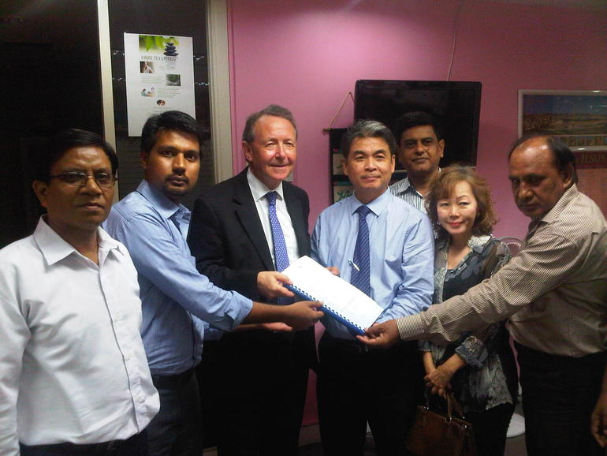
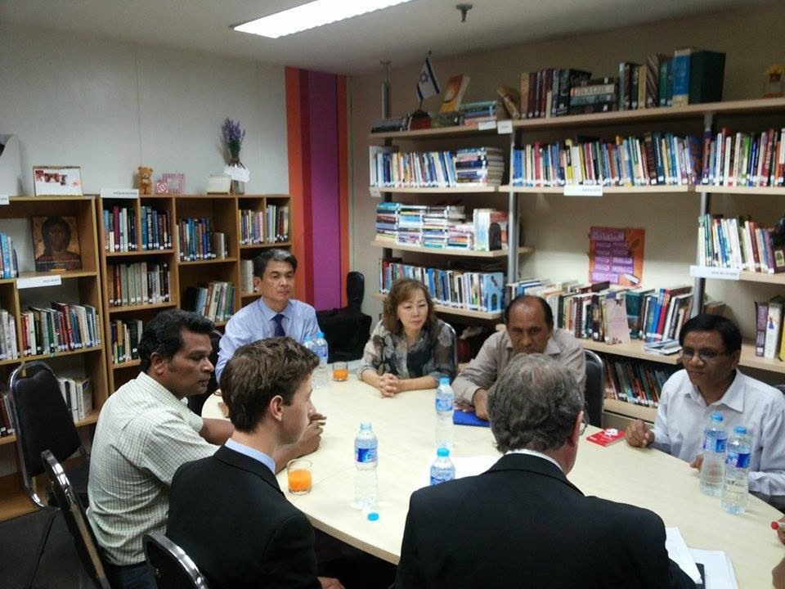
Taking evidence from persecuted Pakistani Christians who have escaped
https://davidalton.net/2016/03/28/carnage-in-lahore-pakistan-and-uk-governments-failure-to-challenge-persecution-or-the-culture-of-impunity-links-to-previous-posts-about-pakistans-christians-shahbaz-bhatti-asia-bibbi-and-the/

Slide 29
Iran
– where there were almost 1000 executions last year, including the execution of Baha’is - and the imprisonment of Saeed Abedini, imprisoned for 10 years for “undermining national security” by hosting Christian gatherings in his home.

Slide 30
China
Religious persecution has led to Chinese Catholics like the late Bishop Cosmas Shi Enxiang, who died last year at 94 years of age, having spent to spend half his life in prison; to Chinese Protestants, since the beginning of 2016, seeing 49 of their churches defaced or destroyed, crosses removed and a pastor’s wife crushed to death in the rubble as she pleaded with the authorities to desist.

Slide 31
Sudan

Slide 32
Sudan’s Field Marshall Omar al Bashir Bashir – indicted by the ICC for Genocide and Crimes against humanity -has travelled with impunity to Kenya, South Africa, China, Nigeria, UAE, Saudi Arabia, Ethiopia, Qatar and Egypt.

Slide 33
South Kordofan – Sudan – “the second genocide of the 21st century” - Chemical weapons now being used against civilians. Is it to be business as usual?

Slide 34
Nigeria: Boko Haram openly say their interim goal is "to eradicate Christians from certain parts of the country.“ There are endless killings.

Slide 35
North Korea

Slide 36
200,000 people are incarcerated:
“there is almost a complete denial of the right to freedom of thought, conscience and religion”;
“Severe punishments are inflicted on people caught practising Christianity”;
“the State considers the spread of Christianity a particularly serious threat.”

Slide 37
In paragraphs 26-31 the UN Report states: “there is almost a complete denial of the right to freedom of thought, conscience and religion”; that religious faith has been supplanted by a cult of “absolute obedience to the Supreme Leader” and “the State considers the spread of Christianity a particularly serious threat.”

Slide 38
Jeon Young-Ok:
“They tortured the Christians the most.
They were denied food and sleep.
They were forced to stick out their tongues
and iron was pushed into it."
"The guards told us that we are not human beings, we are just prisoners…the dignity of human life counted for nothing. " Hea Woo

Slide 39
3. How we should respond; what we might do? Some Things We Might Do We need a consistent, coherent international strategy. At every opportunity we must wake up the world to the scale of the persecution and to the obligations that flow from both Article 18 and the Genocide Convention. However long it takes, we have a duty to bring to justice those responsible for their crimes against humanity.

Slide 40
Some Things We Might Do November 23rd 2016 Was Designated Red Wednesday
Speak Up and Act on behalf of the 5.3 billion people (76 per cent of the world’s population) who live in countries with a high or very high level of restrictions on religion.

Slide 41
Some Things We Might Do
Perhaps we need a new Convention on Religious Freedom to sit alongside the Convention on Genocide – but if we promote such Conventions let’s dedicate ourselves to upholding and enforcing them too – and with universal application – making sure that words like genocide, persecution and discrimination are matched by deeds and are reflected in the way we do business with; sell arms to; or provide aid programmes to those who violate Article 18.

Slide 42
We must promote religious literacy among policy makers and the population at large. Given that 84% of the world’s population declare a religious faith policy makers cannot understand the world if you do not understand religion.
Some Things We Might Do

Slide 43
Some Things We Might Do We must emphasise the tangible benefits that accrue to societies that protect religious freedom. A society which promotes religious freedom will be enlivened and enriched and one that does not will decay.

Slide 44
Learn Each other's Stories and Speak Up For Others Who suffer For their Beliefs
Some Things We Might Do

Slide 45
Some Things We Might Do
The next generation are being reached via the internet and smartphones
We urgently need a persuasive new narrative capable of forestalling the unceasing incitements to hatred which pour forth from the internet

Slide 46
The urgency of addressing the incessant hatemongering and export of radical Islamist ideology was starkly underlined by the execution of the 84-year-old French priest Fr. Jacques Hamel and by the murder of the Glasgow shopkeeper, Asad Shah – who had wished his customers a Happy Easter.

Slide 47
“Silence in the face of evil is itself evil…not to speak is to speak. Not to act is to act.” Dietrich Bonhoeffer

Slide 48
World Summit In Defence of Persecuted Christians
May 2017 Washington D.C.
David Alton – Lord Alton of Liverpool
www.davidalton.net
+ If a faith is worth dying for it might be worth living for.

