Slide 1
Time for the United Nations to create a World Orphans Day? Tokyo and Seoul High Level Forum to establish UN World Orphans Day , organised by Soongsil Kongsaeng Welfare Foundation, and supported by Nippon Foundation. David Alton: Lord Alton of Liverpool – October 2014. www. davidalton.net

Slide 2
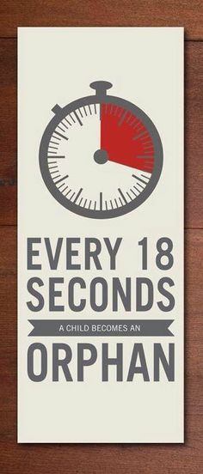

Slide 3
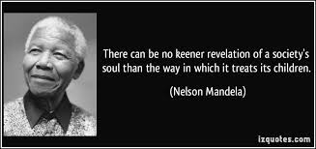

Slide 4
1. What is an orphan and who are they? 2. What are our responsibilities towards orphaned children?

Slide 5
What is an orphan and who are they?
The word orphan is derived from the Greek “orfanos” (ὀρφανός) and is usually translated as a child whose parents are dead or who have abandoned the child permanently.

Slide 6
What is an orphan and who are they?
The Concise Oxford English Dictionary suggests that an orphan is simply “a child bereaved of parents”

Slide 7
What is an orphan and who are they?
One legal definition, in use in the United States, says that a person is orphaned through the “death or disappearance of, abandonment or desertion by, or separation or loss from, both parents”.

Slide 8
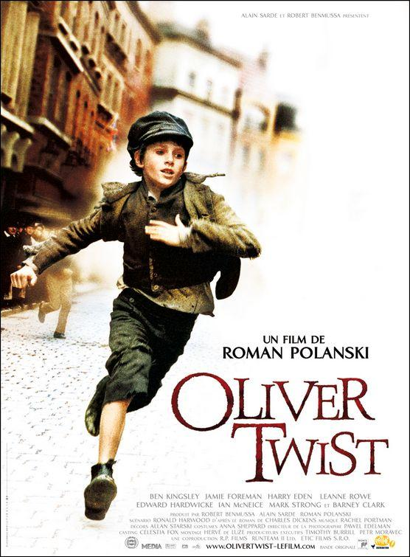
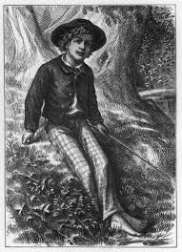
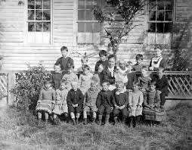
We have a picture of orphans crafted by great novelists such as Charles Dickens, L.M.Montgomery or Mark Twain of Oliver Twist, Ann of Greengables and Tom Sawyer

Slide 9
UNICEF and who say that, for their purposes, an orphan is a child who has lost one or both parents – a paternal orphan being a child who has suffered the loss of their father; a maternal orphan being one who has suffered the loss of their mother; and a double orphan is a child who has seen both of their parents die.

Slide 10
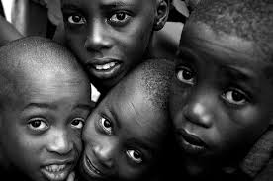
UNICEF adopted this definition two decades ago as the AIDS pandemic swept away millions of parents.
Using this definition, in 2005 UNICEF estimated the number of orphans in sub-Saharan Africa, Asia, Latin America and the Caribbean to be over 132 million (a figure which would increase by nearly 20 million in the next twenty years).

Slide 11
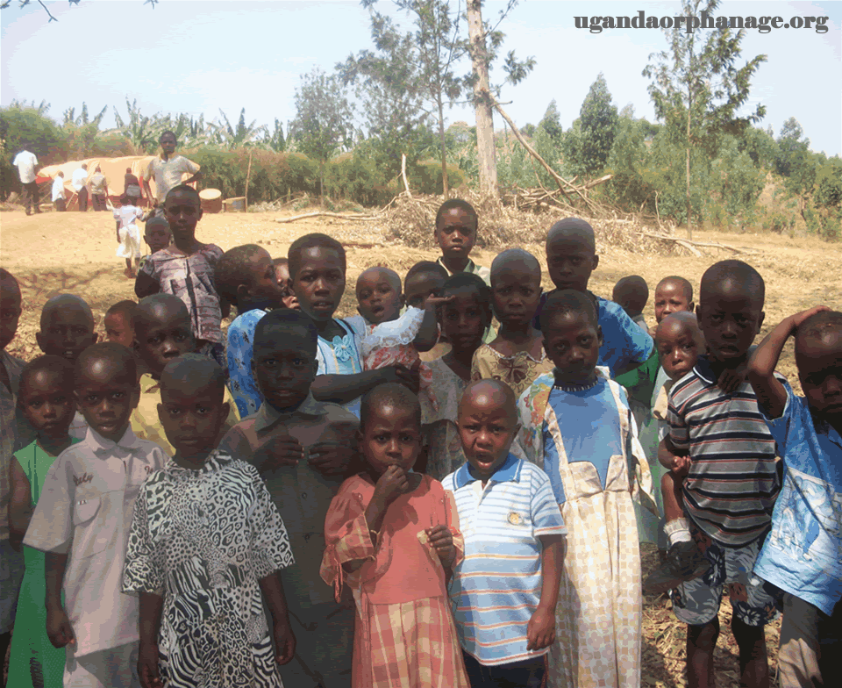
in Uganda in 2002 14.6% of all children, some 1,731,000, were said to be orphans. 51.1% of these are AIDS orphans. By 2014 the total number of orphans in Uganda was 2,700,000 – 1,000,000 orphaned due to AIDS.

Slide 12
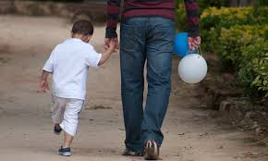
In the UK over 800,000 children have no contact with their fathers and 68,110 children are in the care of local authorities. In the US half a million children are in the foster care system with around 100,000 awaiting adoption.

Slide 13
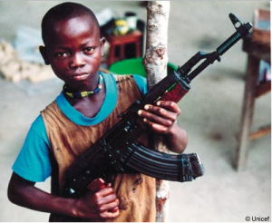
Children who are caught in the cross fire of war-torn nations face bereavement, displacement, and all the physical and psychological trauma which accompanies such violence. Many are abducted and swept up into militias, becoming child soldiers. It is estimated that globally there are 300,000 child soldiers.

Slide 14
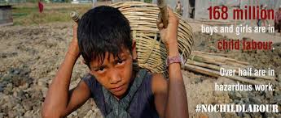
Other children are made to work for unscrupulous employers who pay them a subsistence pittance. They are perhaps lucky in comparison with those who become slave labour, drawn into a life of street crime or who are trafficked into prostitution or sexual gratification. The International Labour Organisation estimates that around 153 million children between the ages of 5 and 14 are forced into child labour.

Slide 15
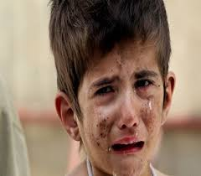
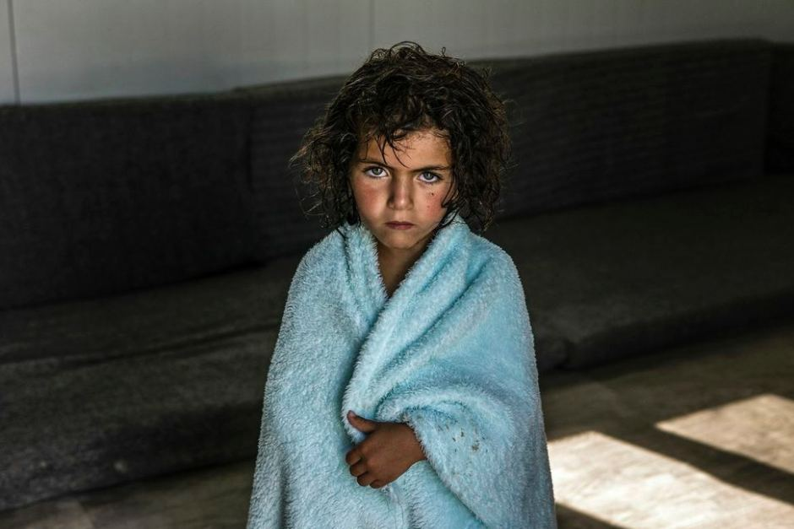
It is now a full year since UNICEF said that the number of children forced to flee Syria had reached one million – which they described as “a shameful milestone” – adding that a further 2 million children are displaced within the country.

Slide 16
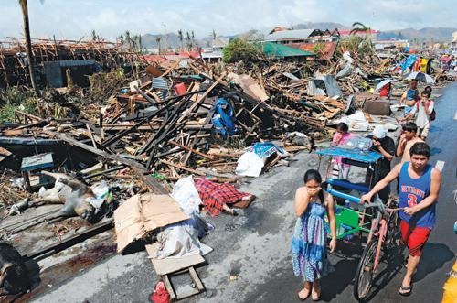
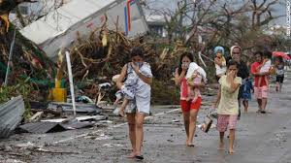
Natural disasters also leave children without parents.
In 2013, in the Philippines, 1.7 million children were seriously affected by Typhoon “Haiyan”.

Slide 17
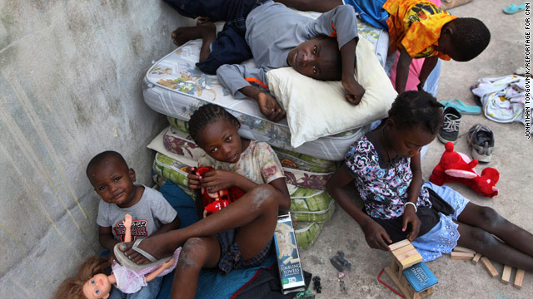
On January 12th 2010 an earthquake with a 7.0 magnitudes struck Haiti and Port-au-Prince became a scene of shocking desolation.

Slide 18
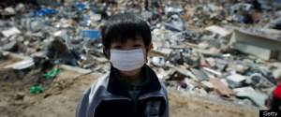
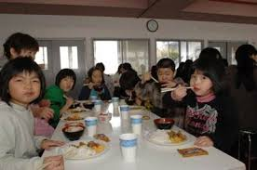
On March 11, 2011, a terrible earthquake and tsunami struck Japan and it left around 200 children without either of their parents and a further 1,200 children lost one of their parents.

Slide 19
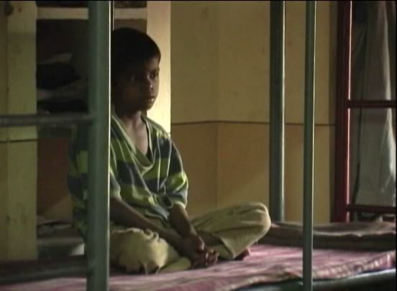
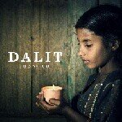
India has more orphans than anywhere else in the world. – an estimated 25 million orphans. The vast majority are from the Dalit, or untouchable, caste.

Slide 20
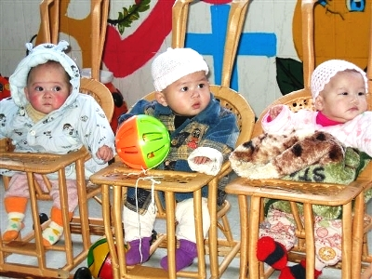
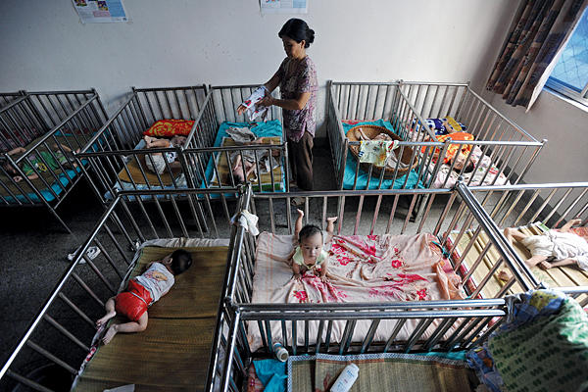
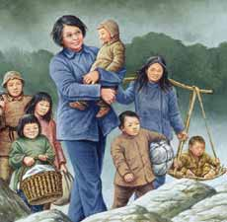
In China there are an estimated half a million orphans and unregulated orphanages are exceedingly common.
Gladys Aylward’s Inn of Sixth Happiness http://davidalton.net/2013/05/11/gladys-aylward-the-little-woman-and-chinas-inn-of-the-sixth-happiness/

Slide 21
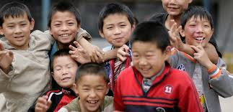
In 2013 China Daily reported that official statistics revealed that only 64 of the country’s 2,853 counties have child welfare homes and that the Ministry of Civil Affairs had promised to help 500 more build facilities by the end of 2015.

Slide 22
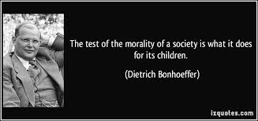

Slide 23
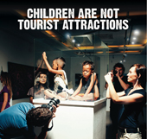
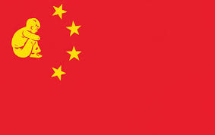
“The test of the morality of a society is what it does for its children.”
Journalists have reported on Cambodian children bought from their parents and sold on at significant profit to Westerners who wish to adopt. China and Russia have also curtailed international adoptions.
We are all familiar with the stories from China where the coercive one child policy has led to the abandonment of millions of little girls. This sex-selection gendercide led to orphanages filled with little girls.

Slide 24
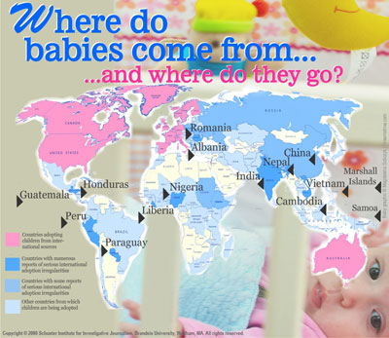
In the 1990s, international adoption exploded in both Russia and China. Research from the UK’s Newcastle University suggests that between 2000 and 2010 410,000 children were adopted by citizens of 27 countries.

Slide 25
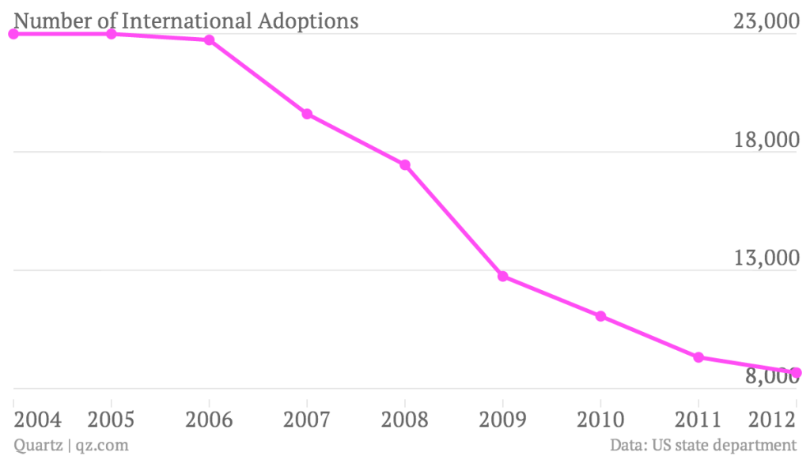

Slide 26
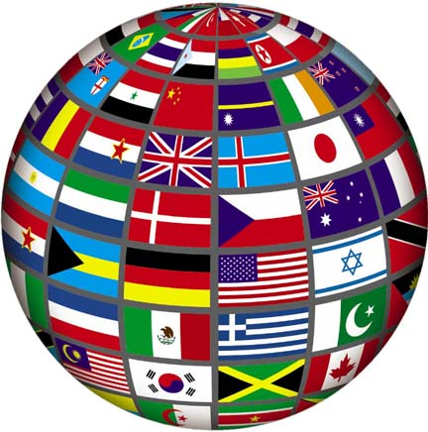
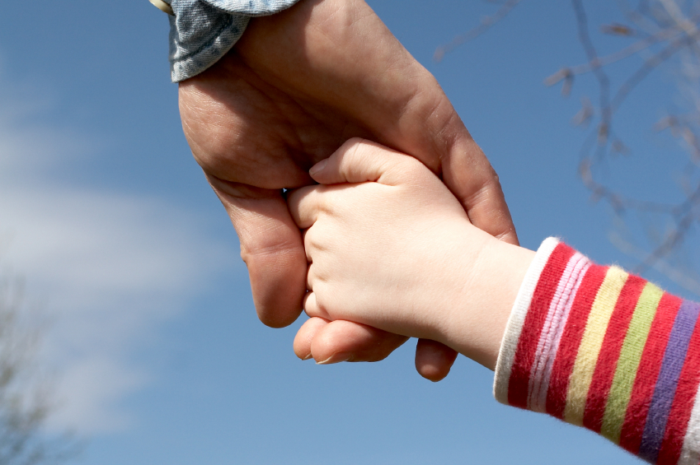
In 1985 South Korea recorded the highest ever adoption rate with 1.3 of every 100 children born sent overseas for adoption – but the Republic of Korea, along with many other nations has changed its attitude towards international adoption.

Slide 27
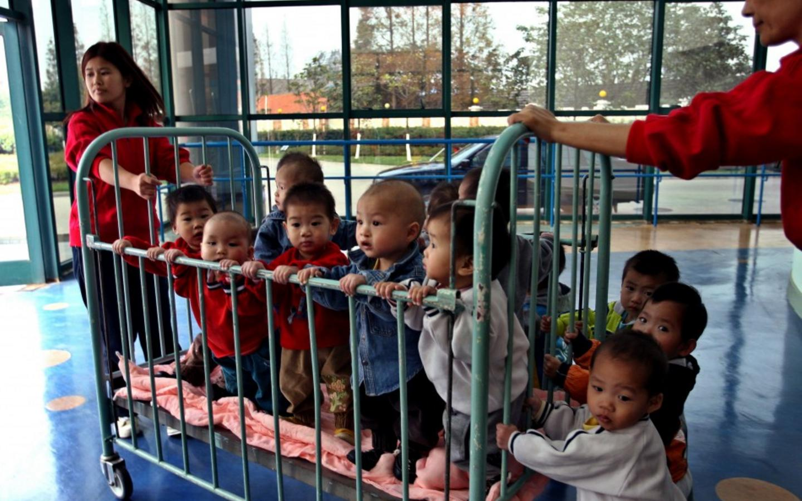
As China reduced international adoptions, the number of children filling its orphanages increases — China’s Ministry of Civil Affairs say the number reached 92,000 in 2011, almost a 50% rise from 2004.

Slide 28
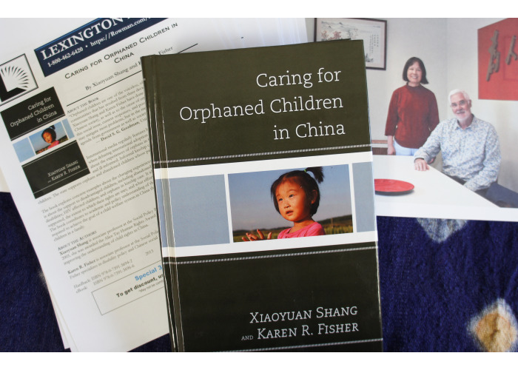

Slide 29
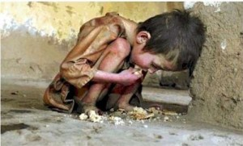
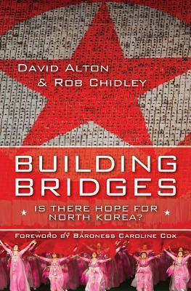
Perhaps the Australian initiative in China may one day be replicated in North Korea.

Slide 30
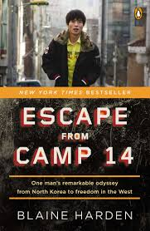
Tortured in the camp at age 14 Shin was forced to watch as his mother and brother were executed. Many North Koreans were orphaned during the famine (the Arduous March), between 1994 and 1997 . It claimed millions of lives. Children were the most adversely affected. The World Health Organisation reported death rates for children at 93 of every 1000, while those of infants were cited at 23 of every thousand.

Slide 31
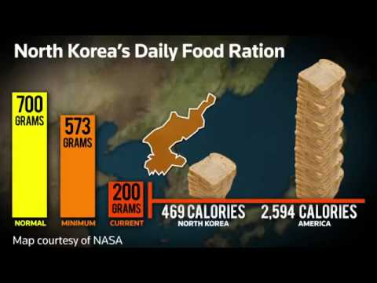
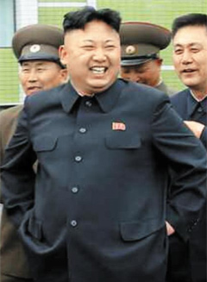
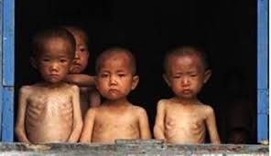

Slide 32
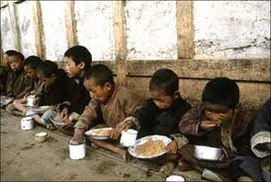
In February 2014 a United Nations Commission of Inquiry described the abuse of human rights in North Korea as “without parallel” stating that more than 200,000 North Koreans, including children, are imprisoned in camps where many perish from forced labour, inadequate food, and abuse and torture by guards
http://davidalton.net/2014/07/24/british-parliament-debates-the-united-nations-commission-of-inquiry-report-into-crimes-against-humanity-in-north-korea/

Slide 33
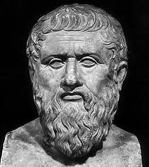
What are our responsibilities towards orphaned children?
In his Laws Plato said that “Orphans should be placed under the care of public guardians. Men should have a fear of the loneliness of orphans and of the souls of their departed parents. A man should love the unfortunate orphan of whom he is guardian as if he were his own child. He should be as careful and as diligent in the management of the orphan’s property as of his own or even more careful still.”

Slide 34
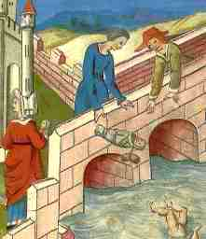
It is estimated that around one third of all Roman children died before they reached ten years of age. Babies were often rejected if they were illegitimate, disabled, female, or regarded as a burden on their families. By contrast, the Egyptians forbade infanticide.

Slide 35
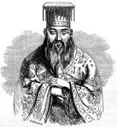
Confucian ethics and precepts includes rén, – which requires altruism and humaneness towards others – and holds in contempt those who fail to show due regard for others.

Slide 36
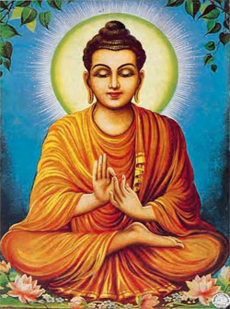
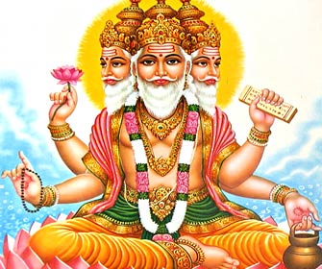
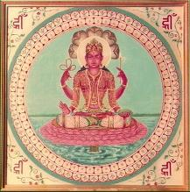
Buddhism, Hinduism and Jainism all place emphasis on the cultivation of generosity to those less privileged – not least because of its effect in purifying and transforming the attitudes and mind of the giver.

Slide 37
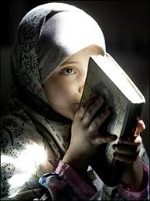
The Holy Qur’an insists: “Treat not the orphan with harshness” (Qur’an 93:9)
The Prophet Muhammad had an orphaned childhood, losing both his parents by the age of six, and this features in early verses of the Qur’an:
“Did He not find you an orphan and give you shelter?” (Qur’an 93:6).
Muslims believe that by befriending and caring for an orphan they are befriending and caring for the Prophet himself.

Slide 38
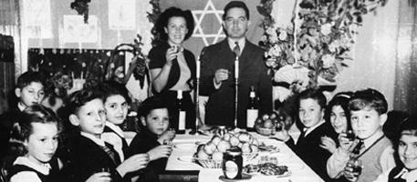
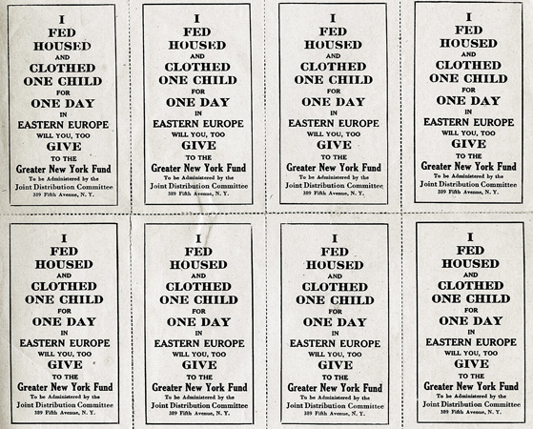
The Jewish faith focusses on the protection of the poor, weak, foreigners, widows and orphans. The Pslamist writes (Psalm 127:3) “Lo, children are an heritage of the LORD…”
The prophet Isaiah tells the people: “Uphold the rights of the orphan; defend the cause of the widow” (Isaiah 1:17). While Jeremiah says that it is pleasing to God “if you do not oppress the stranger, the orphan, and the widow” (Jeremiah 7:5-6).
Throughout the Bible orphans are represented as helpless and requiring our support.

Slide 39
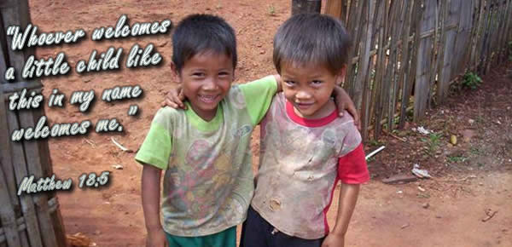
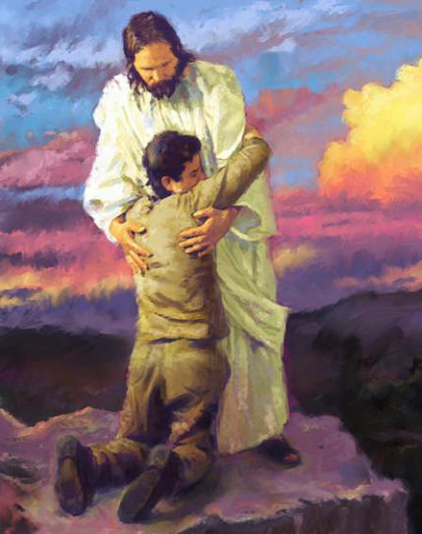
St.James sums up the Christian faith as “religion that God our Father accepts as pure and faultless is this: to look after orphans and widows in their distress and to keep oneself from being polluted by the world “(James 1:27).

Slide 40
In 1923 Eglantyne Jebb created the first charter of children’s rights. She had been arrested and fined for producing and distributing a leaflet entitled “A Starving Baby and Our Blockade has Caused This” which drew attention to the plight of children on the losing side of the First World War.

Slide 41
Jebb insisted that the charity must “not be content to save children from the hardships of life – it must abolish these hardships; nor think it suffices to save them from immediate menace – it must place in their hands the means of saving themselves and so of saving the world.”

Slide 42
Every child should have the necessary means to develop materially and spiritually;
2. Every child should be have access to food and medical help; and, if hampered by developmental problems, given help; if delinquent, given the chance to start again; and if an orphan, provided with shelter and succoured.
3. Every child should be given absolute priority and relief in times of distress;
4. Every child should be protected against exploitation and enabled to earn a living when old enough to do so; and
5. Every child should be encouraged to understand and fulfil his or her potential and to see their obligations to humanity and the common good. These principles were codified as non-mandatory guidelines in the World Child Welfare Charter and endorsed by the League of Nations in 1924.

Slide 43
In the aftermath of the Second World War, the newly formed United Nations stated in its Charter that its primary purpose was “ to save succeeding generations from the scourge of war…to reaffirm faith in fundamental human rights….and to promote social progress and better standards of life in larger freedom” . It also recognised the acute vulnerability of millions of war scarred children and in 1954 the General Assembly proclaimed Universal Children’s Day.

Slide 44
By 1959 the United Nations had amplified Eglantyne Jebb’s five criteria and these would form the 1989 Convention on the Rights of the Child, and was adopted by the General Assembly. It became international law in 1990 .

Slide 45
The Convention asserts that children should be able to grow in a stable environment under the responsibility of their parents. It states that children should not be separated from their mothers especially during the pre-natal and postnatal period. Yet, as a result of war, natural disasters, disease and the absence of parents many of these admirable aims are honoured only in their breach.

Slide 46
“there is no task more important than building a world in which all of our children can grow up to realize their full potential, in health, peace and dignity.” – Kofi Annan

Slide 47
In 2012, the UN Secretary General, Ban Ki-Moon, insisted that every child should have access to education and that education should be used to promote peace, respect and good stewardship of the world in which we live.

Slide 48
The United Nations has designated five days which highlight specific challenges facing the world’s young people: June 4th is International Day of Innocent Children: Victims of Aggression highlighting children as victims of violence and war; June 12th is World Day Against Child Labour; August 12th is International Youth Day and draws attention to cultural and legal issues affecting children. October 11th is The International Day of the Girl Child, promoting the improvement of the human rights and opportunities open to girls; November 20th is Universal Children’s Day.

Slide 49
There is no day dedicated to the world’s 150 million orphans. Given that our children are our most previous and valuable resource, and the one sure hope for our world’s future, it’s high time that there was.
www. davidalton.net

