Slide 1
Good Friday, April 14th 2017
Stonyhurst Retreat
As Others Die For Their Faith, How Can We Encourage British Christians To Live for Theirs?
www.davidalton.net

Slide 2
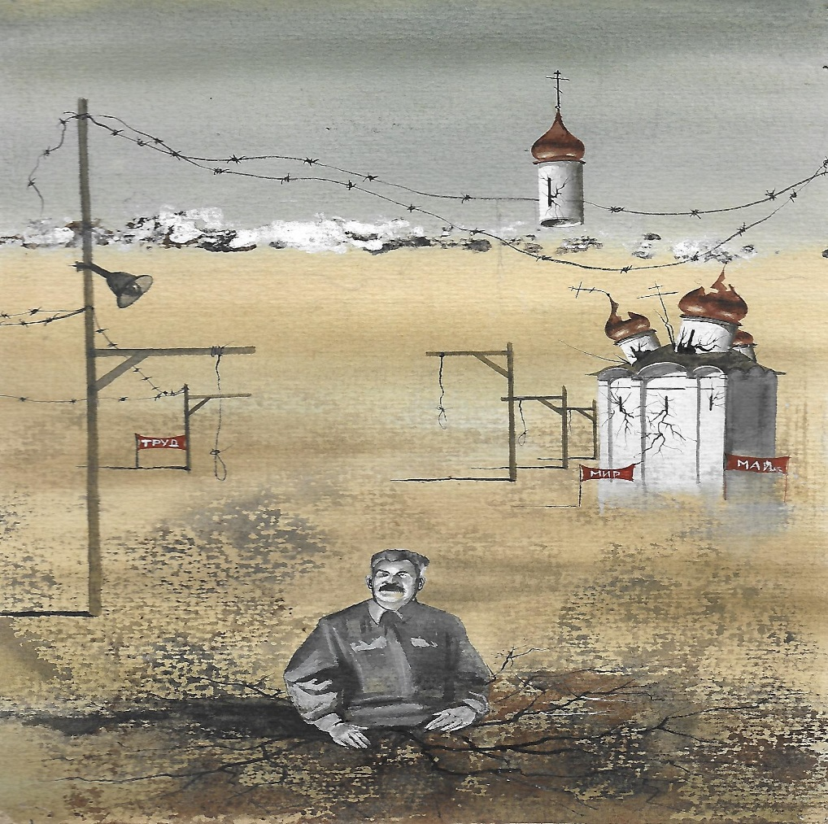
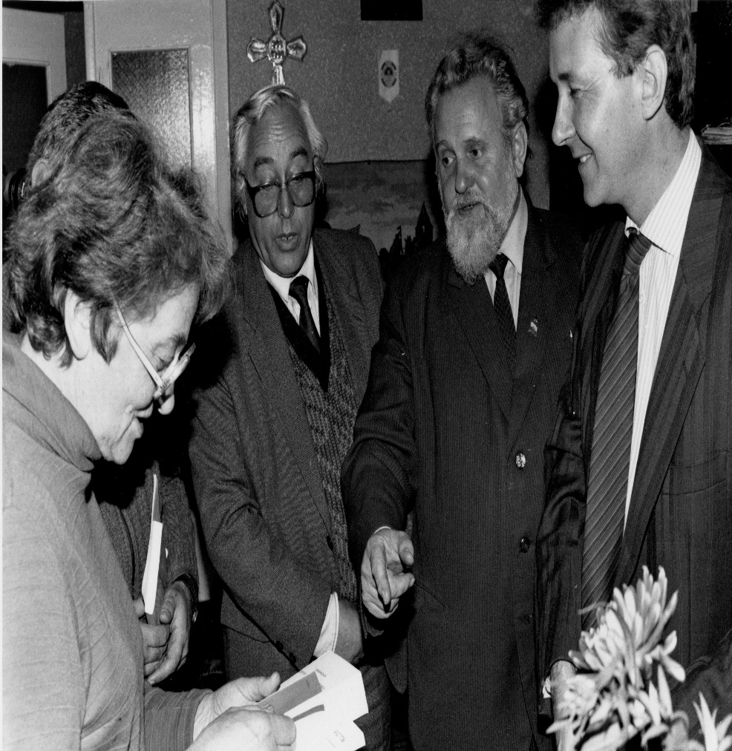
‘Christianity has died many times and risen again; for it had a God who knew the way out of the grave’ G.K.Chesterton - The Everlasting Man
+ If a faith is worth dying for it might be worth living for.

Slide 3
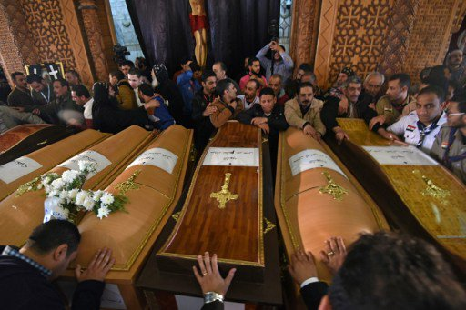
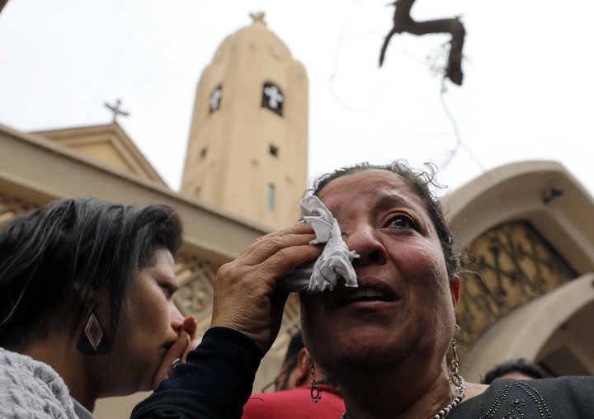
Palm Sunday 2017: two suicide bombings killed 44 people at Coptic churches in Egypt as the Coptic patriarch, Pope Tawadros II, led a Palm Sunday service inside.
+
+ If a faith is worth dying for it might be worth living for.

Slide 4
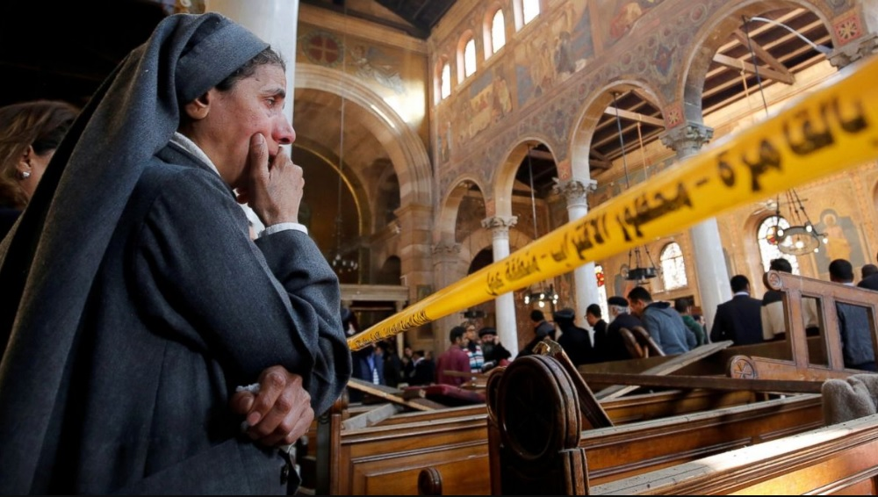
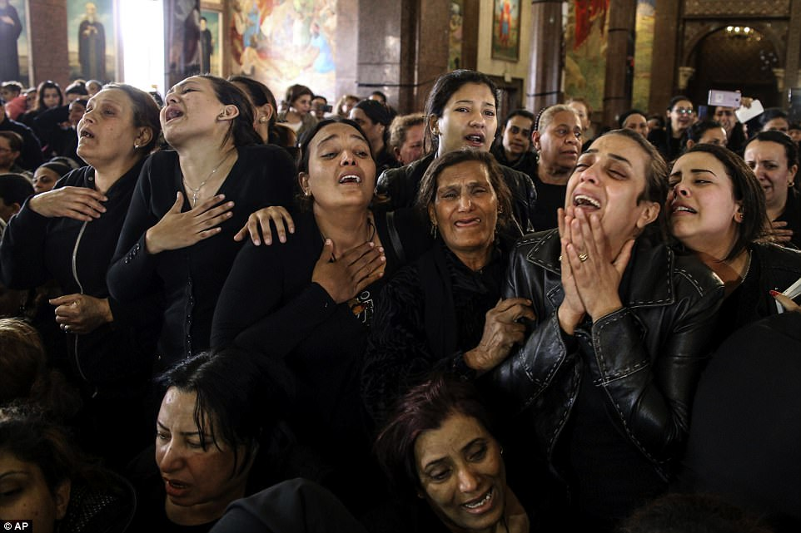
Christianity Being Crucified - as the world remains silent.
+ If a faith is worth dying for it might be worth living for.

Slide 5
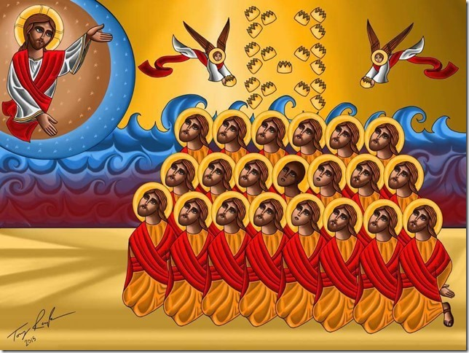
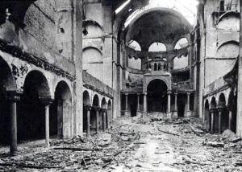
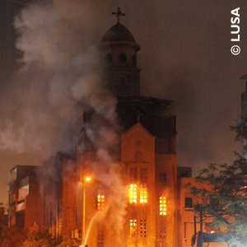
2013 - Egypt’s Kristallnacht - the burning or bombing of more than 50 of Egypt’s churches in Alexandria, Arish, Assiut, Beni Suef, Cairo, Fayoum, Gharbiya, Giza, Minya, Qena, Sohag and Suez. Also attacked were schools, homes and businesses belonging to Coptic Christians.
+ If a faith is worth dying for it might be worth living for.

Slide 6
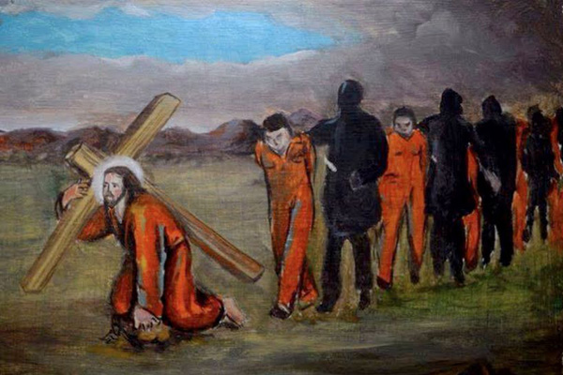
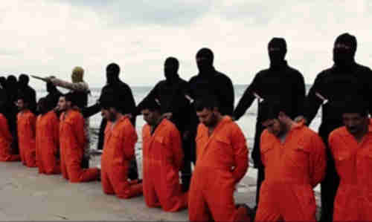
“in the moment of their barbaric execution”, some of the 21 Christians were repeating the words “Lord, Jesus Christ,” – February 2015
+ If a faith is worth dying for it might be worth living for.

Slide 7
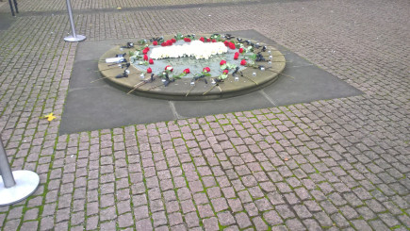
December 2016 Explosion kills 25 Coptic Orthodox worshippers during Sunday worship in Cairo –100,000 Copts leavening Egypt each year.
Genocide and Crimes Against Humanity
When IS seized control of Iraqi territory in the summer of 2014, they gave Christians, as “People of the Book”, four options: leave, convert to Islam, pay a protection tax (jiyza) or be killed. The vast majority fled – an estimated 120,000 in a few short weeks that summer. But those left behind were subjected to torture, forced conversion, sexual slavery and even crucifixion,
ADF Report November 2016
+ If a faith is worth dying for it might be worth living for.

Slide 8

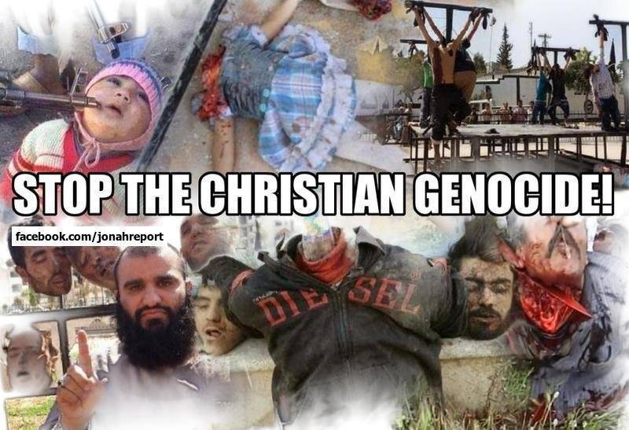
Iraq and Syria: 2017 - Genocide The Crime Above All Crimes.
This genocide includes assassinations of church leaders, mass murders, torture, kidnapping for ransom, the sexual enslavement and systematic rape of Christian girls and women, forcible conversions, the destruction of churches, monasteries, cemeteries and Christian artefacts and theft of lands and wealth from Christian clergy and laity alike. If there is no basis for enforcement rights become meaningless
+ If a faith is worth dying for it might be worth living for.

Slide 9
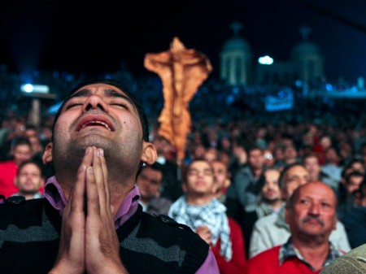
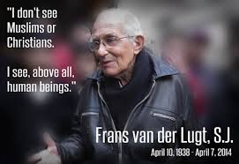
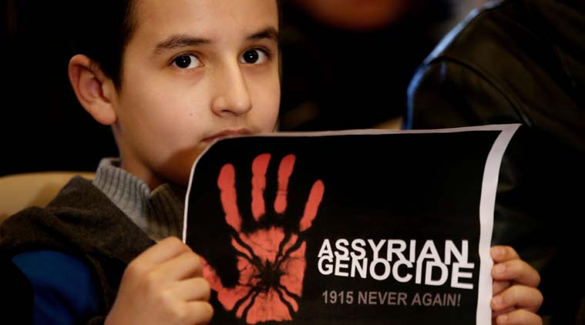
In 1914, Christians made up a quarter of that region’s population. Now they are less than 5%.
+ If a faith is worth dying for it might be worth living for.

Slide 10
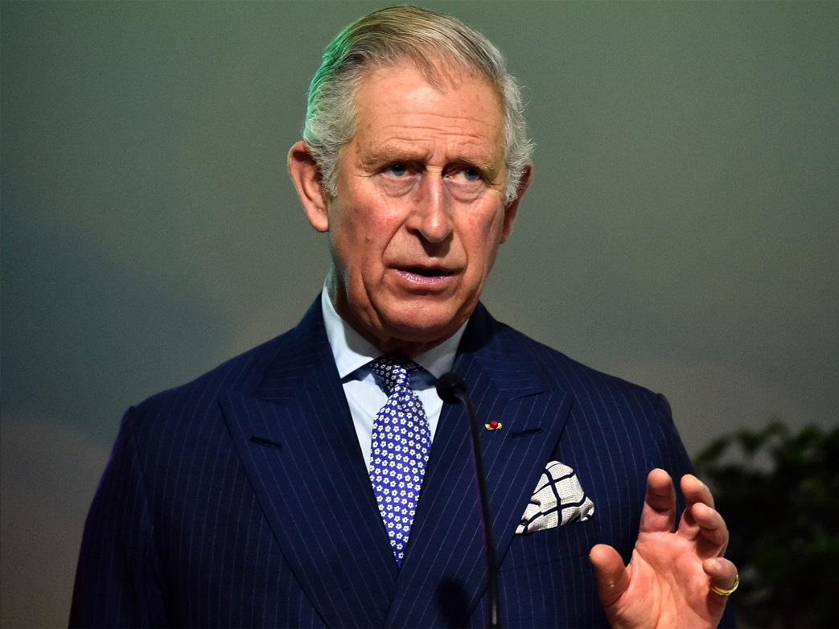
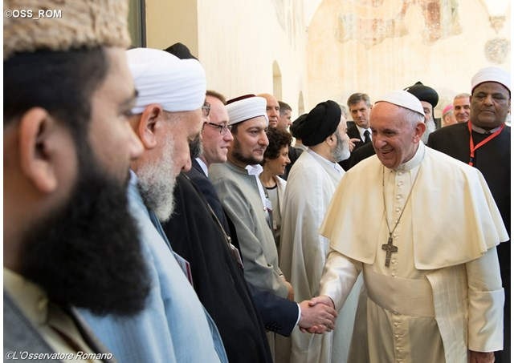
Pope Francis has said that Christians are subject to genocide. Prince Charles says it is “horrendous and heart-breaking”, describing events in Syria and Iraq as an “indescribable tragedy”.
+ If a faith is worth dying for it might be worth living for.

Slide 11


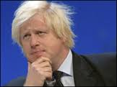

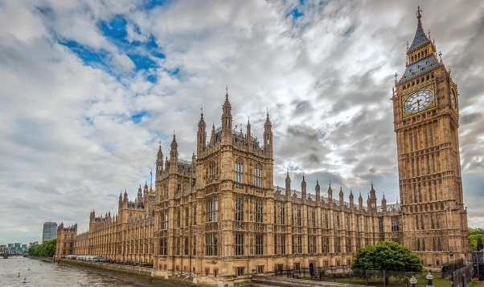
Council of Europe, European Parliament, Australian House of Representatives, American Congress, British House of Commons…named the genoicde for what it is:
In Strasbourg, the Parliamentary Assembly of the Council of Europe have passed a resolution that ISIS, “has perpetrated acts of genocide and other serious crimes punishable under international law”. The European Parliament passed a similar resolution. The Times said the destruction of Christians from the Middle East “now amounts to nothing less than genocide.” while Boris Johnson said “Isis are engaged in what can only be called genocide …..though for some baffling reason the Foreign Office still hesitates to use the term genocide.”
+ If a faith is worth dying for it might be worth living for.

Slide 12
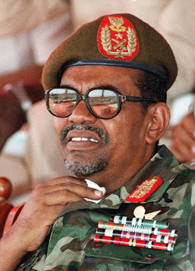
Sudan’s Field Marshall Omar al Bashir Bashir – indicted by the ICC for Genocide and Crimes against humanity -has travelled with impunity to Kenya, South Africa, China, Nigeria, UAE, Saudi Arabia, Ethiopia, Qatar and Egypt.

Slide 13
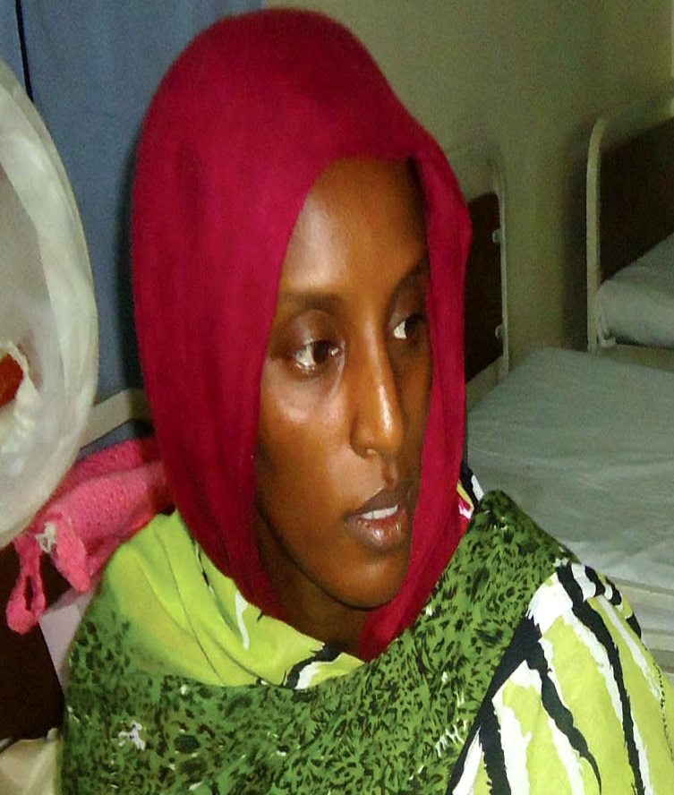
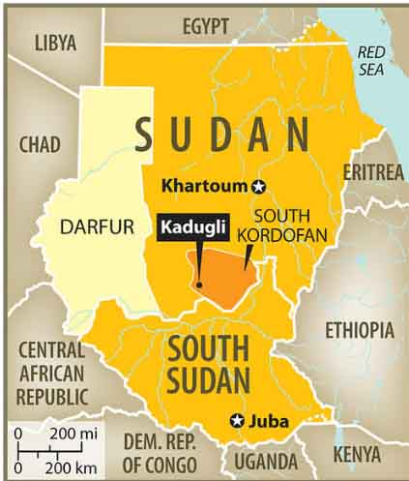
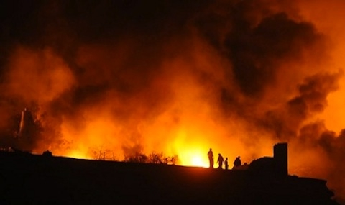
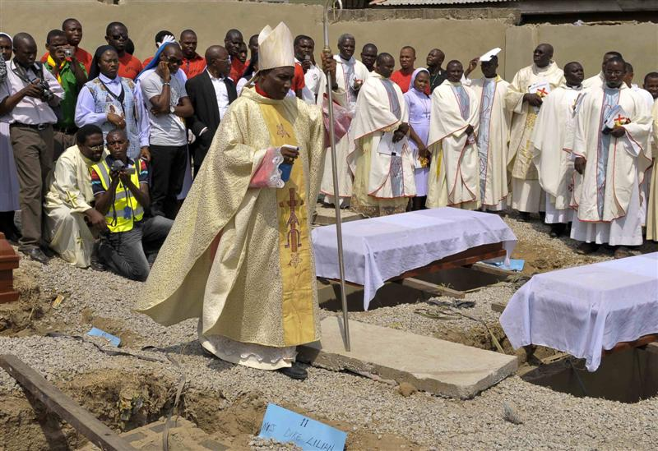
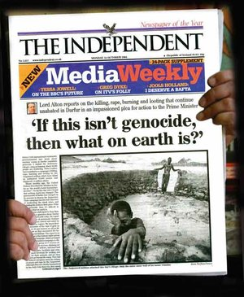
Sudan
+ If a faith is worth dying for it might be worth living for.

Slide 14
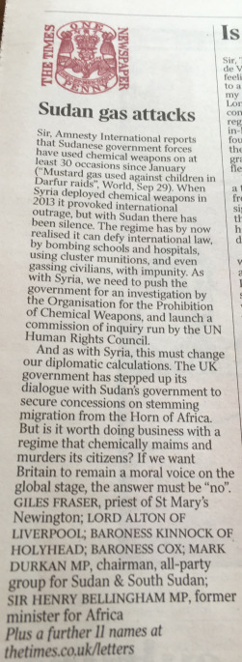
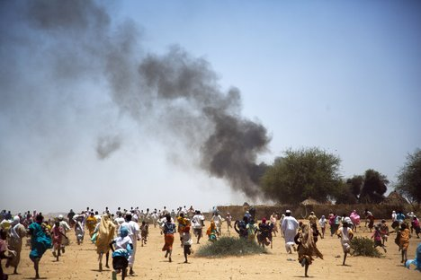
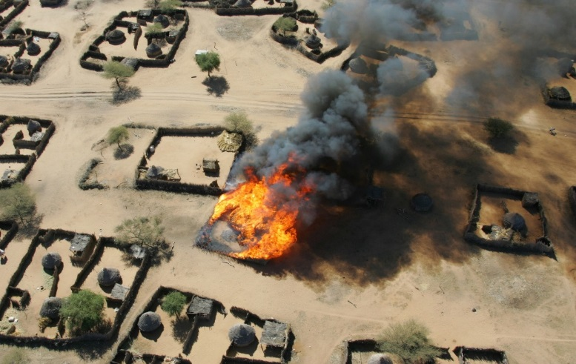
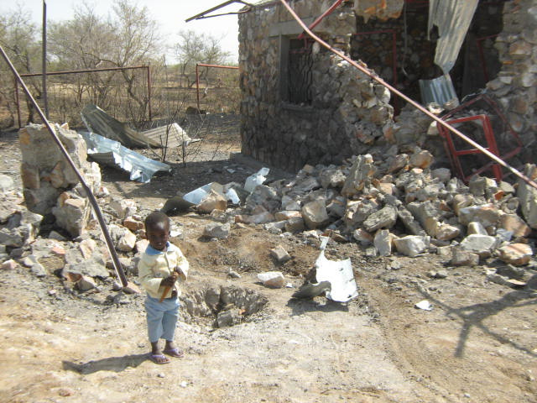
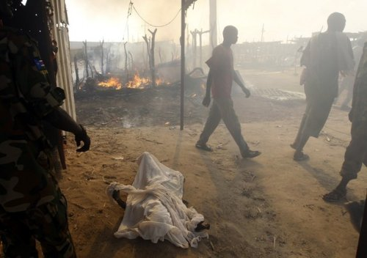
South Kordofan – Sudan – “the second genocide of the 21st century” - Chemical weapons now being used against civilians. Is it to be business as usual?
+ If a faith is worth dying for it might be worth living for.

Slide 15
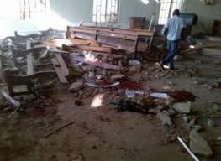
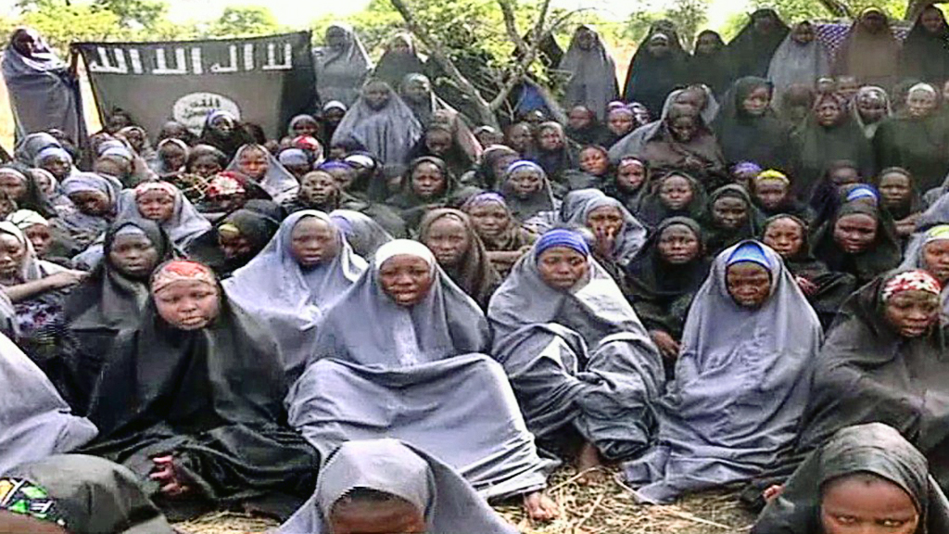
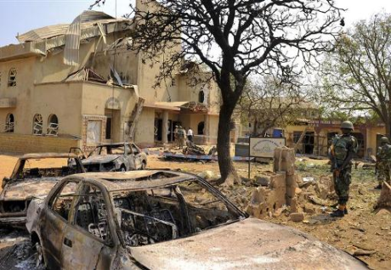
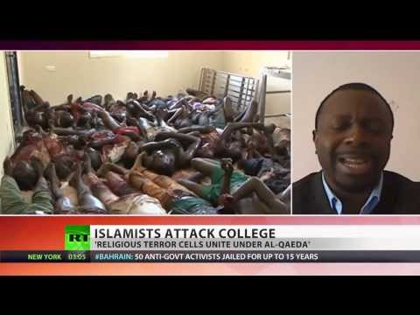
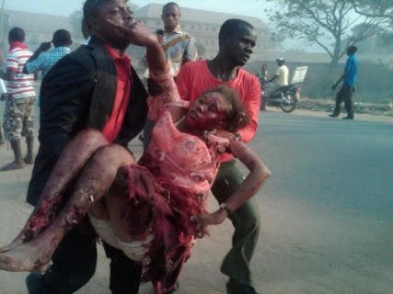
Nigeria: Boko Haram openly say their interim goal is "to eradicate Christians from certain parts of the country.“ There are endless killings.
+ If a faith is worth dying for it might be worth living for.

Slide 16
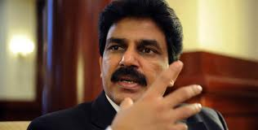
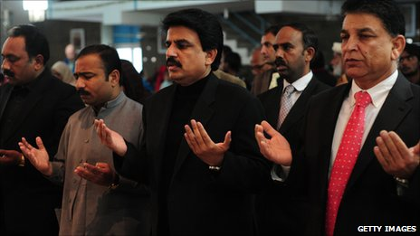
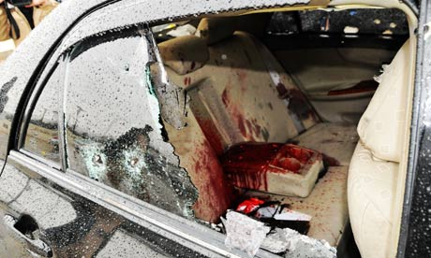
Pakistan 2011 - Shabaz Bhatti was murdered for challenging persecution of minorities and challenging the Blasphemy Laws.
Bhatti said “I want to share that I believe in Jesus Christ, who has given his own life for us. I know what is the meaning of the cross, and I am following the cross, and I am ready to die for a cause.”
+ If a faith is worth dying for it might be worth living for.

Slide 17
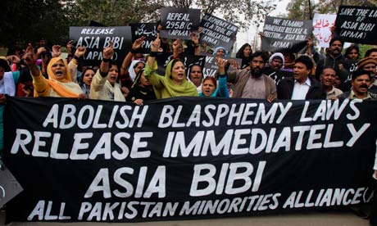
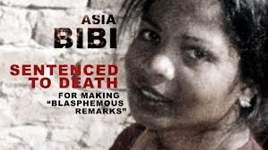
The Use of Blasphemy and Apostasy Laws To Persecute
One quarter of the world’s countries have blasphemy laws – and the more than one in 10 that have laws penalizing apostasy. Both laws are used to falsely accuse, intimidate, and persecute those who dare to hold beliefs that are different from the prescribed beliefs of the regime.
This leads, to a death sentence in cases like that of Pakistan’s Asia Bibi – imprisoned since 2009.
+ If a faith is worth dying for it might be worth living for.

Slide 18
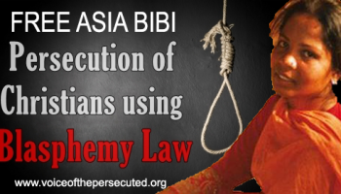
“I cried alone, putting my head in my hands. I can no longer bear the sight of people full of hatred, applauding the killing of a poor farm worker. I no longer see them, but I still hear them, the crowd who gave the judge a standing ovation, saying: "Kill her, kill her! Allahu Akbar!" The court house is invaded by a euphoric horde who break down the doors, chanting: "Vengeance for the holy prophet. Allah is great!" I was then thrown like an old rubbish sack into the van... I had lost all humanity in their eyes” – Asia Bibbi –mother of five (one of whom is significantly disabled).
"I believe in my religion and in Jesus Christ, who died on the cross for the sins of mankind.”
+ If a faith is worth dying for it might be worth living for.

Slide 19
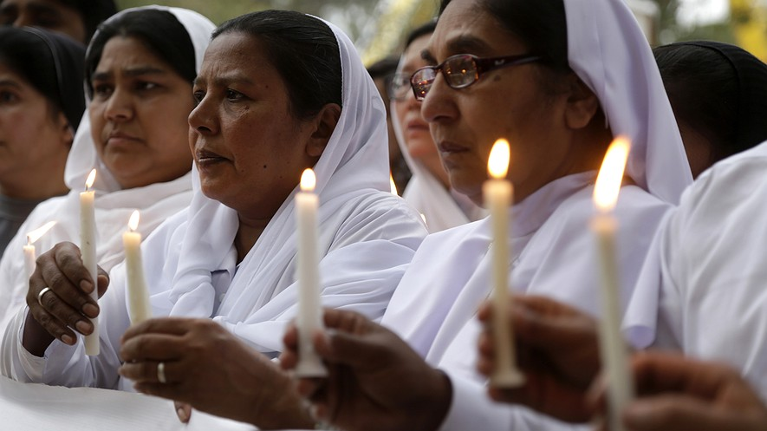
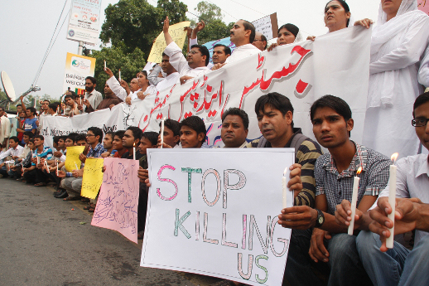
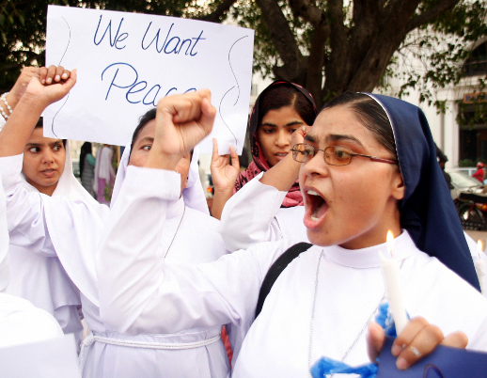
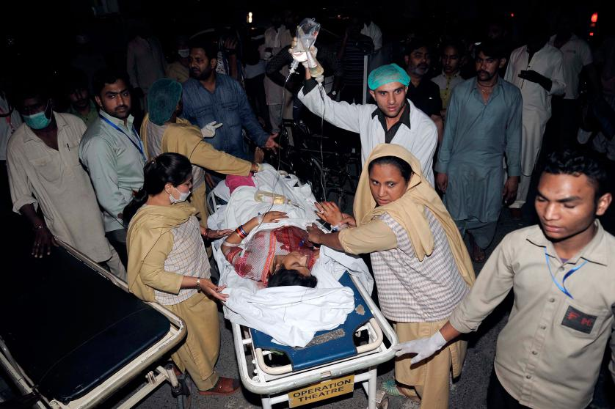
2016 - Easter in Lahore: More than 70 dead; 340 injured
+ If a faith is worth dying for it might be worth living for.

Slide 20
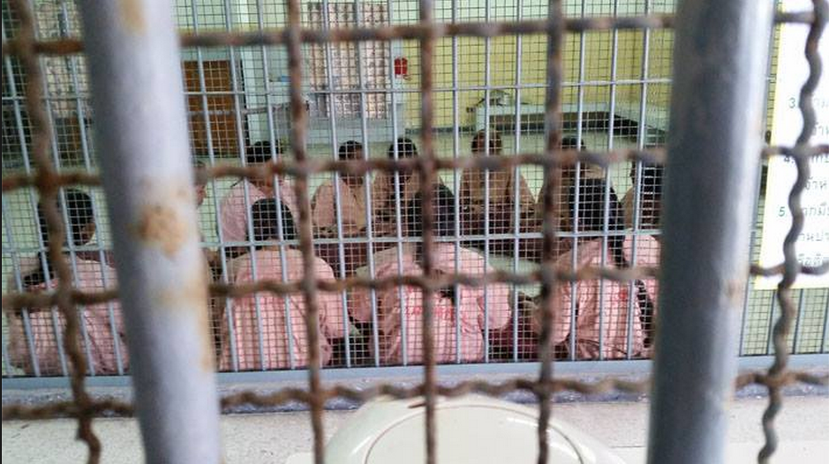
2016 - Pakistani Christians kept like caged animals in detention centres
+ If a faith is worth dying for it might be worth living for.

Slide 21

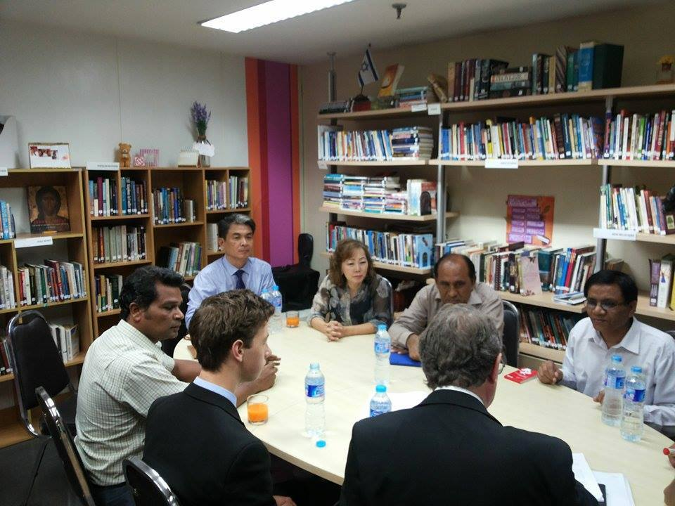
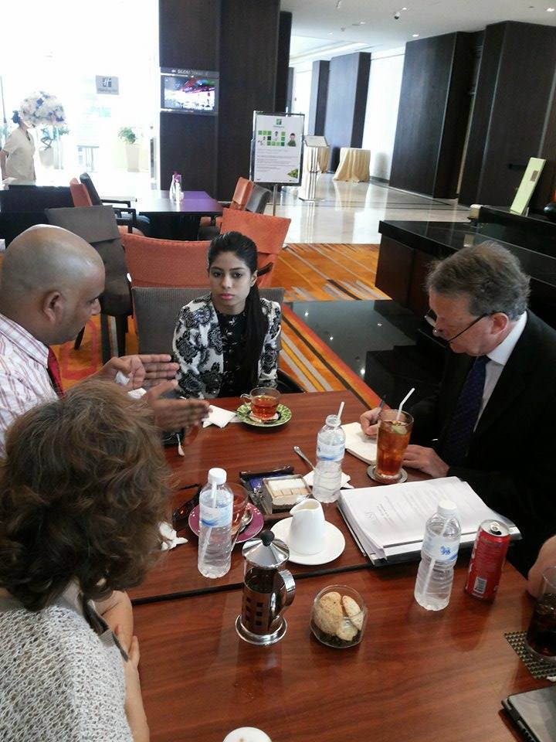
Taking evidence from persecuted Pakistani Christians who have escaped
+ If a faith is worth dying for it might be worth living for.

Slide 22
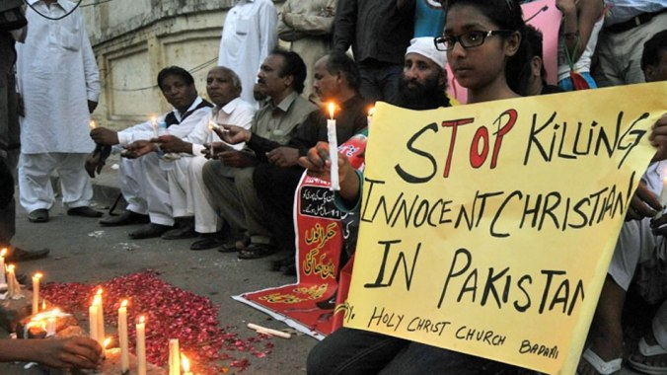

2016 Report launched in Parliament which catalogues the systematic campaign targeting Pakistan’s religious minorities
https://davidalton.net/2016/03/28/carnage-in-lahore-pakistan-and-uk-governments-failure-to-challenge-persecution-or-the-culture-of-impunity-links-to-previous-posts-about-pakistans-christians-shahbaz-bhatti-asia-bibbi-and-the/
+ If a faith is worth dying for it might be worth living for.

Slide 23


Muhammad Ali Jinnah
-“You may belong to any religion, caste or creed—that has nothing to do with the business of the State…Minorities, to whichever community they may belong, will be safeguarded. Their religion, faith or belief will be secure. There will be no interference of any kind with their freedom of worship. They will have their protection with regard to their religion, faith, their life and their culture. They will be, in all respects, the citizens of Pakistan without any distinction of caste and creed” – the white in the flag represents different religious faiths and minorities.

Slide 24

More than £1 billion of British aid, given over the past two years to Pakistan: “it’s not persecution” – British Government

Slide 25


2016 - The urgency of addressing the incessant hatemongering and export of radical Islamist ideology was starkly underlined by the execution of the 84-year-old French priest Fr. Jacques Hamel and by the murder of the Glasgow shopkeeper, Asad Shah – who had wished his customers a Happy Easter.
+ If a faith is worth dying for it might be worth living for.

Slide 26


Iran
– where there were almost 1000 executions last year, including the execution of Baha’is - and the imprisonment of Saeed Abedini, imprisoned for 10 years for “undermining national security” by hosting Christian gatherings in his home.
+ If a faith is worth dying for it might be worth living for.

Slide 27


China
Religious persecution has led to Chinese Catholics like the late Bishop Cosmas Shi Enxiang, who died last year at 94 years of age, having spent to spend half his life in prison; to Chinese Protestants, since the beginning of 2016, seeing 49 of their churches defaced or destroyed, crosses removed and a pastor’s wife crushed to death in the rubble as she pleaded with the authorities to desist.
+ If a faith is worth dying for it might be worth living for.

Slide 28


China
1500 churches in Zhejiang province have had their crosses removed – some demolished. Since July 280 rights lawyers, like Zhang Kai, have been arrested. Bishop Ma under house arrest since 2012
+ If a faith is worth dying for it might be worth living for.

Slide 29


North Korea
+ If a faith is worth dying for it might be worth living for.

Slide 30


200,000 people are incarcerated:
“there is almost a complete denial of the right to freedom of thought, conscience and religion”; “Severe punishments are inflicted on people caught practising Christianity”.
“the State considers the spread of Christianity a particularly serious threat.”
+ If a faith is worth dying for it might be worth living for.

Slide 31
In paragraphs 26-31 the COI state: “there is almost a complete denial of the right to freedom of thought, conscience and religion”; that religious faith has been supplanted by a cult of “absolute obedience to the Supreme Leader” and “the State considers the spread of Christianity a particularly serious threat.”
+ If a faith is worth dying for it might be worth living for.

Slide 32


Jeon Young-Ok:
“They tortured the Christians the most.
They were denied food and sleep.
They were forced to stick out their tongues
and iron was pushed into it."
"The guards told us that we are not human beings, we are just prisoners…the dignity of human life counted for nothing. " Hea Woo
+ If a faith is worth dying for it might be worth living for.

Slide 33

Religious Persecution Is In Violation of the 1948 UDHR, Ruins Lives, Destroys Countries and is a Key Driver for Forced Migration.
Throughout the world people are being persecuted because of their Faith. The young, the old, women and children, priests, Sisters and religious leaders are victims of kidnap , torture and death.
+ If a faith is worth dying for it might be worth living for.

Slide 34


Like the canary in the mine, early indications of abuses of freedom or religion or belief are a harbinger of far worse that will come.

Slide 35



Slide 36


Article 18 remains one of the most important but overlooked of the 30 articles that comprise the 1948 Universal Declaration of Human Rights. The declaration’s stated objective was to realise, “a common standard of achievement for all peoples and all nations”.

Slide 37

“Religious freedom cannot just mean freedom for some…it must be freedom of all religious people”.
She rejoiced in having friends from all faiths and all races.
“ an international
Magna Carta for all mankind”

Slide 38


The Genocide Convention was the culmination of years of campaigning by the Jewish lawyer, Raphael Lemkin. It recognised that “international co-operation” was needed, “to liberate mankind from such an odious scourge”.

Slide 39


Lemkin studied the 1915 genocide of Armenian Christians and the massacre of Assyrian Christians at Simele, in Iraq, in 1933.
+ If a faith is worth dying for it might be worth living for.

Slide 40

In 1933 Franz Werfel published, The Forty Days of Musa Dagh, a novel based on a true story about the Armenian genocide. His books were burnt by the Nazis.
A convert to Catholicism he later wrote “The Song of Bernadette.”

Slide 41


Article 18 and the Genocide Convention emerged from the infamies of the 20th century
…..from the Armenian genocide to the defining depredations of Stalin’s gulags and Hitler’s concentration camps; from the pestilential nature of persecution, demonisation, scapegoating and hateful prejudice; and, notwithstanding violence associated with religion, it emerged from ideology, nation and race.

Slide 42
Hitler famously asked, “Who now remembers the Armenians?” The Armenian deportations and genocide claimed the lives of an estimated 1.5 million Armenian Christians.
+ If a faith is worth dying for it might be worth living for.

Slide 43



The bloodiest century in human history with the loss of 100 million lives. The Dead Were Measured In Their Millions

Slide 44


When, in 1948, the 30 articles of the UDHR were adopted by the General Assembly, the eight abstentions included the Soviet Union and Saudi Arabia – the latter argued that there was a conflict with Sharia Law
Simultaneously the international community adopted the Genocide Convention

Slide 45


Genocide: “never again” all over again

Slide 46




The four great murderers of the 20th century—Mao, Stalin, Hitler and Pol Pot—were united by their hatred of religious faith.
+ If a faith is worth dying for it might be worth living for.

Slide 47
So What Might We Do?
Show Solidarity
Speak Out
Promote Dialogue and Reconciliation
Evangelise - Let the blood of martyrs be the seed of the church.
‘Christianity has died many times and risen again; for it had a God who knew the way out of the grave’ G.K.Chesterton - The Everlasting Man
+ If a faith is worth dying for it might be worth living for.

Slide 48

“Silence in the face of evil is itself evil…not to speak is to speak. Not to act is to act.” Dietrich Bonhoeffer
+ If a faith is worth dying for it might be worth living for.

Slide 49

Some Things We Might Do
Red Wednesday – Wednesday November 23rd was a moment to focus on the dramatic increase in religious persecution worldwide which has occurred in the past six years. 5.3 billion people (76 per cent of the world’s population) live in countries with a high or very high level of restrictions on religion.
From Bangladesh, where atheists are murdered with impunity to Saudi Arabia where churches are banned and converts are criminalised, to Burma, where Muslim Rohingya are denied citizenship, to Iran where Baha'is are executed, to China, where bishops are imprisoned and churches demolished, to countries like Syria, Iraq, Nigeria, Pakistan, Sudan and North Korea, where believers are subjected to genocide, crimes against humanity, persecution or discrimination, lives are literally soaked in blood. Red Wednesday was a chance to show solidarity and to demonstrate that their suffering is not forgotten; a chance for people of all faiths and none to shine a light on global suffering.
+ If a faith is worth dying for it might be worth living for.

Slide 50


November 23rd 2016 Was Designated Red Wednesday
+ If a faith is worth dying for it might be worth living for.

Slide 51

“Religious freedom is a daily stark choice between life and death” HRH Prince Charles, Christmas 2016
+ If a faith is worth dying for it might be worth living for.

Slide 52



Justin Welby ن ‏@JustinWelby 10h10 hours ago
+ If a faith is worth dying for it might be worth living for.

Slide 53



+ If a faith is worth dying for it might be worth living for.

Slide 54



+ If a faith is worth dying for it might be worth living for.

Slide 55

+ If a faith is worth dying for it might be worth living for.

Slide 56

Some Things We Might Do
Perhaps we need a new Convention on Religious Freedom to sit alongside the Convention on Genocide – but if we promote such Conventions let’s dedicate ourselves to upholding and enforcing them too – and with universal application – making sure that words like genocide, persecution and discrimination are matched by deeds and are reflected in the way we do business with; sell arms to; or provide aid programmes to those who violate Article 18.
+ If a faith is worth dying for it might be worth living for.

Slide 57
Some Things We Might Do
Article 18 is a foundational human right—many would say the foundational right. While there should be no hierarchy of rights, and all rights are interdependent, without the freedom to choose, practise, share without coercion and change your beliefs, what freedom is there? We must promulgate freedom of religion or belief at every opportunity
+ If a faith is worth dying for it might be worth living for.

Slide 58
When the Government say this is “one of the Government’s key human rights priorities”, we need to provide resources which are commensurate with the scale of the challenge – certainly more than one full time FCO desk officer.
Compare the £34 billion spent on military operations since the Cold War with the paltry resources deployed in promoting Article 18.

Slide 59



Some Things We Might Do
The next generation are being reached via the internet and smartphones
We urgently need a persuasive new narrative capable of forestalling the unceasing incitements to hatred which pour forth from the internet
+ If a faith is worth dying for it might be worth living for.

Slide 60

Some Things We Might Do
The Facebook for the Bible page has 4.5 million followers while the God Wants You To Know app has 2 million active users each month.
+ If a faith is worth dying for it might be worth living for.

Slide 61


Learn Each other's Stories and Speak Up For Others Who suffer For their Beliefs
Some Things We Might Do
+ If a faith is worth dying for it might be worth living for.

Slide 62



Jonathan (Lord) Sacks, in his brilliant critique, Not in God’s Name: Confronting Religious Violence, provides some valuable insights into the shared stories of the Abrahamic faiths – including the story of Ismael and displacement
“The great faiths provide meaning and purpose for their adherents. The question is: can they make space for those who are not its adherents, who sing a different song, hear a different music, tell a different story?”. -The Dignity of Difference
+ If a faith is worth dying for it might be worth living for.

Slide 63



Dignitatis Humanae
“Let them form men who will be lovers of true freedom – men who will come to decisions through their own judgement and who…will govern their activities with a sense of responsibility…Religious freedom ought to have this further purpose and aim, namely that men may come to act with greater responsibility in fulfilling their duties in community life.”
Societies which deny such freedoms are invariably unhappy societies. Research shows a direct link between economic prosperity and religious freedom.

Slide 64

Lyse was right when she said: If you don’t understand religion —including the abuse of religion — you won’t understand what is happening in our world.
+ If a faith is worth dying for it might be worth living for.

Slide 65


Where Theodore House and the Christian Heritage Centre Come In – a place where you can “understand religion” and deepen your faith.
Theodore of Tarsus (602 – 19 September 690) was 8th Archbishop of Canterbury from 668 to 690, best known for his reform of the English Church and establishment of a school in Canterbury - sent to England by Pope St.Pope St.Vitalian
Some Things We Might Do
+ If a faith is worth dying for it might be worth living for.

Slide 66

Theodore House– Phase Three
Phase 3 will cost over £4 million
Phase 3 will provide over 30 units of accommodation, lecture facilities, and break out rooms. Visitors will be able to deepen their experience of the Collections or spend time on Retreat – using the beautiful countryside to step outside of daily life, to reflect, to find solace and ultimately to discern their own beliefs more truly. We intend to develop the Tolkien Trail; and a Hopkins Trail along with the “College to the Castle” rural walk.
+ If a faith is worth dying for it might be worth living for.

Slide 67


+ If a faith is worth dying for it might be worth living for.

Slide 68

The Theodore Trust
+ If a faith is worth dying for it might be worth living for.

Slide 69

+ If a faith is worth dying for it might be worth living for.

Slide 70

+ If a faith is worth dying for it might be worth living for.

Slide 71
Other Funds: The Bowland Charitable Trust
£300,000 From: Tony Cann
Sent: 12 January 2016 09:06
To: ALTON OF LIVERPOOL, Lord
Subject: Our meeting and more
I enjoyed our meeting and support your idea of what I would call St Deniols of the north.
If you proceed we (Bowland Charitable Trust) will donate at least £300,000 and this could be more as plans and directions unfold.

Slide 72
Other Funds:
£100,000 – anonymous donation towards the Theodore House Chapel
£200,000 Ben Kim
£10,000 – family of Fr.Nick King SJ for a named room
£13,6000 (Mark Thompson, John Stiller and Charles Wilson) – towards the cost of the Peter and Bridget Hardwick Library
$60,000 – Leonard Leo – Catholic American Charity
£200,000 Knight of Columbus

Slide 73



The Stations of the North
+ If a faith is worth dying for it might be worth living for.

Slide 74
Stations of the North:
1.Making a Choice
2.Betrayal
3.Blasphemy
4.Denial
5.Judgement
6.King
7.Humility
8. Solidarity
9. Desolation and Consolation
10. Trust and Obedience
11.Promise
12.Tenderness
13.It is Finished
14.Patience
15.Walk With Me
A Pilgrim Way : The way to Stonyhurst has been a well trodden path for many centuries and it is still a remarkable destination, that will be enriched through the hospitality offered to those that attend the retreat and study centre. The stations of the cross trail should add to this call to pilgrims across the world and capture the vision ‘THE WORLD IS OUR HOUSE’.
+ If a faith is worth dying for it might be worth living for.

Slide 75


Slide 76



The Stations of the North
+ If a faith is worth dying for it might be worth living for.

Slide 77

A Tolkien Trail and a Hopkins Trail
The Windhover - To Christ Our Lord
I caught this morning morning's minion, king-dom
of daylight's dauphin, dapple-dawn-drawn Falcon, in his riding
Of the rolling level underneath him steady air, and striding
High there, how he rung upon the rein of a wimpling wing
In his ecstasy! then off, off forth on swing,
As a skate's heel sweeps smooth on a bow-bend: the hurl and gliding
Rebuffed the big wind. My heart in hiding
Stirred for a bird, – the achieve of, the mastery of Brute beauty and valour and act, oh, air, pride, plume, here
Buckle! AND the fire that breaks from thee then, a billion times told lovelier, more dangerous, O my chevalier!
No wonder of it: shéer plód makes plough down sillion
Shine, and blue-bleak embers, ah my dear,
Fall, gall themselves, and gash gold-vermilion.
+ If a faith is worth dying for it might be worth living for.

Slide 78
The Christian Heritage Centre
at Stonyhurst
Using Objects to tell a story: the 4 phases of the CHC
- home to the oldest surviving museum collection in the English-speaking world
THE WORLD IS OUR HOUSE
+ If a faith is worth dying for it might be worth living for.

Slide 79














Some of Our Patrons
Royal patrons: Lord and Lady Nicholas
Windsor, Albert and Leopold

Slide 80









Our Trustees
The Trust
The Christian Heritage Centre at Stonyhurst is a fully
independent registered Charitable Trust established to raise £10 million to:
•• House and care for the unique Collections and to
make them accessible to as wide an audience as possible – with the development of a Study Centre and an international Visitors Centre;
•• Facilitate an educational programme for people of all
ages and cultures, promoting dialogue, tolerance, and mutual respect at a time when the world is witnessing a tragic resurgence of religious conflict – using the Collections to reflect more deeply on questions of faith, persecution and tolerance.
Mrs.Jan Graffius – our Curator – and Professor Peter Davidson – our Academic Advisor.
+ If a faith is worth dying for it might be worth living for.

Slide 81


Phase One
Thanks to the Society of Jesus St Peter’s – built in 1835 – was restored at a cost of over £1 million. It is a small version of
King's College Chapel at Cambridge. One of the first churches to be built after
Emancipation in 1829, it is an important example of church architecture in the Gothic Revival Perpendicular style.

Slide 82
Phase Two
Phase 2 includes the restoration of various historic
Libraries and the chapel museum – Arundell Library, the Square Library, the Bay Library, Old Chapel Museum – housing 50,000 books and artefacts

Slide 83
E.L.Wiegand Foundation: Phase Two, the Old Chapel Museum and Historic Libraries
Dear Lord Alton,
I am pleased to announce that the Board of Trustees of the E. L. Wiegand Foundation has approved Grant Number 2420 in the amount of $210,000.00 USD. Specifically, this grant supports the purchase of upright and desktop display cases with fibre-optic lighting, monitoring and conservation equipment, and digital photography program for The Christian Heritage Centre at Stonyhurst. Congratulations!
Currently, our office is preparing the Grant Agreement. As Chairman of the Board of Governors you will sign the Agreement. In addition, the President-Executive Director of the Centre will sign. Please provide the complete name and title of the primary administrator of the Centre and confirmation of your title relative to the Centre.
The Foundation will disburse the grant funds directly to the British Schools and Universities Foundation, Inc. with The Christian Heritage Centre specified as the beneficiary. We request that The Christian Heritage Centre at Stonyhurst and the British Schools and Universities Foundation, Inc. enter into an agreement that specifies the grant funds received by the British Schools and Universities Foundation, Inc., as agent for The Christian Heritage Centre at Stonyhurst, will be distributed within five days of receipt for the purposes specified in the Grant Agreement to be signed. This original document shall be sent to the Foundation office.
Thank you for your assistance and commitment to the preservation of Christian heritage.
Very truly yours,
Kristen A. Avansino
President & Executive Director
165 W. Liberty Street, Suite 200
Reno, Nevada 89501
(775) 333-0310 x.109 – office
(775) 333-0314 – fax

Slide 84

The Collections are the oldest surviving museum collection in the English-speaking world. Some objects remind us of the price paid for religious freedom and the cost of persecution
+ If a faith is worth dying for it might be worth living for.

Slide 85
The cultural significance of the Stonyhurst collection transcends national boundaries and is of common importance for present and future generations of many peoples and nations – underscoring the importance of mutual respect.
+ If a faith is worth dying for it might be worth living for.

Slide 86




Christian Heritage Centre Events and Exhibitions: the tale of Two Thomas’ s
Thomas Becket’s Fight For Conscience and Religious Freedom Commemorated at Westminster.
A Symposium on the relevance of Becket’s story, held at Lambeth, was sponsored by Christian Heritage Centre. The Archbishop of Canterbury, the Rt. Revd.Justin Welby, was the key note speaker.
+ If a faith is worth dying for it might be worth living for.

Slide 87






Receptions at Mr.Speaker’s House and
Westminster Abbey
+ If a faith is worth dying for it might be worth living for.

Slide 88




Slide 89


The Christian Heritage Centre at Stonyhurst deserves the support of everyone who values Christian truth.
– Paul Johnson, author of A History of the American People
+ If a faith is worth dying for it might be worth living for.

Slide 90

The Universe Features on the CHC
+ If a faith is worth dying for it might be worth living for.

Slide 91




Many visitors …but the collections remain largely inaccessible to the general public: Recent visitors included Cardinal Charles Bo of Burma and Carl Anderson the US Supreme Knight of the Knights of Columbus.
+ If a faith is worth dying for it might be worth living for.

Slide 92


Phase Four will be the development of a Christian heritage Centre Visitors centre - a major resource for Ribble Valley

Slide 93


Four Phases:
The final phase will cost in the region of £6 million. It is a chance to create an international visitors’ attraction; to tell the Catholic story; and a place to promote religious coexistence.
The Christian Heritage Centre
at Stonyhurst
THE WORLD IS OUR HOUSE
http://www.christianheritagecentre.com/

Slide 94

Theodore House: Work begins on the feast of St. Joseph the Worker at the beginning of Mary’s month. A Service of Blessing will follow “Music of A May Morning” at 8.00 am.
The Risen Christ from a 15th century Book of Devotions produced for the French Royal Family.
‘Christianity has died many times and risen again; for it had a God who knew the way out of the grave’ G.K.Chesterton - The Everlasting Man

Slide 95
Good Friday, April 14th 2017
Stonyhurst Retreat
As Others Die For Their Faith, How Can We Encourage British Christians To Live for Theirs?
www.davidalton.net

