Slide 1
.
A Faith Worth Dying For Might Be Worth Living For
“Laying Down Their Lives for their Faith”
Celebrate 2015
www.davidalton.net

Slide 2
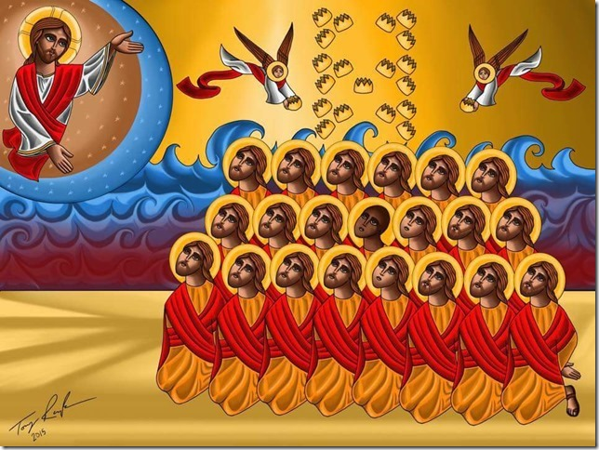
“in the moment of their barbaric execution”, some of the 21 Christians were repeating the words “Lord, Jesus Christ,” – February 2015

Slide 3
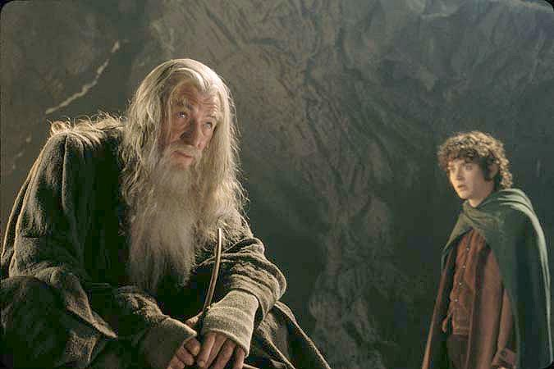
"I wish it need not have happened in my time," said Frodo. "So do I," said Gandalf, "and so do all who live to see such times. But that is not for them to decide. All we have to decide is what to do with the time that is given us."

Slide 4
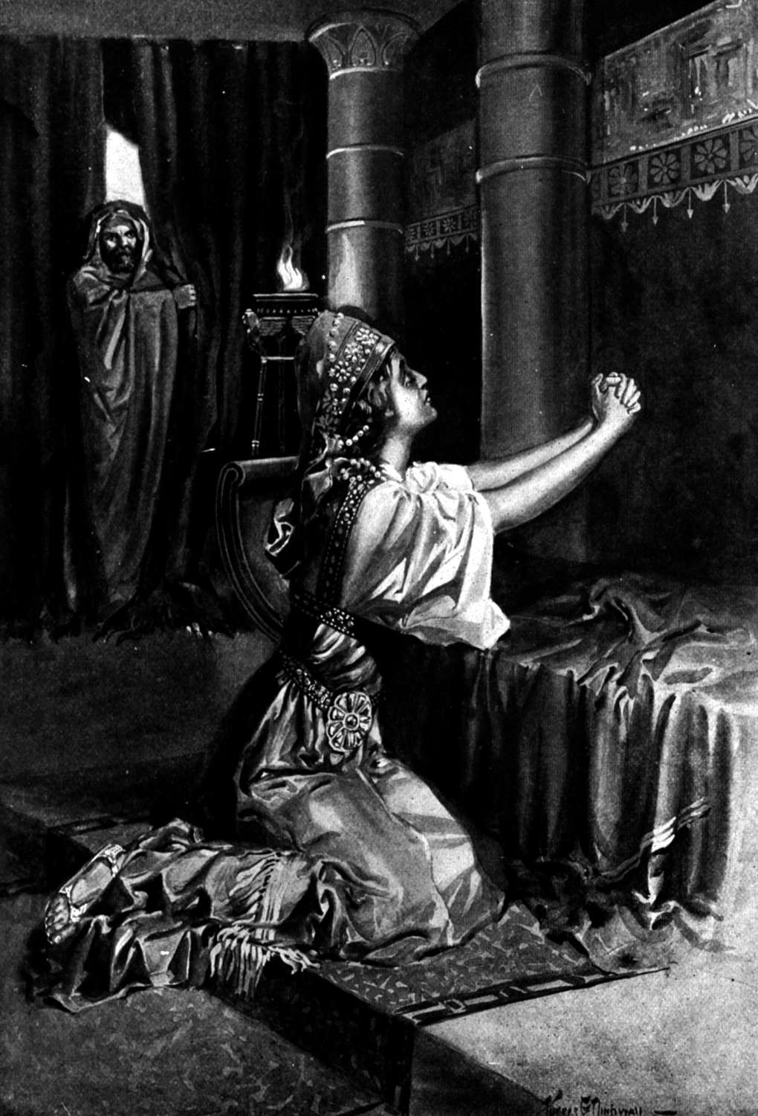
Esther fasts and prays: For Such A Time As This

Slide 5
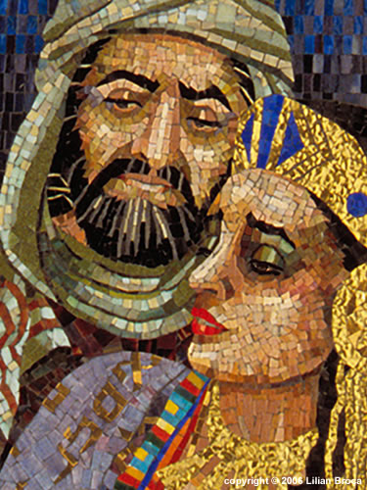
Mordecai dresses in sackcloth and as he fasts he puts himself in God’s hands. It is now that he says to Esther: “And who knows whether you have come to the kingdom for just such a time as this?”

Slide 6
Esther’s willingness to risk all – “If I perish, I perish” - turns history on its head. She begs the king and says: “how can I look on, while my people suffer what is in store for them? How can I bear to witness the extermination of my race?”
“

Slide 7
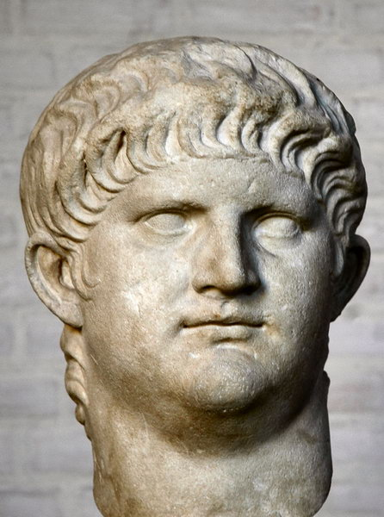
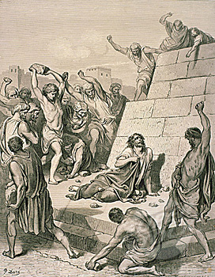
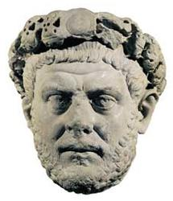
From the crucifixion of Christ Himself, to the stoning to death of Stephen; from the execution of Peter, Paul and the early disciples, to the deaths of maybe as many as 100,000 people at the hands of emperors such as Nero and Diocletian;

Slide 8
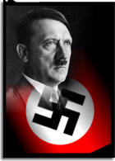
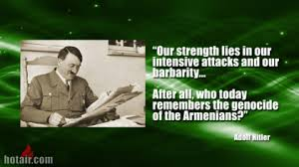
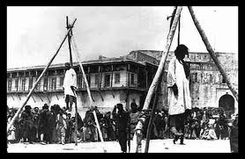
"who now remembers the Armenians?". Will our generation similarly ask the question "who now remembers the Christian minorities of the Middle East and North Africa, Pakistan or North Korea?" - Do not ask where was God at Auschwitz.

Slide 9
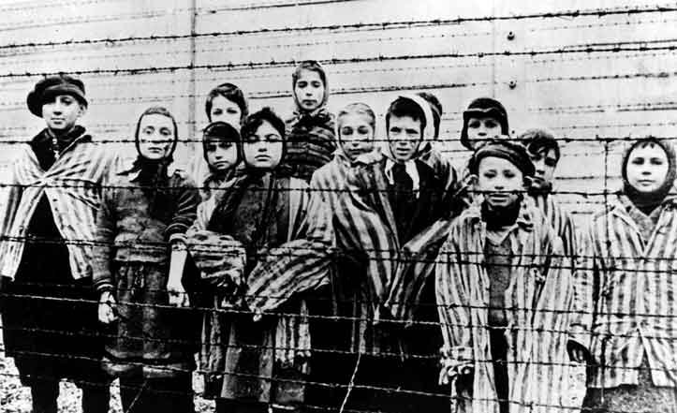
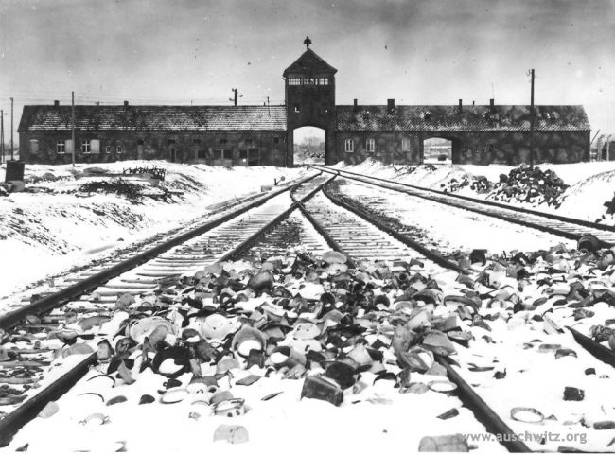
The 1948 Declaration on Human Rights was born in the in the criminality of twentieth century totalitarianism and the gas chambers of Bergen-Belsen and Auschwitz.

Slide 10
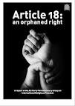
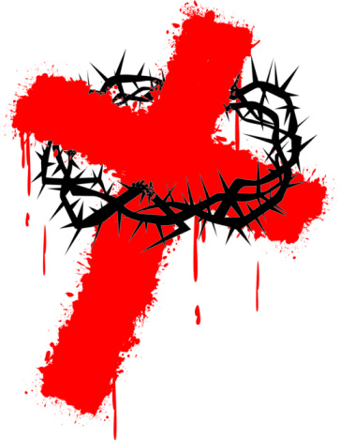
“Everyone has the right to freedom of thought, conscience and religion;
this right includes freedom to change his religion or belief, and freedom,
either alone or in community with others and in public or private,
to manifest his religion or belief in teaching, practice, worship and observance.”
Article 18 - An Orphaned Right

Slide 11
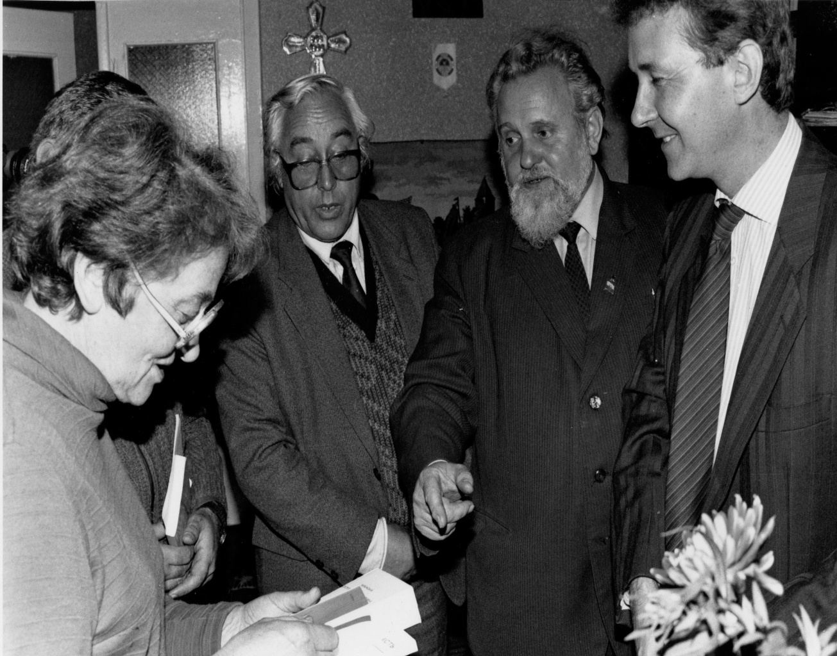
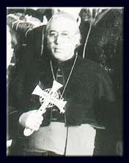
Ukraine: with Ivan Gel and Bishop Vasylyk – who between them spent more than 30 years in Soviet jails.

Slide 12
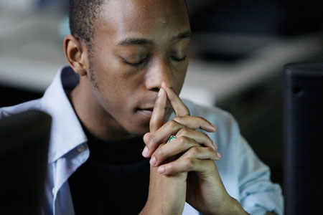
A poll showed that more than four out of five churchgoers
(84 per cent) think that religious freedoms,
of speech and action, are at risk in the UK. A similar proportion (82 per cent)
feel it is becoming more difficult to live as a Christian in an increasingly secular country.

Slide 13
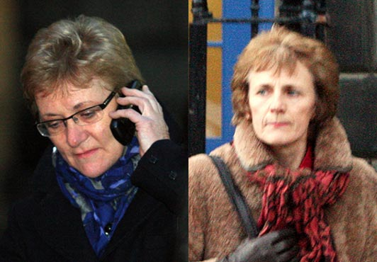
Scottish Catholic midwives ordered to take part in abortions

Slide 14
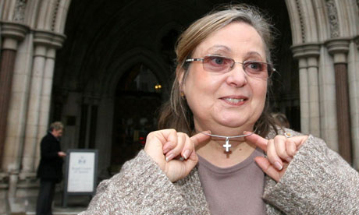
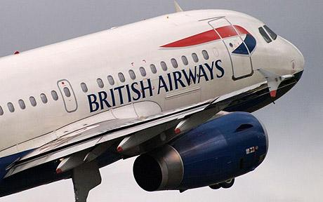
British Airways go to Court to stop Nadia Eweida from wearing a cross around her neck

Slide 15
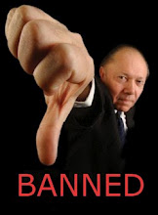
Yorkshire College removes Easter and Christmas from the calendar in case it offends people; Perth Hospital told to remove Communion Table; Bideford Council told to ban prayers.

Slide 16
Barely a day passes without reports of some new atrocity being committed against Christians. Christian girl gang raped in Pakistan; husband and wife burnt alive; Asia Bibbi sentenced to death; hundreds of girls kidnapped and sold into slavery by Boko Haram in Nigeria; men publically crucified and beheaded in Syria; Kenyans shot at point blank range. 21 Coptic Christians behaded.

Slide 17
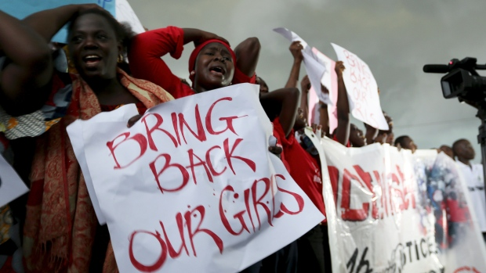
Nigerian Abductions

Slide 18
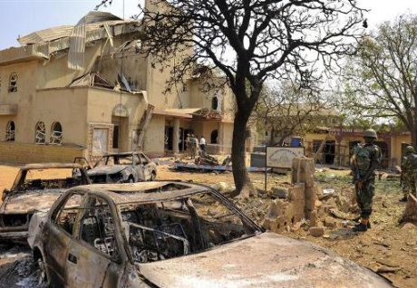
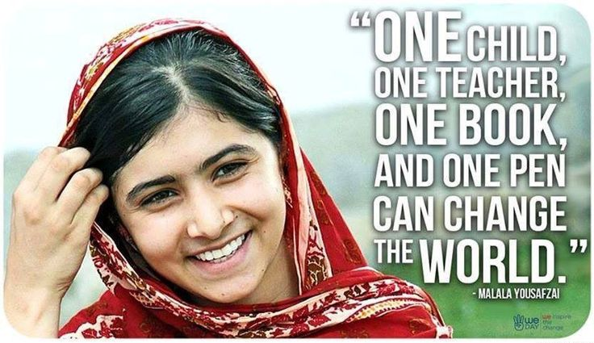
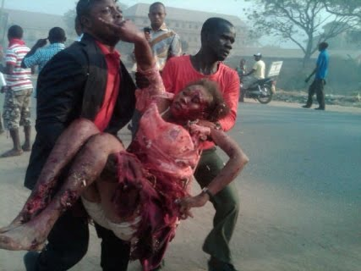
Nigeria: Boko Haram openly say their interim goal is "to eradicate Christians from certain parts of the country.“ 250 killed in 2012.

Slide 19
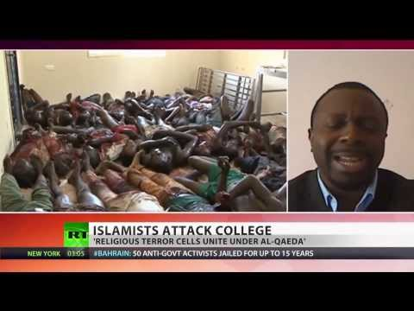
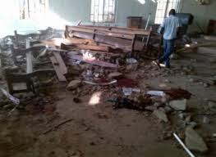
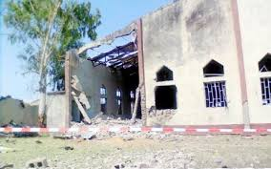

Slide 20
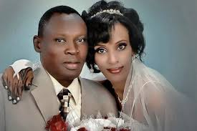
Meriam Ibrahim – sentenced to death and 100 lashes

Slide 21
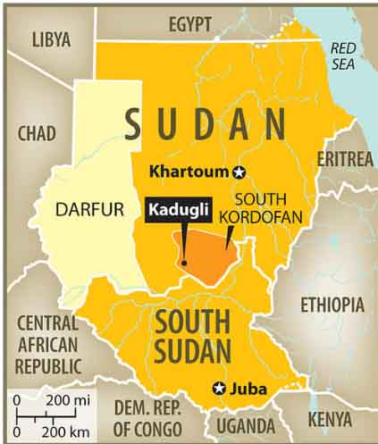
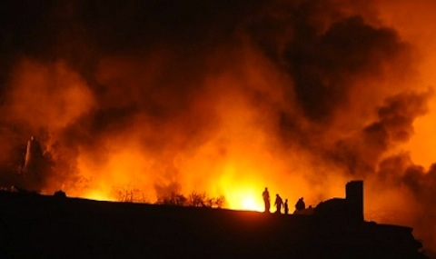
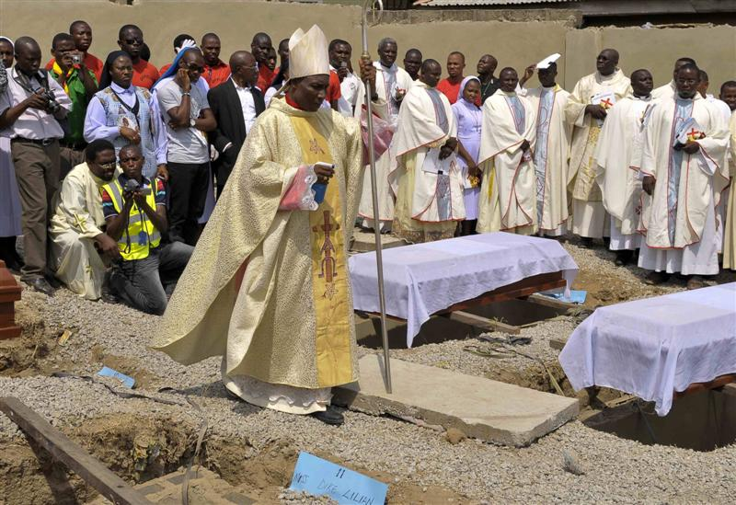
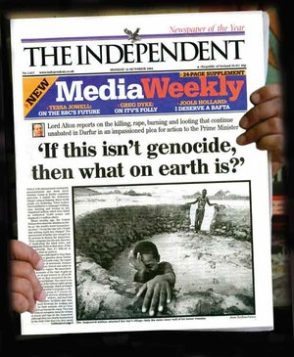

Slide 22
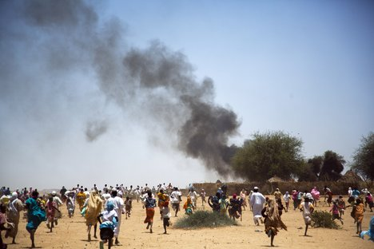
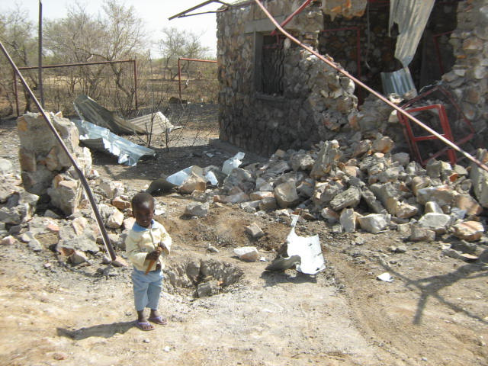
South Kordofan – Sudan – the second genocide of the 21st century.

Slide 23
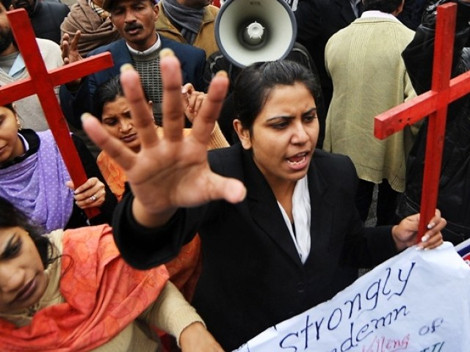
Pakistan: In a population of over 172 million people, only about 1.5% (3 million) is Christians -half Catholic, half Protestant.

Slide 24
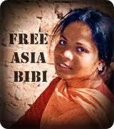
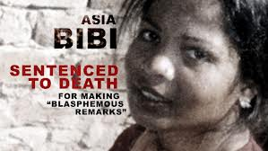
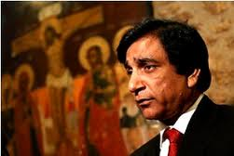
Bhatti’s last breaths were uttered in defence of Asia Bibi, the illiterate Christian mother of five, jailed in 1999, for alleged blasphemy against Islam, and sentenced to death.
Dr.Paul Bhatti’s work has led to death threats against him and he has now had to leave the country.

Slide 25
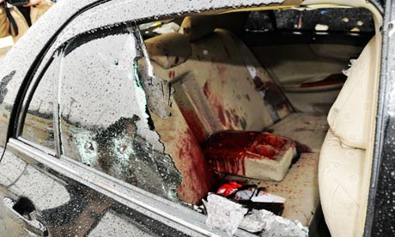
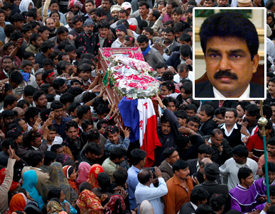
March 2nd marks the 4th anniversary of the assassination of Clement Shahbaz Bhatti in 2011, murdered in cold blood and in in broad daylight in Pakistan’s capital, and still no one has been brought to justice.

Slide 26
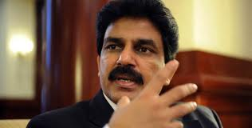
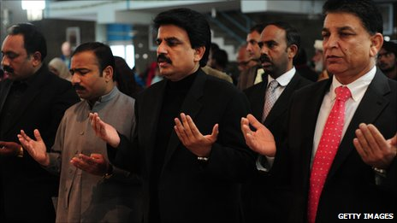
A Faith worth Dying For….Pakistan’s murdered Minister for Minorities: Shabaz Bhatti
Bhatti said “I want to share that I believe in Jesus Christ, who has given his own life for us. I know what is the meaning of the cross, and I am following the cross, and I am ready to die for a cause.”

Slide 27
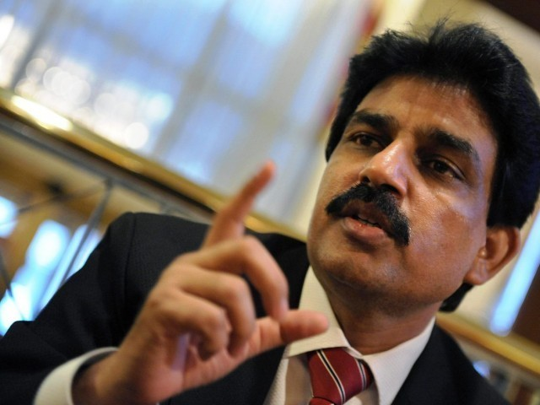
Shahbaz Bhatti said his stand would “send a message of hope to the people living a life of disappointment, disillusionment and despair” adding that his life was dedicated to “the oppressed, the down-trodden and the marginalised” and to “the struggle for human equality, social justice, religious freedom and the empowerment of religious minorities’ communities.”

Slide 28
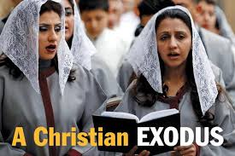
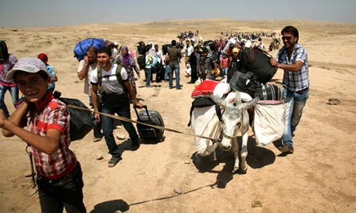
In Syria, Christians, some of whom fled from the persecution in neighbouring Iraq, have been caught in the unremitting cross fire and targeted by radical Islamist groups

Slide 29
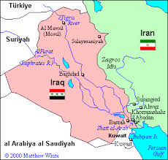
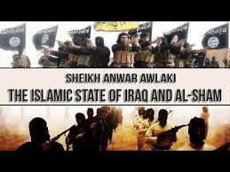
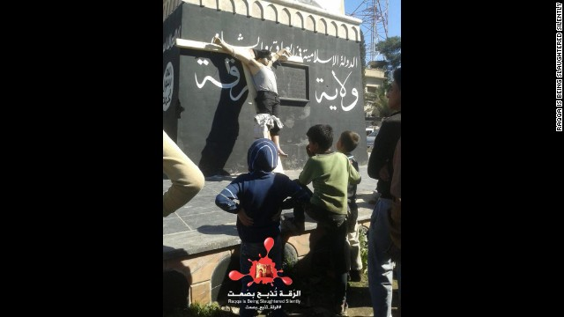

Slide 30
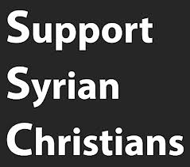

Slide 31
Aymenn al-Tamimi says: “In case ISIS’s ambitions to a global caliphate were still not apparent to anyone, ISIS’s official Twitter account for Raqqa province had this to say on the imposition of the dhimmi pact: ‘Today in Raqqa and tomorrow in Rome.’”

Slide 32
The spiritual meadow is today a battlefield. Before the war the Christians of Syria accounted for between 4.5% and 10% of the population.

Slide 33
In Homs, a Dutch priest, Father Van der Lugt, trapped in the old city, described how residents cut off for more than a year developed chronic mental health problems following the breakdown of social order. He said, “Our city has become a lawless jungle”. He was murdered in April.

Slide 34
The city of Homs, the third largest in Syria, has now seen almost its entire Christian population of 50,000 to 60,000 flee for safety as fighting continues in that stricken country. The number of Christians left in the city has reportedly fallen to below 1,000

Slide 35
IRAQ: 58 Christians were killed during evening mass at Our Lady of Perpetual Help, the Syrian Catholic cathedral in Baghdad: 1.4 million Christians reduced to 150,000.

Slide 36
More than 100,000 Copts left Egypt during one recent nine month period

Slide 37
Egypt’s Kristallnacht

Slide 38
"Churches in the Middle East are threatened in their very existence” – Pope Benedict

Slide 39
According to a Report by the Pew Centre between 2006 and 2010, Christians were harassed in 139 countries around the world.

Slide 40
Congressman Chris Smith (R-N.J.): Christians “remain the most persecuted religious group the world over.”
Chancellor, Angela Merkel, says that Christians are the most persecuted group in the world today.

Slide 42
Yoo Sang-joon: a Korean Raoul Wallenberg

Slide 43
Pope John Paul II described a community of Christians “unique in the history of the church"
St.Andrew Kim – the first Korean priest to be martyred. Around 10,000
Catholics died for their faith in Korea – and continue to do so: “The Korean Martyrs” by Msgr.Richard Rutt.

Slide 45
In a vivid account, recorded in “March Till They Die” by an Australian Columban priest, Fr.Philip Crosbie, seized in 1950, with an American bishop, along with nuns, Anglicans, Methodists and a Salvation Army Superintendent Patrick Byrne, described how they were put on starvation rations and force marched – some executed, some left to die.

Slide 46
In March Hea Woo gave a graphic and powerful account of her time inside a the camp - where torture and beatings are routine, and where prisoners were so hungry they were reduced to eating rats, snakes, or even searching for grains in cow dung. In such places the dignity of human life counted for nothing.

Slide 48
Jeon Young-Ok’s Evidence
Jeon Young-Ok: “They tortured the Christians the most.
They were denied food and sleep.
They were forced to stick out their tongues
and iron was pushed into it."

Slide 49
"Sometimes we had soup with nothing in it, just full of dirt. In some places whole families were put into camps. They separated the men from the women and even if they saw each other they couldn't talk to each other. The guards told us that we are not human beings, we are just prisoners, so we don't have any right to love. We were just animals. Even if people died there, they didn't let the family members outside know. "

Slide 50
If you were to bench-mark the findings of the recent United Nations Commission of Inquiry into the abuse of human rights in North Korea, against the thirty articles set out in the 1948 Universal Declaration of Human Rights, it would be difficult to find a single article which Kim Jong-un’s regime does not breach.

Slide 51
In paragraphs 26-31 the COI state: “there is almost a complete denial of the right to freedom of thought, conscience and religion”; that religious faith has been supplanted by a cult of “absolute obedience to the Supreme Leader” and “the State considers the spread of Christianity a particularly serious threat.”

Slide 52
“the gravity, scale and nature of these violations reveal a State that does not have any parallel in the contemporary world”. These “unspeakable atrocities” , include “extermination, murder, enslavement, torture, imprisonment, rape, forced abortions and other sexual violence, persecution on political, religious, racial and gender grounds, the forcible transfer of populations, the enforced disappearance of persons and the inhumane act of knowingly causing prolonged starvation” and warrant a referral to the International Criminal Court (ICC).

Slide 53
Beyond the show churches Judge Kirby says that “Christians are prohibited from practising their religion and are persecuted. People caught practising Christianity are subject to severe punishments in violation of the right to freedom of religion and the prohibition of religious discrimination”.

Slide 54
On my third visit to North Korea I was allowed to speak to the congregation at the Changchung Catholic church and met with members of the congregations at the other churches.

Slide 55
At Anju – 80 kilometres north of Pyongyang - believers have met in the rubble of their church for 50 years

Slide 56
Catholic Opposition Leader Kim Dae Jung – jailed for six years – becomes South Korea’s President and a Nobel Peace Prize laureate: at this time pray for Korea as it faces grave new dangers.

Slide 57
“If the police break into the cathedral, I will be in the very front.
Behind me, there will be reverends and nuns. After we are wrestled down, there will be students.”
Cardinal Stephen Kim”
(see: http://davidalton.net/2012/07/14/two-korean-kims-two-remarkable-and-brave-men/

Slide 58
If I was sitting in the rubble of a Syrian or Egyptian church, or in a gulag in North Korea, or had just seen my home destroyed or, even worse, my loved ones killed, I would think that our endless self absorbed debates, which often mirror the rights-driven agenda of the secular world, are self indulgence of a high order.

Slide 59
Get Involved: Take A Stand

Slide 60
Failure to take action….
We have been the silent witnesses of evil deeds.
What we shall need is not geniuses, or cynics, or misanthropes, or clever tacticians, but plain, honest, straightforward men.”

Slide 61
“In Germany they came first for the Communists and
I didn’t speak up because I wasn’t a communist. Then
they came for the Jews and I didn’t speak up because
I wasn’t a Jew. Then they came for the trades unionists
and I didn’t speak up because I wasn’t a trades unionist.
Then they came for the Catholics and I didn’t speak up
because I was a Protestant. Then they came for me –
and by that time no one was left to speak up for me.”
Pastor Martin Niemoller
Who will be left to speak for you?

Slide 62
.
A Faith Worth Dying For Might Be Worth Living For
“Laying down their lives for their Faith”
Celebrate 2015
www.davidalton.net

