Slide 1
A Battle of Beliefs - a matter of life and death
A Premier Lecture: Liverpool, 17th June 2016.
David Alton www.davidalton.net

Slide 2
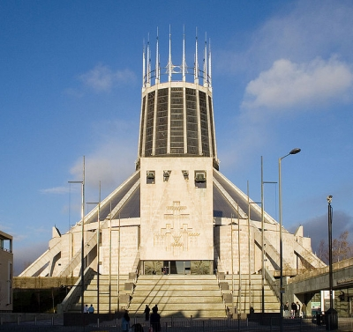
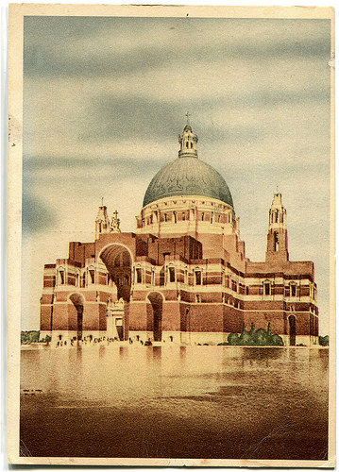
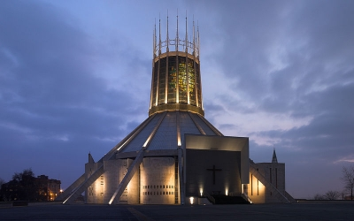
A Battle of Beliefs - a matter of life and death - A Premier Lecture: Liverpool, June 2016.
David Alton www.davidalton.net

Slide 3
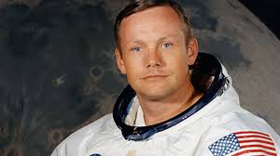
Neil Armstrong: “I am a Deist”
“I have to tell you, I am more excited stepping on these stones than when I was stepping on the moon” – at Temple Mount, Jerusalem, when he asked if Jesus would have walked here.

Slide 4
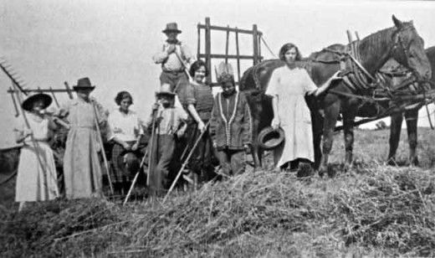
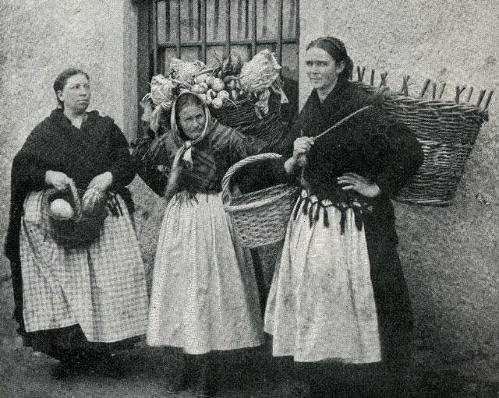
Pennies of the Poor

Slide 5
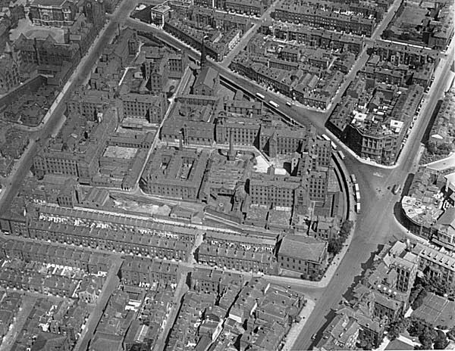
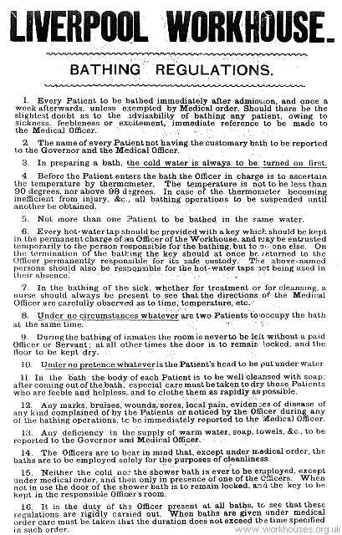
Built in 1769 and expanded in 1840s Liverpool’s Workhouse became one of the largest in the country with 3,000 inmates and at times as many as 5,000

Slide 6
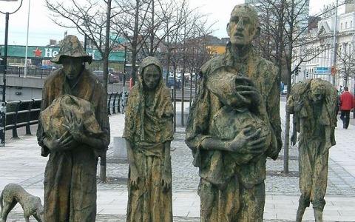
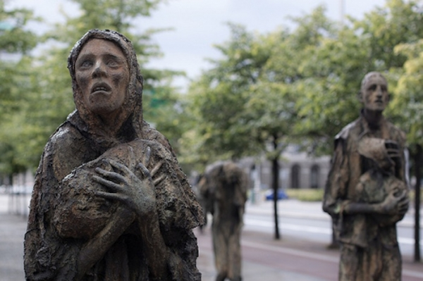
3 Million Irish Migrants Fled Famine 1 Million Died

Slide 7
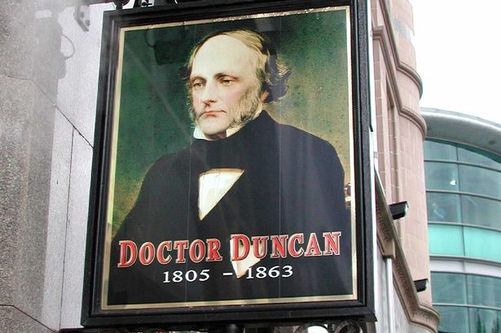
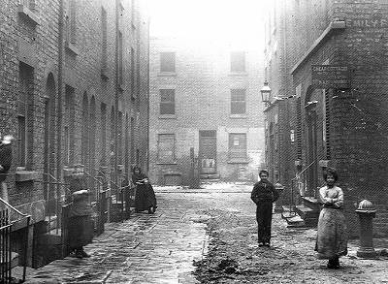
At the height of the famine, in 1847, no fewer than 1,280, mainly Irish, people died in Liverpool. There were 20,000 street children. Dr. Duncan, the City’s pioneering public health officer estimated that some 100,000 people were living in abject conditions

Slide 8
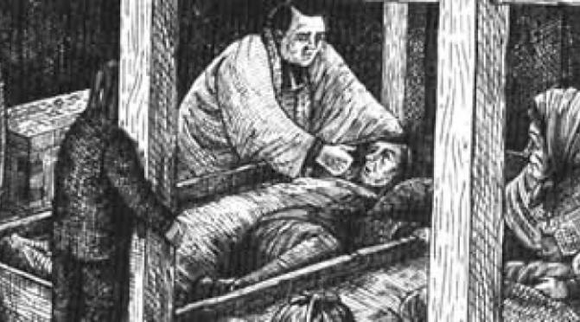
In the parish of St. Mary’s in one week there were 166 burials of Irish Catholics; 105 of them were children.

Slide 9
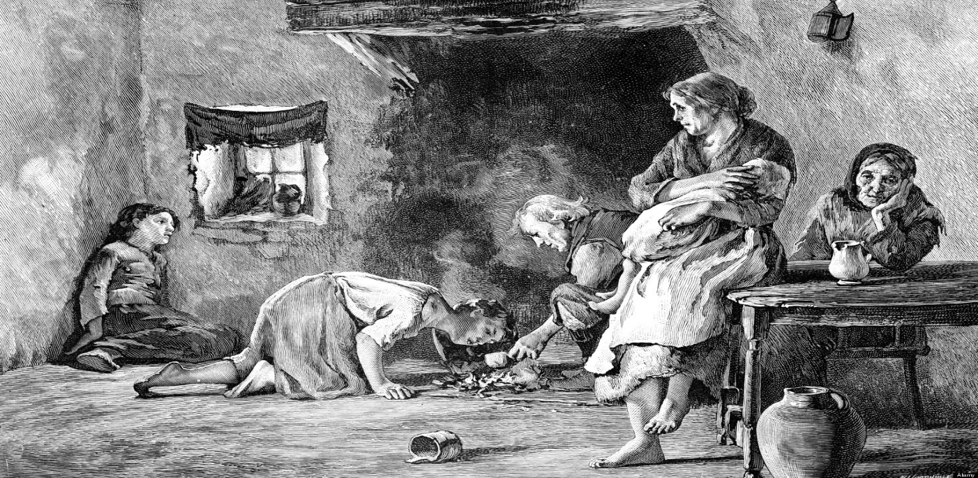
The death of Sarah Burns:
“The floor was composed of mud; in that hovel there were seventeen human beings crowded together without even so much as a bit of straw to lie down on” – Liverpool Coroner

Slide 10
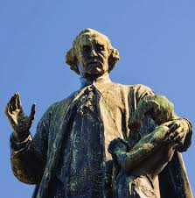
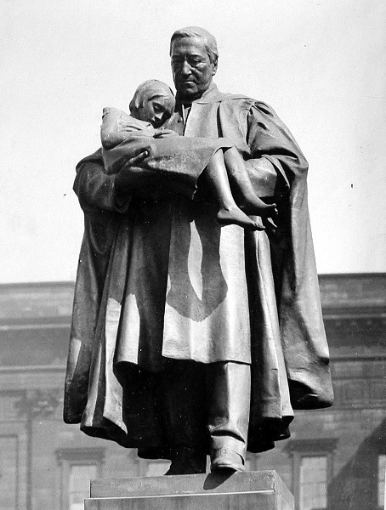
Men like the Canon James Nugent and Canon Major Lester worked together to rescue children from the streets of Liverpool

Slide 11
Fr.Nugent wrote: “Wherever you turned you saw crowds of dirty, shoeless, naked children. It would seem as if they were Nobody’s Children.”
He movingly noted that “the birds of the air have their resting places and the very dogs have their warm kennels, but these poor little ones huddle together under railway arches, in empty boxes, under theatre show boards, over bakers’ ovens – in fact anywhere to get a little heat and protection from the frosty and nipping night air.”

Slide 12
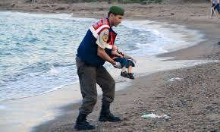
The question is not “where is God?” in all of this but “where are the people with power and resources who can put right this man-made suffering?”

Slide 13
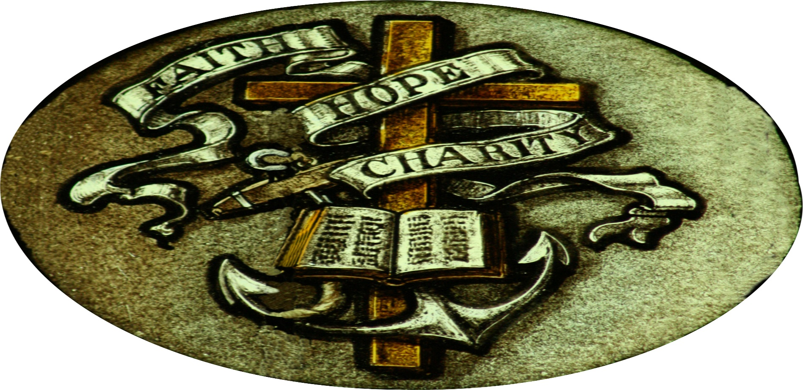
Faith, Hope and Charity - three timeless impulses for every society and every age.

Slide 14

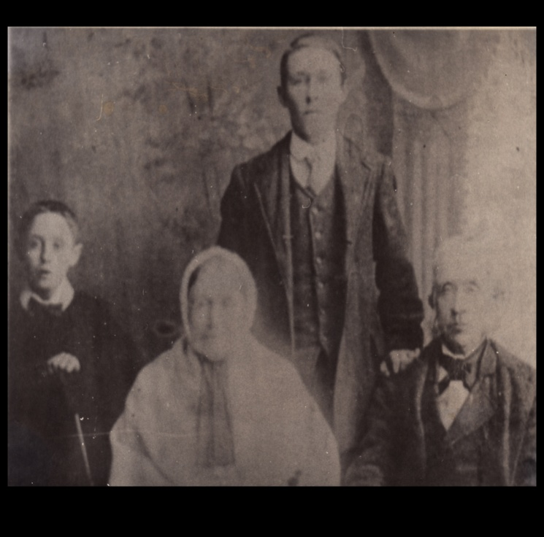
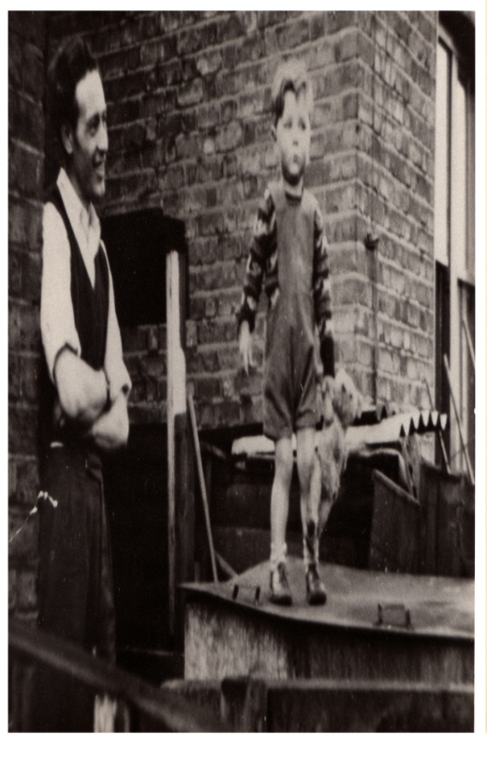
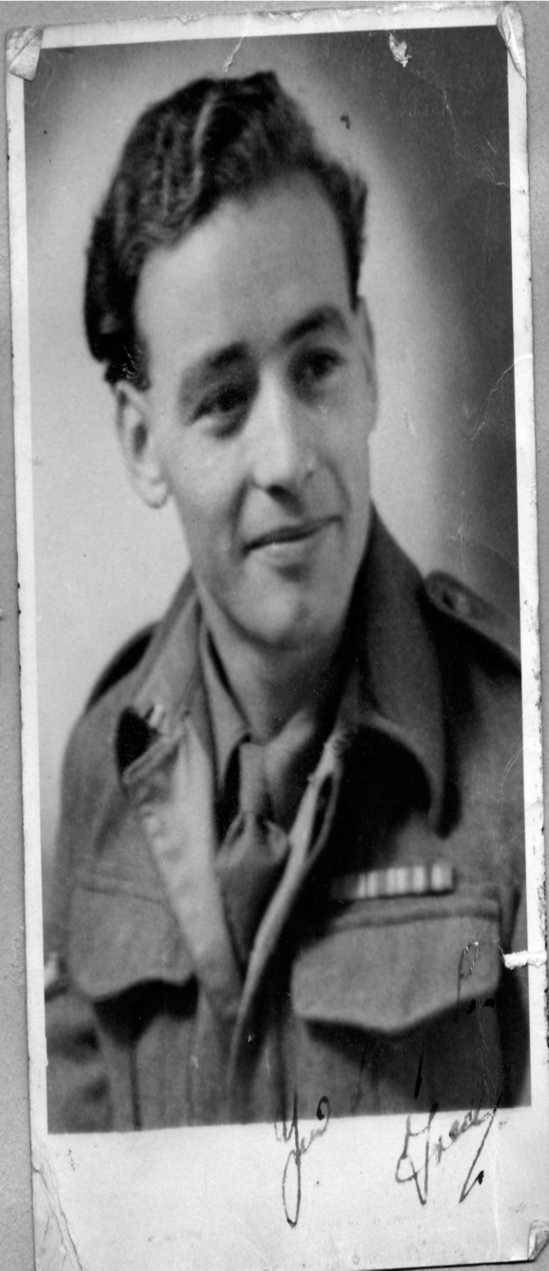
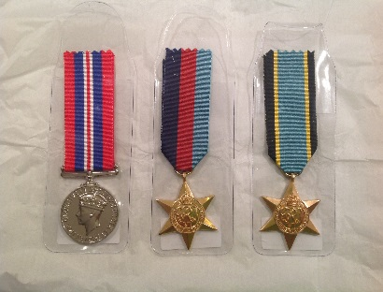
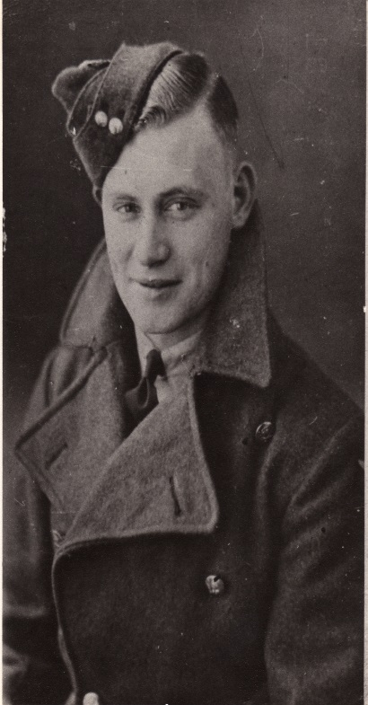
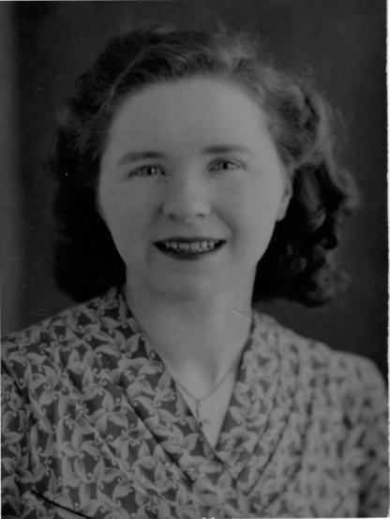
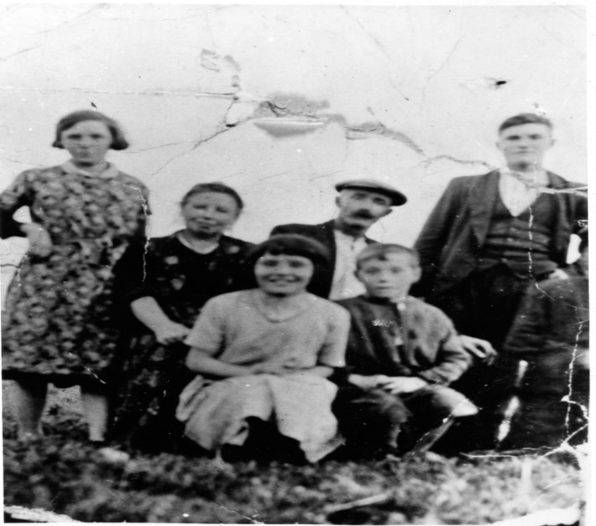

Slide 15
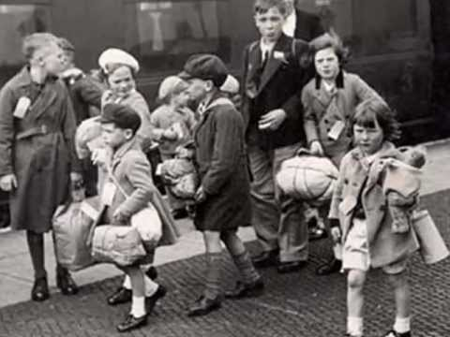
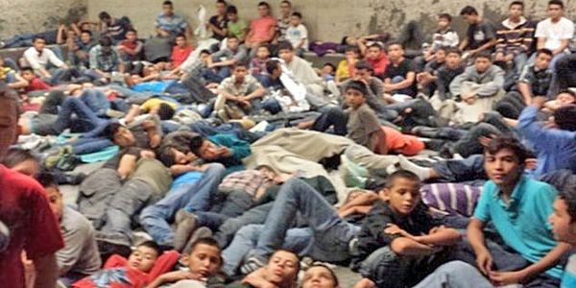
Last year, 25,000 unaccompanied children arrived in Europe and Europol say 10,000 have gone missing

Slide 16
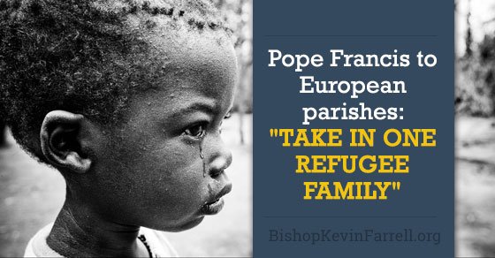
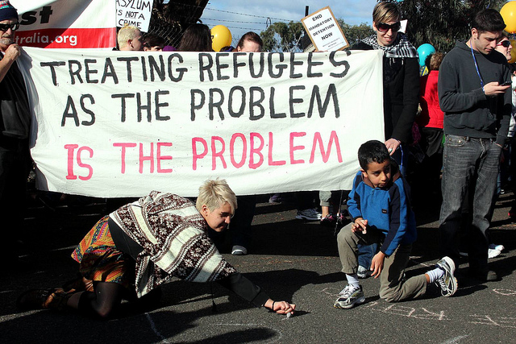
55 million people are refugees, asylum seekers or internally displaced persons, with a further 60 million forcibly displaced.

Slide 17
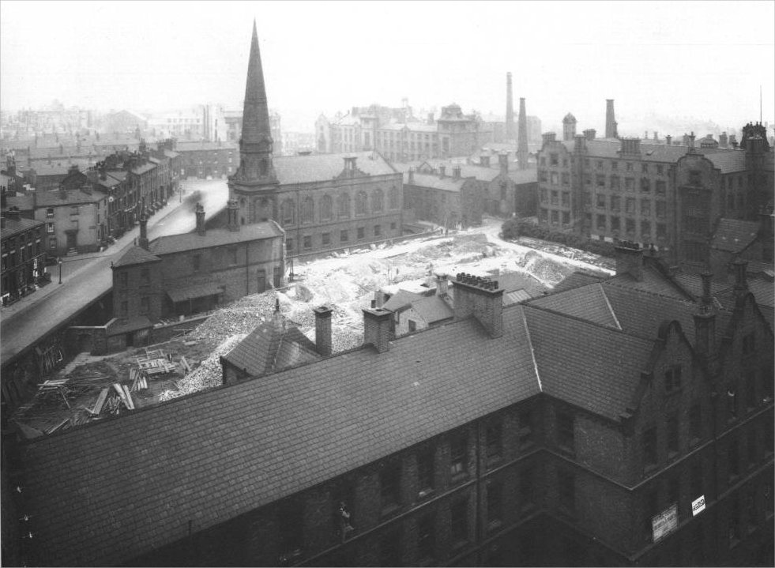
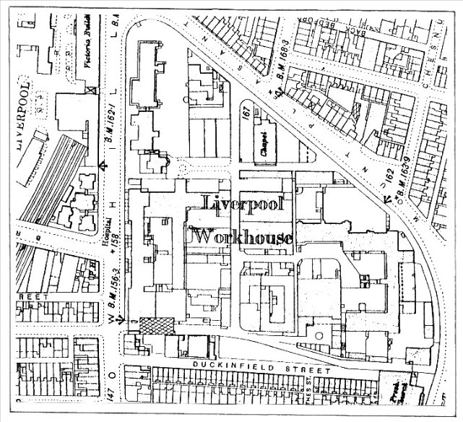
Excavating the foundations for the Metropolitan cathedral while in the throes of demolishing the Workhouse -1931-.

Slide 18
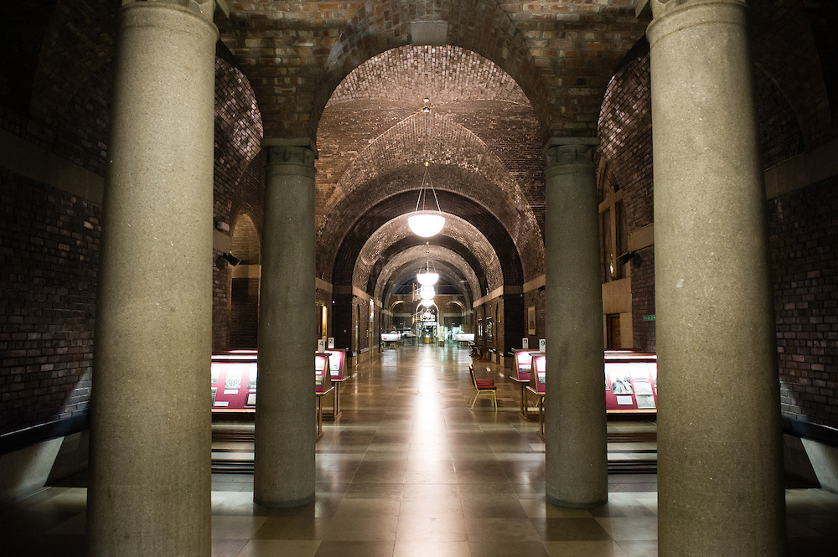
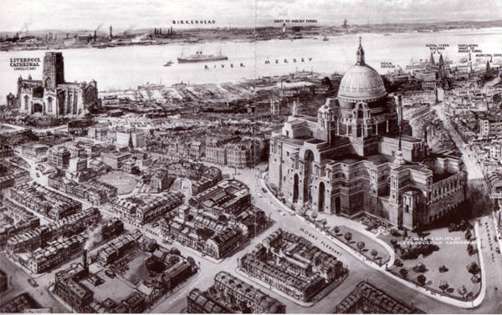
When the workhouse was closed in 1925 and demolished in 1931 this, then, was the obvious place to build a house of prayer, where wounds might be healed and old wrongs forgiven.

Slide 19
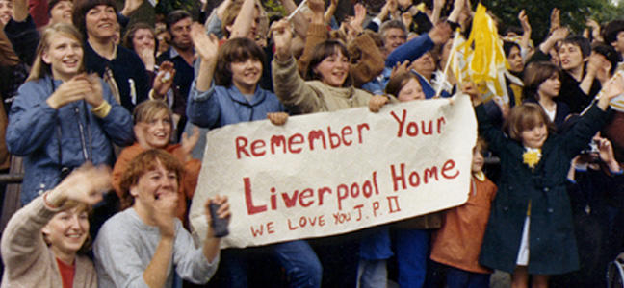
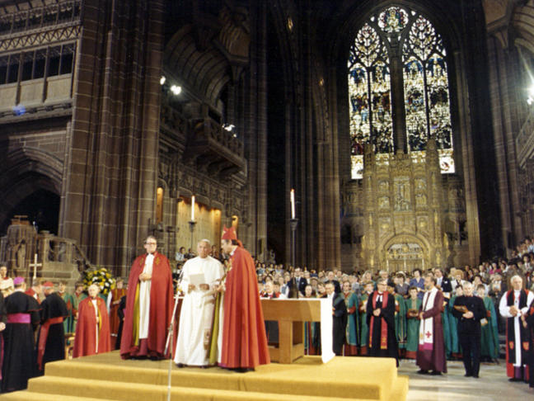
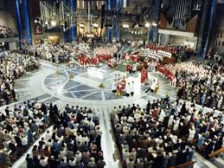
Pentecost 1982

Slide 20
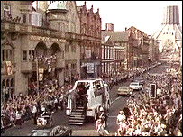
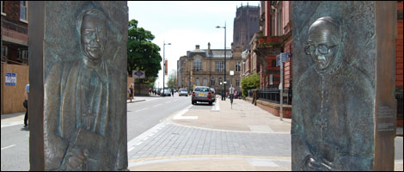
Archbishop Derek Worlock and Bishop David Sheppard are jointly commemorated in Hope Street in Stephen Broadbent’s open door statue.

Slide 21
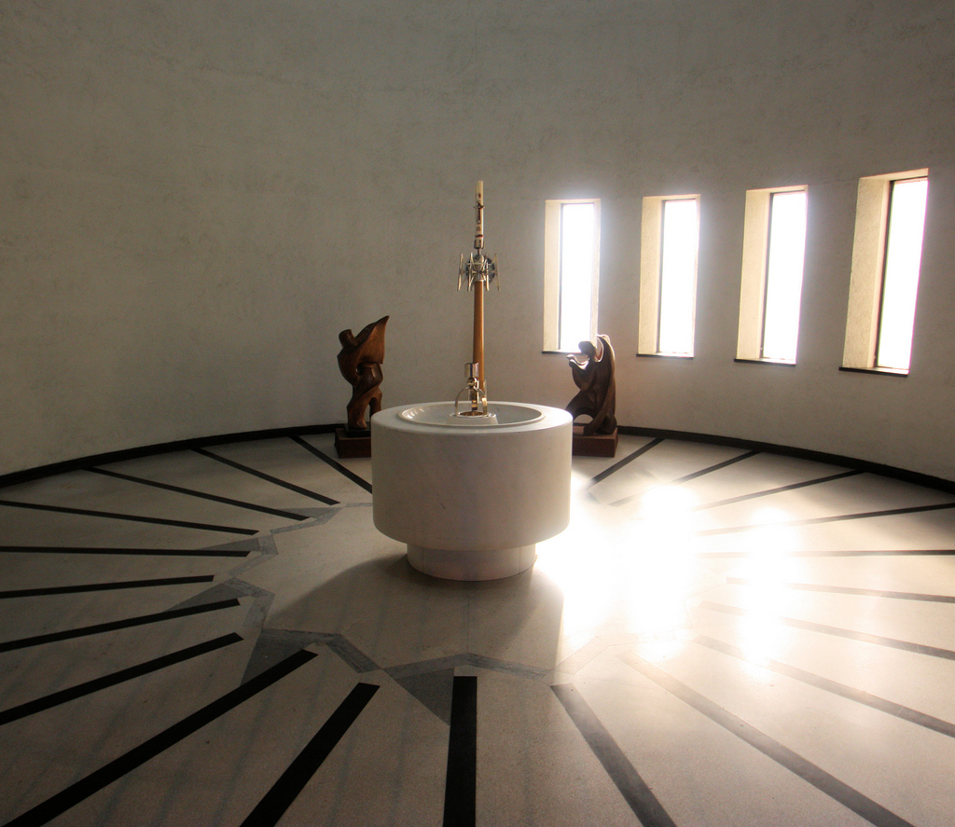
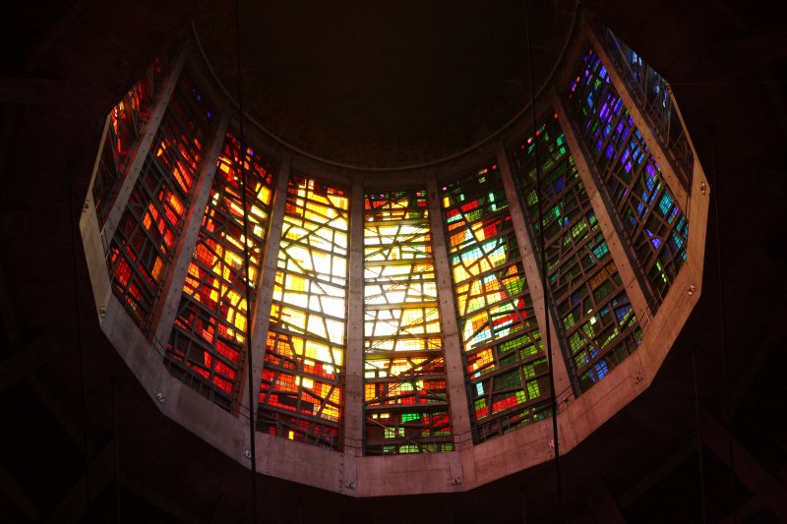
Two of my children were christened in the baptistery

Slide 22
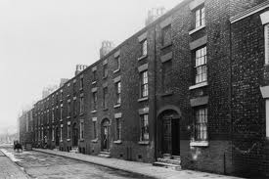
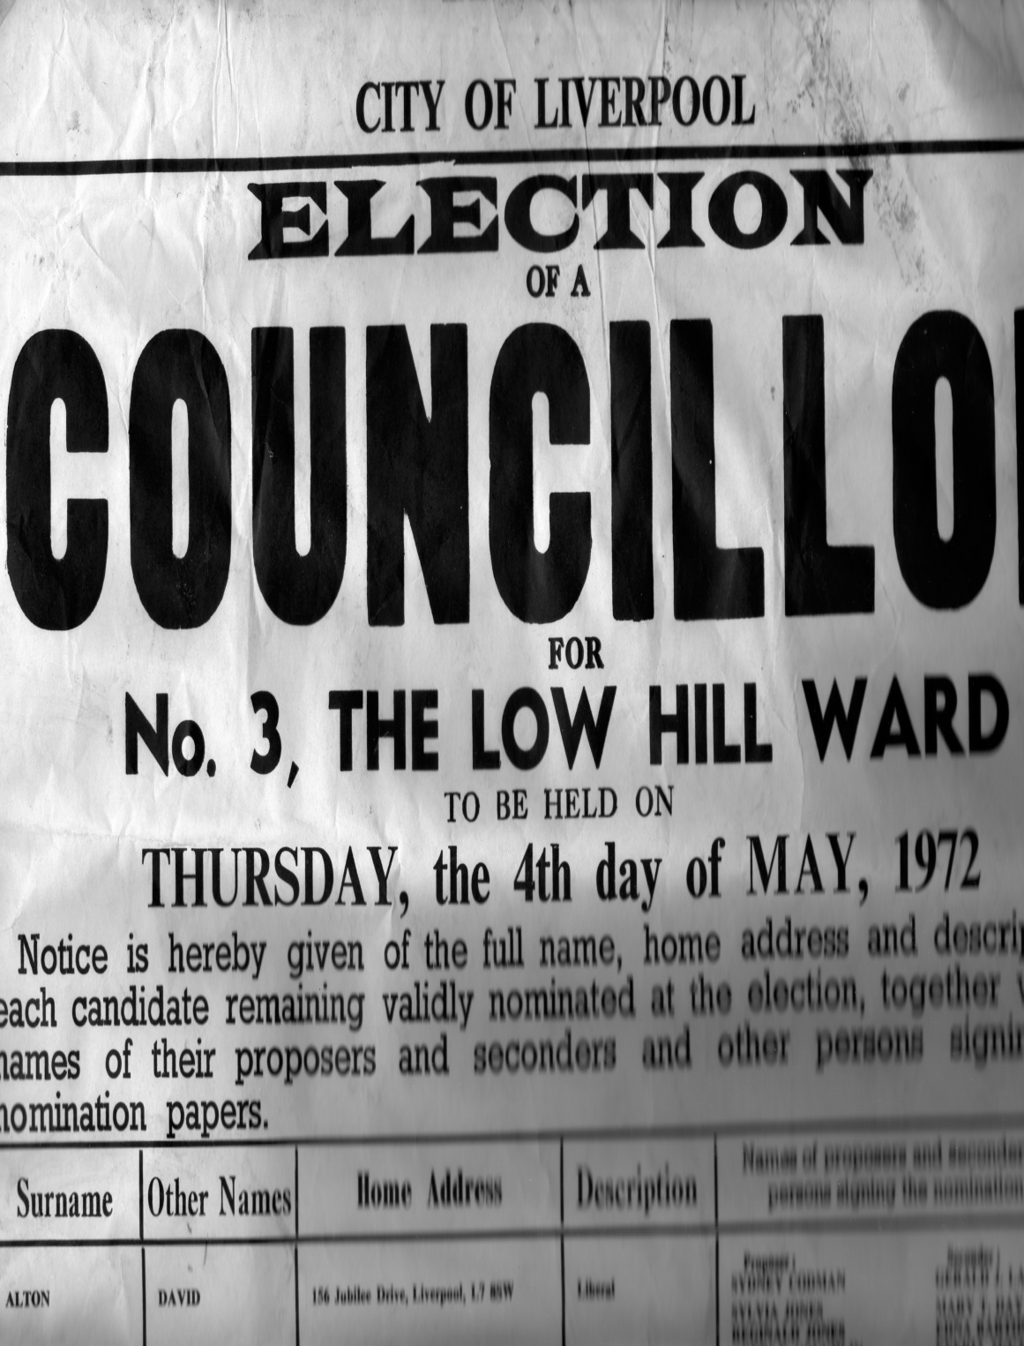
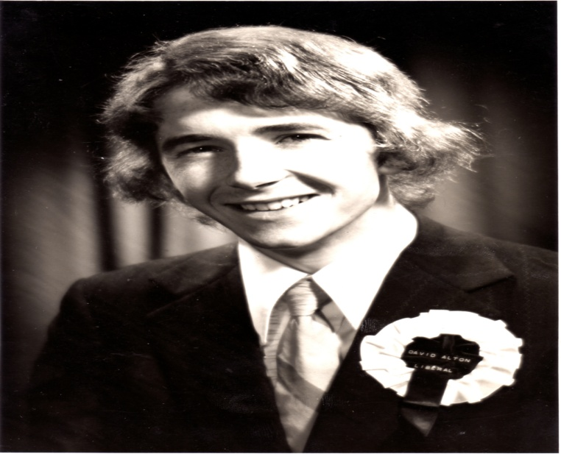

Slide 23
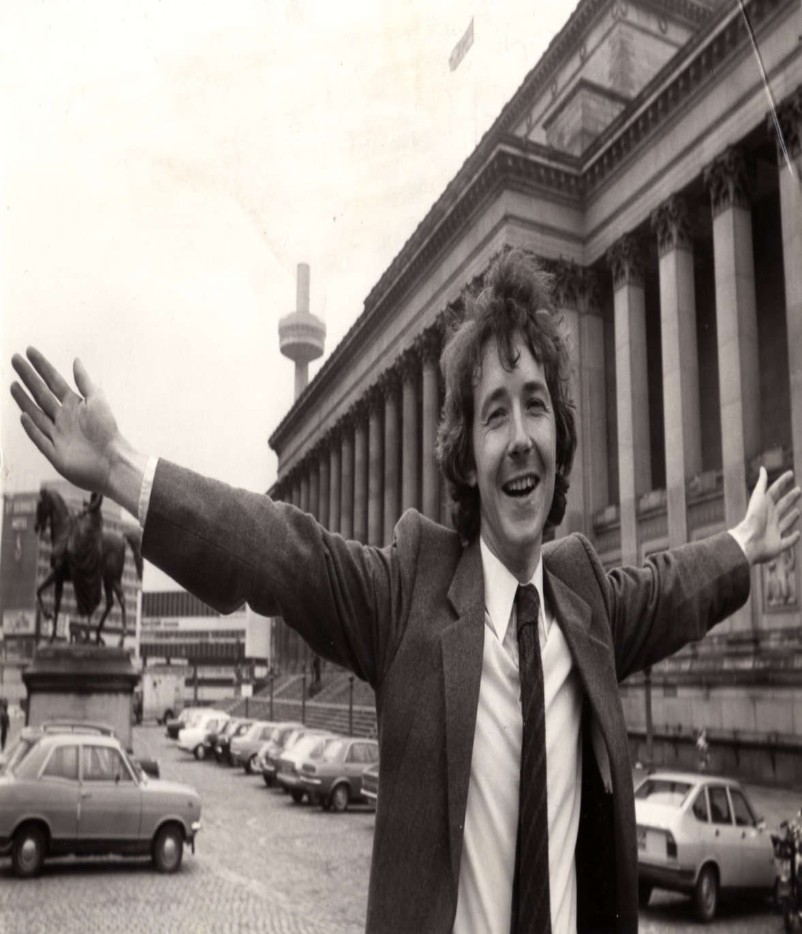
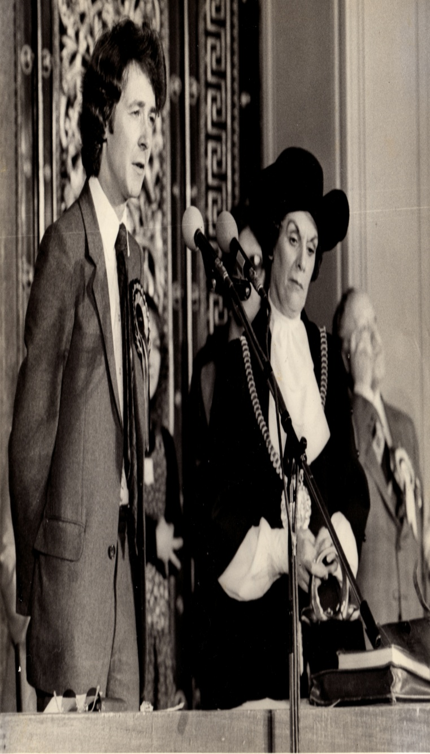
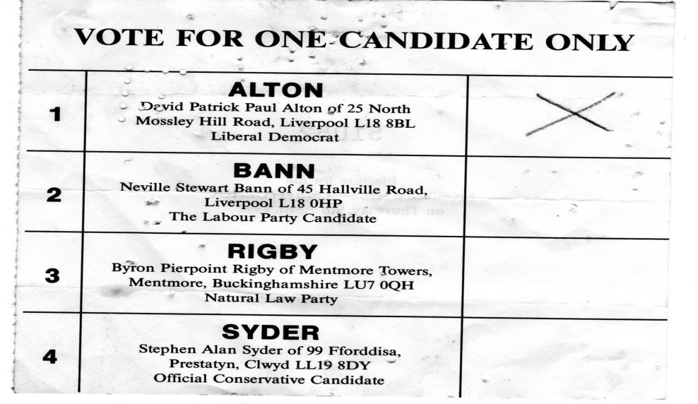

Slide 24
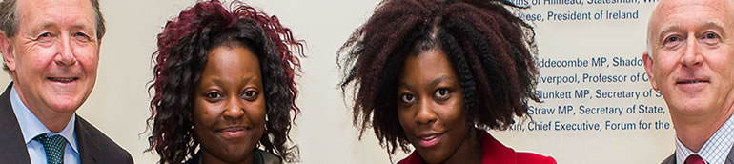
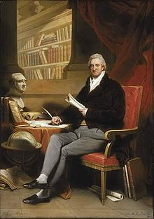
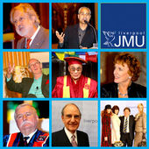
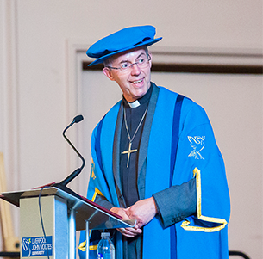

Slide 25

Isaiah tells us that we must always remember the rock from which we were hewn.

Slide 26




Slide 27
The Guardian
“The idea that people have some rights just because they are human, and entirely irrespective of merit, certainly isn’t derived from observation of the world. It arose out of Christianity, no matter how much Christians have in practice resisted it. Although human rights have become embedded in our institutions at the same time as religious observance has been in decline, they could become vulnerable in an entirely post-Christian environment where the collective memory slips from the old moorings inherited from Christian ethics.”

Slide 28


You can’t remove the foundations from under a house and expect it to stay standing

Slide 29

All over the world Christianity is under attack from a pincer movement of aggressive secularisation, on one hand, and religious movements that have embraced violence, on the other.

Slide 30

If we truly love our country should we not be equally distressed to see a nation forgetting who it is and incapable of recognising what was once cherished and loved.

Slide 31




One of Liverpool’s oldest churches

Slide 32


“my right to choose” is the leitmotif against which we are told to live our lives

Slide 33

800,000 children have no contact with their fathers

Slide 34

Around 2,000 people are sleeping rough in England tonight

Slide 35

85,000 people languish in our jails

Slide 36

People in the UK owed a staggering £1.475 trillion at the end of April 2016.

Slide 37


We Define Ourselves By Our Possessions

Slide 38

An estimated 1 million elderly people who do not see a friend or neighbour during an average week

Slide 39

“If you’re demented, you’re wasting people’s lives—your family’s lives—and you’re wasting the resources of the NHS” – Baroness Warnock.

Slide 40

Dame Cicely Saunders Founder of the modern hospice movement

Slide 41

Five million images of child abuse are in circulation on the internet, featuring some 400,000 children; 600 of our unborn children are aborted every day – some up to birth

Slide 42

Last year 660 million antidepressants were issued at a cost of nearly £6 billion to the NHS; in one recent year Samaritans answered 4.6 million calls from people in despair - one call every seven seconds, suicide accounts for 20 per cent of all deaths among young people aged 15 to 24

Slide 43

How right was the learned rabbi, Hillel, when he said: "If I am not for myself, who will be for me? But if I am only for myself, who am I? “

Slide 44



In our materialistic, throw away culture, the devil arrives in carpet slippers

Slide 45


Slide 46


Two senior Scottish Catholic midwives lost their jobs having been told that they have no right of conscience in refusing to oversee mid and late term abortions, many on the grounds of disability.

Slide 47

There is little serious study of theology in most universities while many media outlets do their best to air brush out beliefs that have not withstood the scrutiny of the Islington wine bar.

Slide 48


Mary and the magic baby or the festival of Wintermas

Slide 49

Jonathan Sacks
“This is not yet, but it comes close to, self-hatred … It represents the breakdown of an identity, and nothing good can come of it”.
He warns how it happens:
“”””then it became valuing all cultures equally, a completely different proposition. Then it became valuing all cultures except your own. That is when it becomes pathological. You cannot value all cultures except your own … one who does not respect himself cannot confer respect on others”.

Slide 50



Thomas Merton and the Seven Storey Mountain

Slide 51



Bede, Cuthbert, and Aidan

Slide 52



“Seven times a day I praise you.”

Slide 53


British Christians kept learning alive – creating hospitals, universities, hospices and a nationwide network of parishes that honoured God and welded the nation together

Slide 54







The Quakers, William Wilberforce, Thomas Clarkson, Granville Sharpe, Olaudah Equiano, Josiah Wedgewood, John Newton, and the Liverpool MP William Roscoe.

Slide 55

“As to its politics, this country has much less, I think, to fear than to hope;
unless through a corruption of its religion -
against which, as Conservative or Liberal, I can perhaps say I have striven all my life long.”

Slide 56

“We look forward to the time when the power of love will replace the love of power, and then will our world know the blessings of peace.” - W.E.Gladstone,
Prime Minister Four Times,
Son of Liverpool – his statue stands in St.John’s Gardens behind St.George’s Hall

Slide 57



All our mainstream political; traditions are rooted in Christianity –
Keir Hardie,
Arthur Henderson, George Lansbury.
“We are a Christian country” – David Cameron.

Slide 58
The Westminster Declaration of the MCD
Six principles:
Social Justice Empowerment, Active compassion, Good stewardship, Reconciliation Respect for life

Slide 59

Whatever characteristics we have they are a reflection of God’s own image. God made us uniquely different from one another and it is this beauty of difference that we must honour and cherish.

Slide 60


It is into this enfeebled and weakened environment that religious radicalism has entered.
Eritrean and Egyptian Christians Executed by ISIS
“in the moment of their barbaric execution”, some of the 21 Christians were repeating the words “Lord, Jesus Christ,” – February 2015

Slide 61


Ed Hussain, author of The Islamist

Slide 62
Ed Hussain said he wrote his book to throw light on:
“the appeal of extremist thought, how fanatics penetrate Muslim communities and the truth behind
their agenda of subverting the West and moderate Islam.”
He said:
“Five years later, after much emotional turmoil, I rejected fundamentalist teachings and returned to normal life and my family.”
Reflecting on why he feels comfortable in Britain, he said:
“I am proud Britain never became a godless, communist land. We fought two world wars to protect the history, culture and people, not to see what makes it British eroded because of spineless politicians too scared to say "Christmas" in public.
“Millions of Muslims and others feel welcome here because of our similar beliefs in Jesus, God, and the afterlife. Even if people do not share those religious beliefs, they can still be part of the Christmas spirit.

Slide 63

Asad Shah, who was murdered at Easter outside his shop in Glasgow

Slide 64


Pakistan’s green and white flag was designed to represent the green of Islam and the white of the minorities

Slide 65

“You may belong to any religion, caste or creed—that has nothing to do with the business of the State…Minorities, to whichever community they may belong, will be safeguarded. Their religion, faith or belief will be secure. There will be no interference of any kind with their freedom of worship. They will have their protection with regard to their religion, faith, their life and their culture. They will be, in all respects, the citizens of Pakistan without any distinction of caste and creed
- Muhammad Ali Jinnah

Slide 66


Clement Shahbaz Bhatti murdered 2011 in cold blood and in in broad daylight in Pakistan’s capital, and still no one has been brought to justice.

Slide 67


Pakistan’s murdered Minister for Minorities: Shabaz Bhatti
Bhatti said “I want to share that I believe in Jesus Christ, who has given his own life for us. I know what is the meaning of the cross, and I am following the cross, and I am ready to die for a cause.”

Slide 68


Bhatti’s last breaths were uttered in defence of Asia Bibi, the illiterate Christian mother of five, jailed in 1999, for alleged blasphemy against Islam, and sentenced to death.

Slide 69


2016 Report launched in Parliament which catalogues the systematic campaign targeting Pakistan’s religious minorities
https://davidalton.net/2016/03/28/carnage-in-lahore-pakistan-and-uk-governments-failure-to-challenge-persecution-or-the-culture-of-impunity-links-to-previous-posts-about-pakistans-christians-shahbaz-bhatti-asia-bibbi-and-the/

Slide 70

Pakistani Christians kept like caged animals

Slide 71



Taking evidence from persecuted Pakistani Christians who have escaped

Slide 72

More than £1 billion of British aid, given over the past two years to Pakistan: “it’s not persecution” – British Government

Slide 73




Easter in Lahore: More than 70 dead

Slide 74



The Armenian genocide claimed between 800,000 and 1.5 million Armenian, Greek Orthodox and Assyrian Christians lost their lives.

Slide 75



In Iraq and Syria, the Christian and Yazidi populations have been devastated.

Slide 76



Times Report

Slide 77


Orlando June 2016

Slide 78


Aleppo: the killing continues

Slide 79
Genocide Bill

Slide 80



We have won votes in the House of Commons, the American congress, the European Parliament and the Australian House of Representatives but still our government lamentably fail to name these events for what they are

Slide 81

Where are the protests?
Nina Shea, an International Human Rights Lawyer, says:- “Our churches, at the local level, which have been largely silent up till now, must now actively engage for this campaign to succeed. Where are the widespread demonstrations? Where are letters by their thousands to political leaders to do more? Where are the spontaneous grassroots campaigns? I don't see them…If just 1% of Christians were outraged and mobilized we would see political action across the board."

Slide 82



With Daw Aung San Suu Kyi in Burma and giving evidence about the persecution of ethnic minorities including Muslim Rohingya

Slide 83


Saeed Abedini and Bishop Cosmas Shi Enxiang

Slide 84



Forgive but remember.

Slide 85





Never forget that the four great murderers of the 20th century—Mao, Stalin, Hitler and Pol Pot—were united by their hatred of religious faith.

Slide 86



The bloodiest century in human history with the loss of 100 million lives.

Slide 87



Slide 88


Jeon Young-Ok’s Evidence
Jeon Young-Ok: “They tortured the Christians the most.
They were denied food and sleep.
They were forced to stick out their tongues
and iron was pushed into it."
"Sometimes we had soup with nothing in it, just full of dirt. In some places whole families were put into camps. They separated the men from the women and even if they saw each other they couldn't talk to each other. The guards told us that we are not human beings, we are just prisoners, so we don't have any right to love. We were just animals. Even if people died there, they didn't let the family members outside know. " Hea Woo

Slide 89


A Pew Research Centre study begun a decade ago found that of the 185 nations studied, religious repression was recorded in 151 of them.

Slide 90

The BBC’s Chief Correspondent, Lyse Doucet, is right when she says: "If you don't understand religion - including the abuse of religion - it's becoming ever harder to understand our world."

Slide 91


The 1948 Declaration on Human Rights was born in the in the criminality of twentieth century totalitarianism and the gas chambers of Bergen-Belsen and Auschwitz.

Slide 92


One outcome was the promulgation, in 1948, of the 30 Articles of the Universal Declaration of Human Rights.

Slide 93

All over the world, from North Korea to Syria, the dishonouring of Article 18 is evident in new concentration camps, abductions, rape, imprisonment, persecution, public flogging, mass murder, beheadings and the mass displacement of millions of people
Freedom of Religion or Belief in Pakistan & UK Government Policy

Slide 94


Every person uniquely reflects the Divine Likeness, and for that reason alone we are required to uphold the dignity of each.

Slide 95

Britain is, for all its faults, a society in which adulterers are not flogged, gays are not executed, women are not stoned for not being veiled, churches are not burned, so-called apostates had not, until recently, been killed, and non-believers are not forced to convert or treated as 'dhimmis' or second-class citizens.

Slide 96


In the battle of beliefs – which for so many are a matter of life and death - we know that learning to live together in respect and tolerance - whether we have a religious faith or not – is truly the challenge of our times: www.davidalton.net

Slide 97
A Battle of Beliefs - a matter of life and death
A Premier Lecture: Liverpool, June 2016.
David Alton www.davidalton.net

